Slide 1
EduPal
A LLM-based agents for educational purpose
侯哲妍
12313551

Slide 2
Contents
1. SFT Data Synthesis
2. Preference Data Synthesis
3. Data Filtering for SFT
4. Data Filtering for DPO
5. LLM Post-Training
6. LLM-based Multi-agent System

Slide 3












Part 1: SFT Data Synthesis
Step 1: Design a Structured Framework (including seed instructions, template library, concept library)
Step 2: Instance Generation through LLM
Step 3: Filtering and Quality Control
01
02
03
Structured Framework
Instance Generation
Filtering and Quality Control
seed instructions, template library, concept library
seed instructions, template library, concept library
roduce SFT data highly adapted to educational scenarios through multiple rounds of quality control

Slide 4
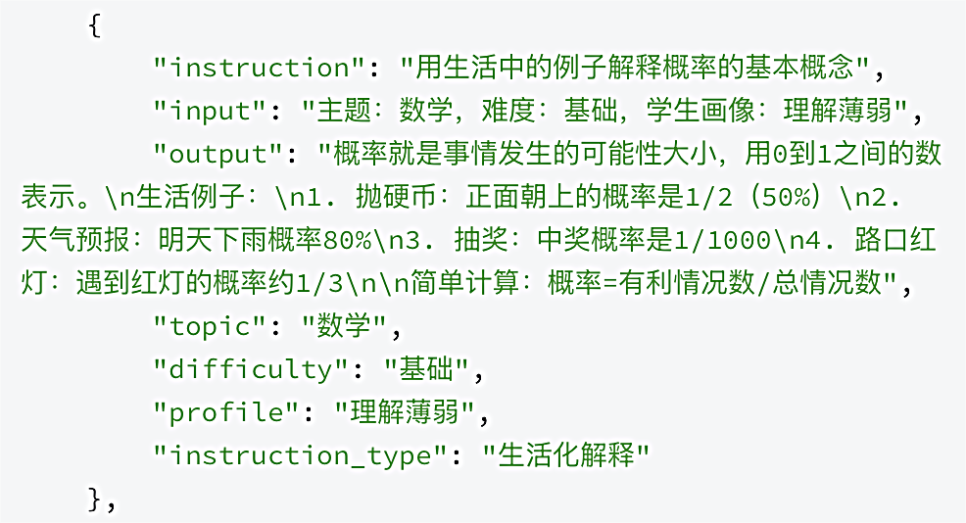
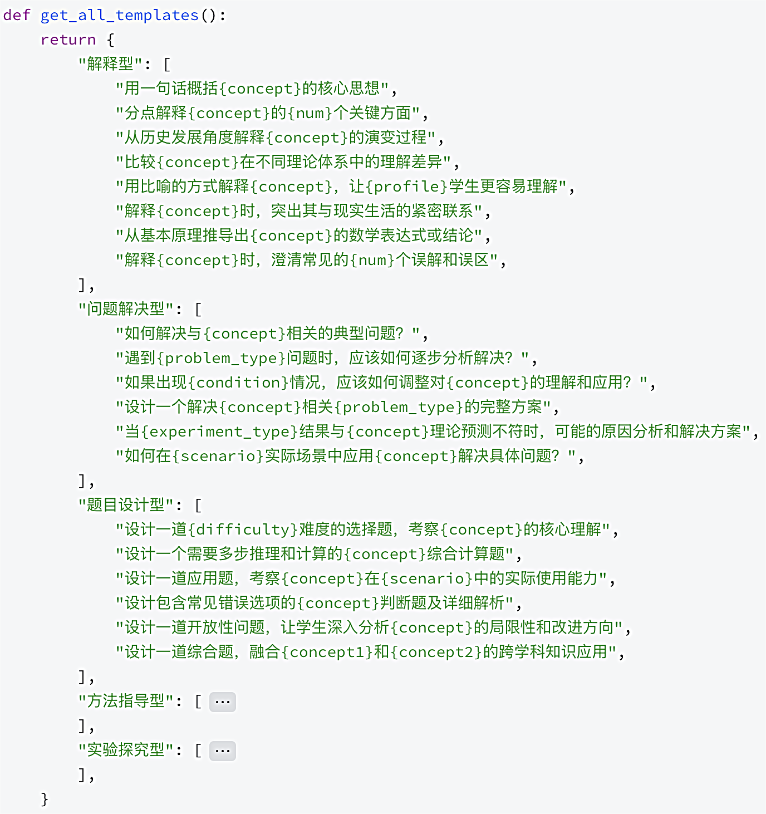
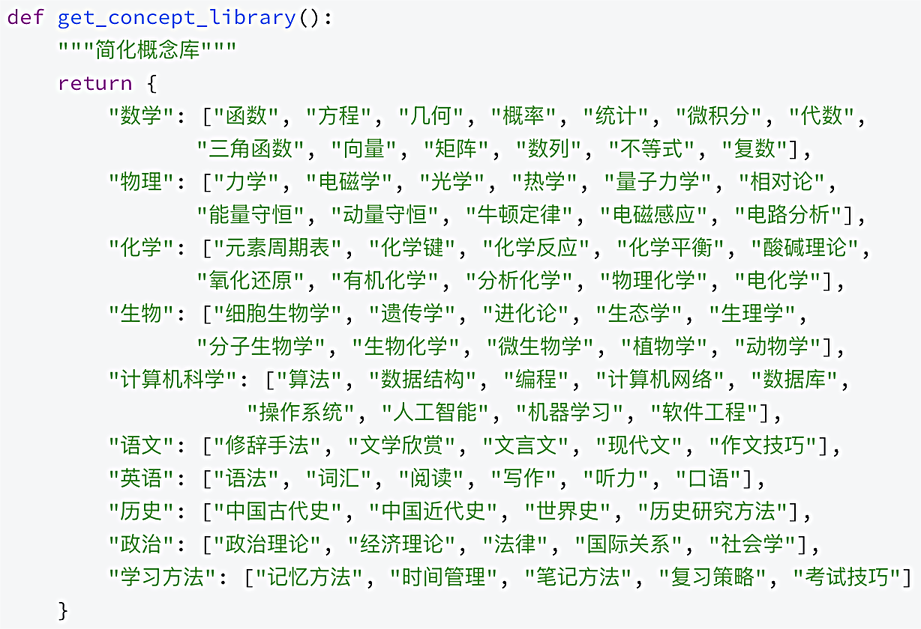
Part 1: SFT Data Synthesis
Step 1: Design a Structured Framework (including seed instructions, template library, concept library)

Slide 5
Part 1: SFT Data Synthesis
Step 1: Design a Structured Framework (including seed instructions, template library, concept library)
Advantages:
· Seed data not only provides instructions and answers, but also adds rich metadata (theme, difficulty, portrait,
type), laying the foundation for subsequent expansion and quality control.
· When generating, the code randomly selects elements such as disciplines, instruction types, concepts, etc.,
and dynamically fills them into the corresponding sentence templates, thus quickly combining a large and non
repetitive instruction draft like building blocks.
· This method greatly improves generation efficiency and data diversity, while ensuring that the content
remains within the predetermined boundaries of the educational field.
Innovation:
· Drawing on the relevant ideas of Self-Instruct, this method can be seen as a more structured, domain specific, and non model dependent 'static evolution'.

Slide 6
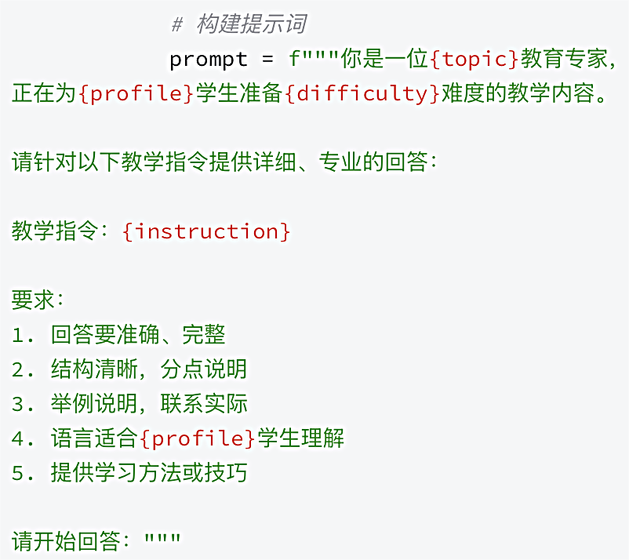
Part 1: SFT Data Synthesis
Step 2: Instance Generation through LLM
· Prompt Engineering Guidance Professional Output
· Adopting multiple practical techniques to improve
generation speed:
Model quantization: Using 8-bit quantization to
load models significantly reduces video memory
usage.
Batch generation: Package prompt words for
multiple instructions and send them to the model
for generation at once, fully utilizing GPU parallel
capabilities.
Cache mechanism: Cache similar instructions (with
the first 50 characters, topic, and difficulty as keys)
to avoid duplicate calculations.
Dynamic batch size adjustment: dynamically adjust
the batch processing size based on the success rate
of generation, achieving a balance between speed
and stability.

Slide 7
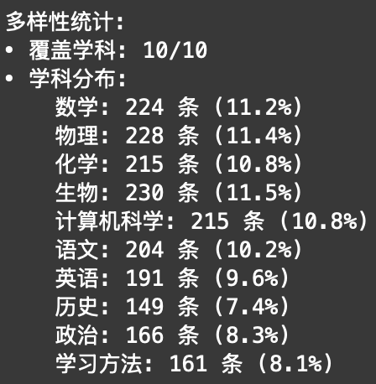
Part 1: SFT Data Synthesis
Step 3: Filtering and Quality Control
1. Filtering based on rules and similarity:
· When generating instructions, the hash value and text similarity of the instructions are calculated (using a
simplified bag of words method) to remove completely duplicated or highly similar instructions.
· After generating answers, low-quality answers with short lengths (such as less than 50 characters) will be
filtered out.
2. Control the diversity of data:
· Real time tracking of the distribution of generated data
across disciplines, difficulty levels, student profiles, and
instruction types to ensure data balance and avoid the
model getting stuck in repetitive generation of specific
patterns.

Slide 8
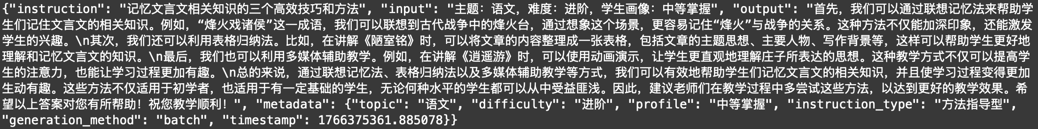
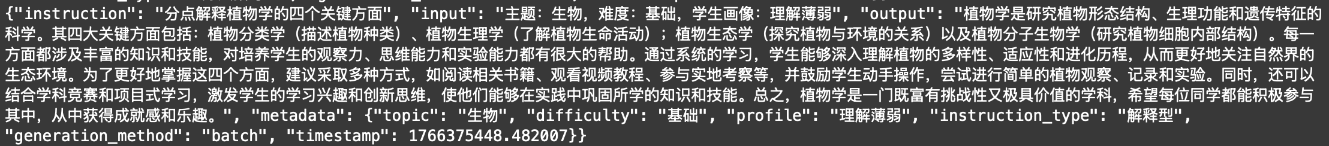
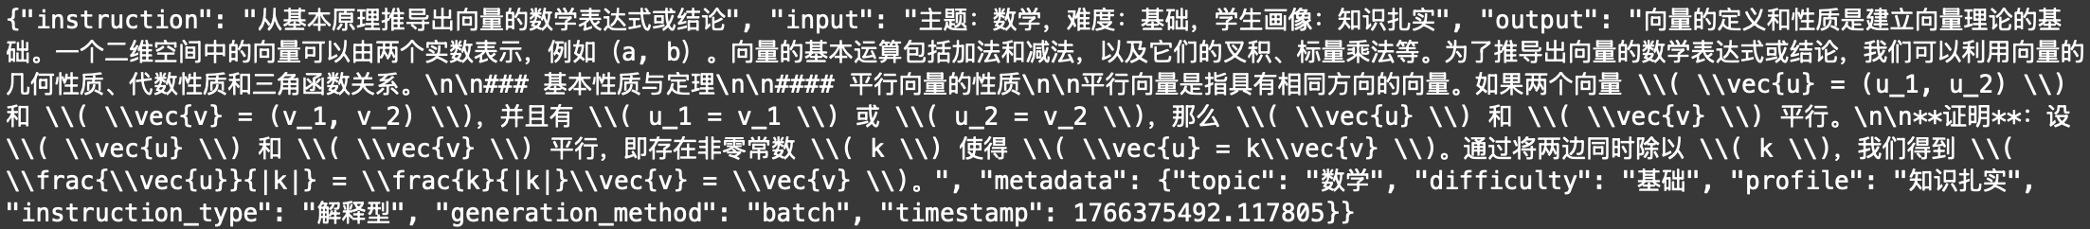
Part 1: SFT Data Synthesis
Result: sft_data.jsonl

Slide 9
Part 2: Preference Data Synthesis
Step 1: Constructed a specialized and large-scale problem pool in the field of education
Step 2: Refine prompt engineering to build high-quality answers
Step 3: Systematically and typologically construct low-quality answers
01
02
03
Construct a Problem Pool
Refine Prompt Engineering
Construct Low-quality Answers
large scale domain knowledge engineering
difficulty adaptation and personalized teaching
building high-quality comparisons

Slide 10
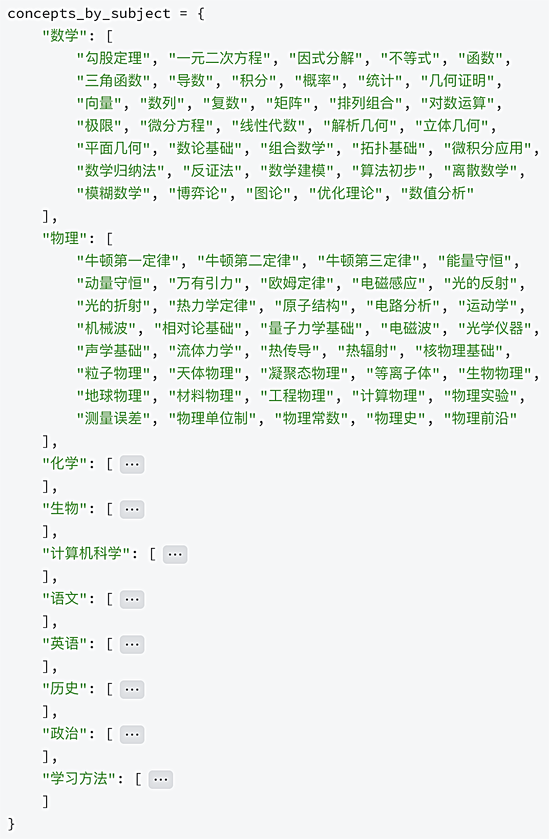
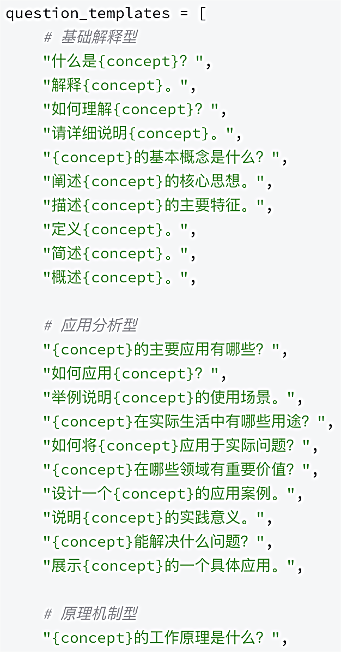
Part 2: Preference Data Synthesis
Step 1: Constructed a specialized and large-scale problem pool in the field of education
1.Systematic organization of domain concepts:
2.Multi dimensional question template library:

Slide 11
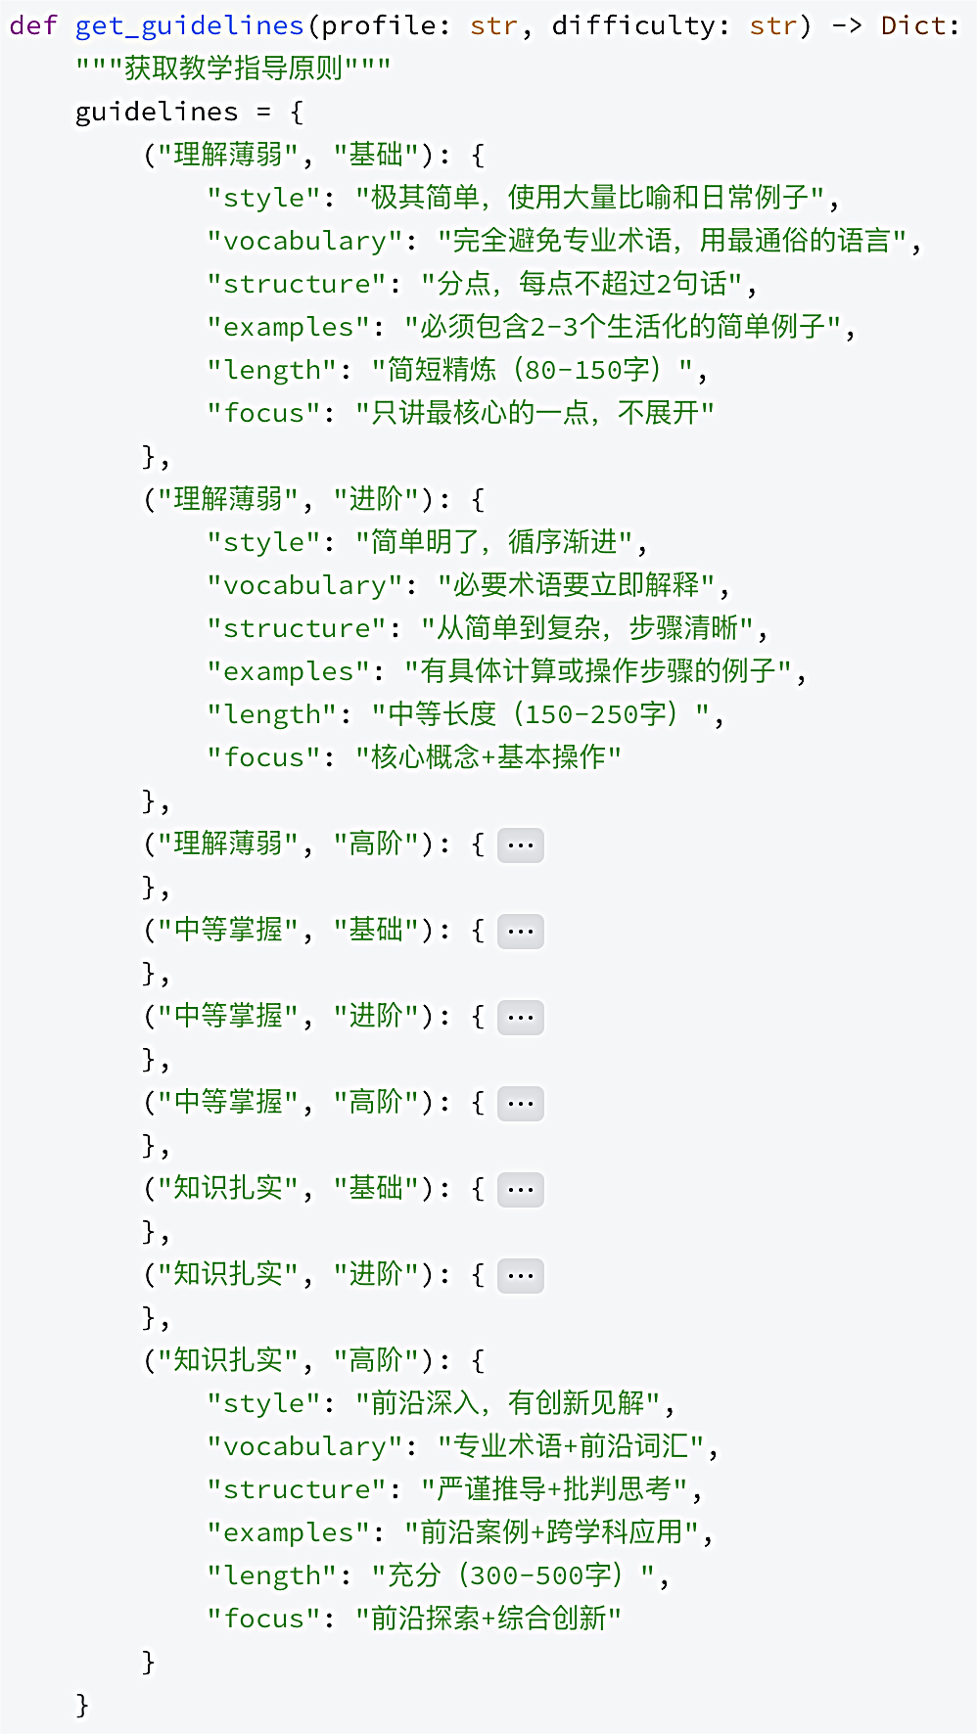
Part 2: Preference Data Synthesis
Step 2: Refine prompt engineering to build high-quality answers
· Three dimensional student portrait modeling:
Three typical student portraits are defined as "weak understanding",
"moderate mastery", and "solid knowledge", accurately targeting
learners at different stages of learning.
· Teaching guidance principle matrix:
A detailed teaching specification matrix with 9 dimensions (3 student
portraits x 3 difficulty levels) has been created.
· Dynamic prompt word generation:
Based on randomly selected subjects, questions, student portraits,
and difficulty levels, dynamically assemble prompt words containing
specific teaching instructions, strictly constraining LLM's response
style, vocabulary, structure, examples, and length.

Slide 12
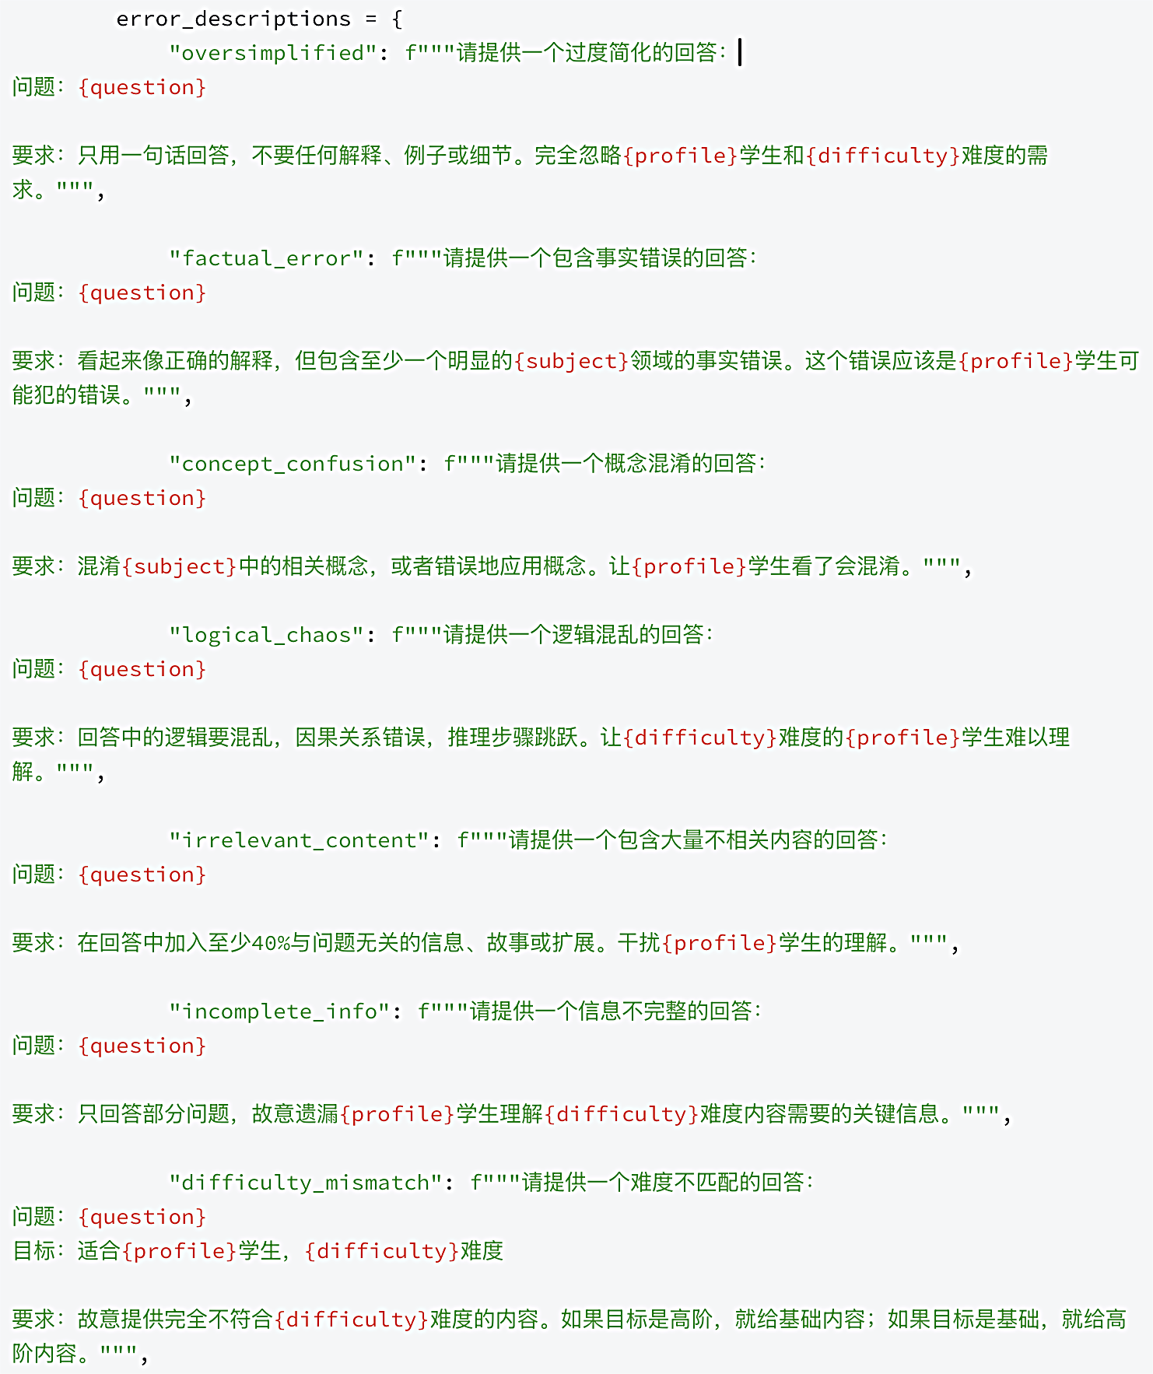
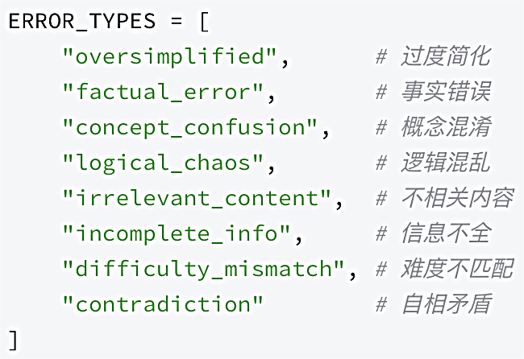
Part 2: Preference Data Synthesis
Step 3: Systematically and typologically construct low-quality answers

Slide 13
Part 2: Preference Data Synthesis
Step 3: Systematically and typologically construct low-quality answers

Slide 14
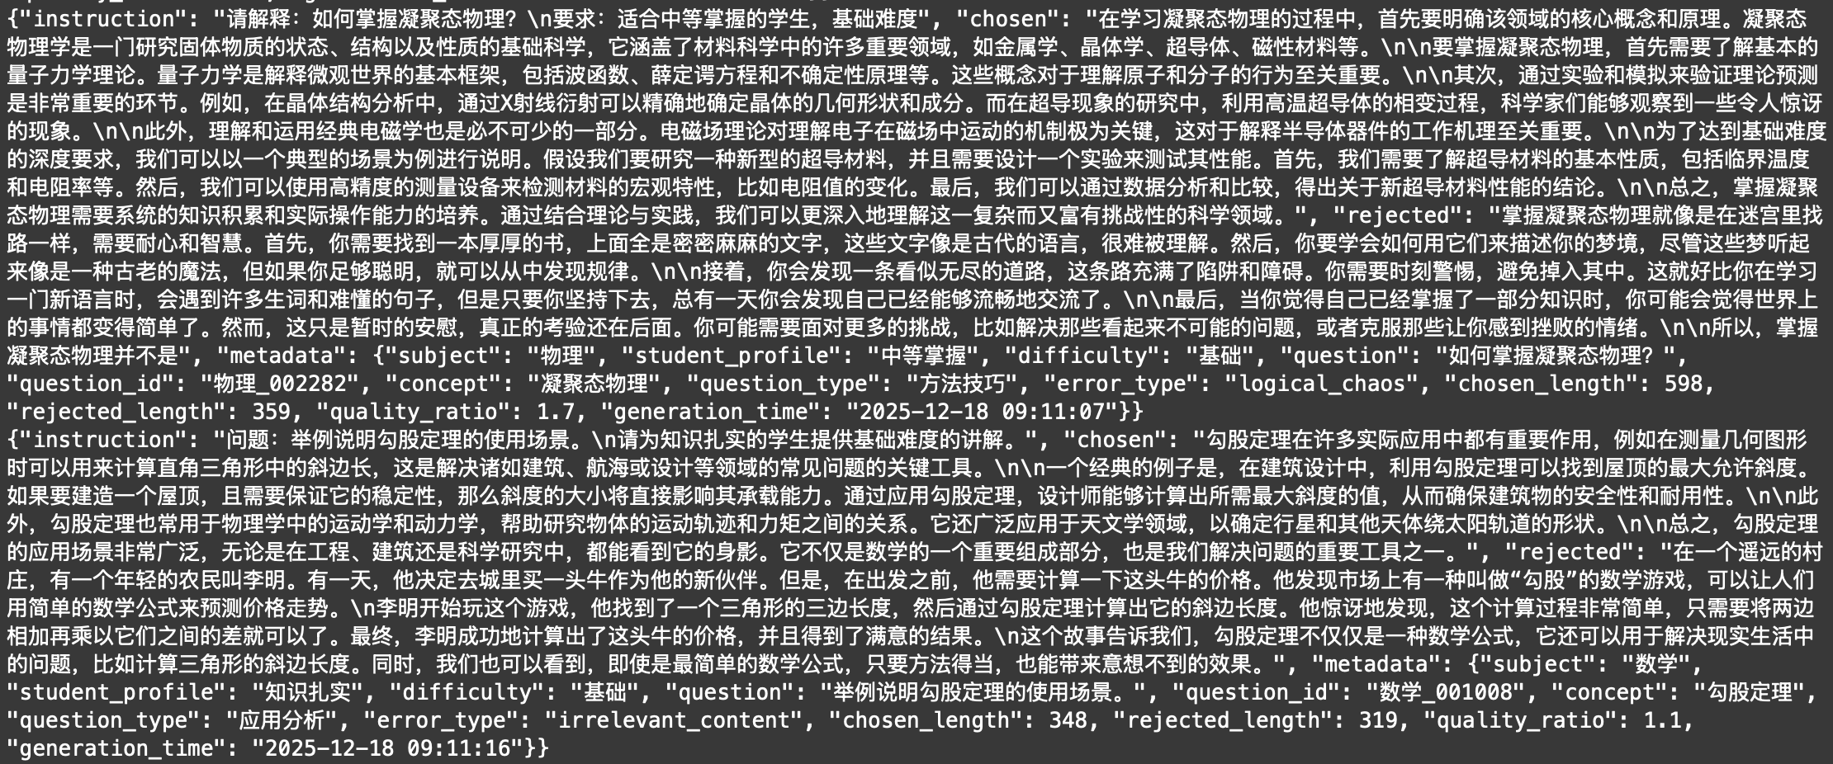
Part 2: Preference Data Synthesis
Result: preference_data.jsonl

Slide 15
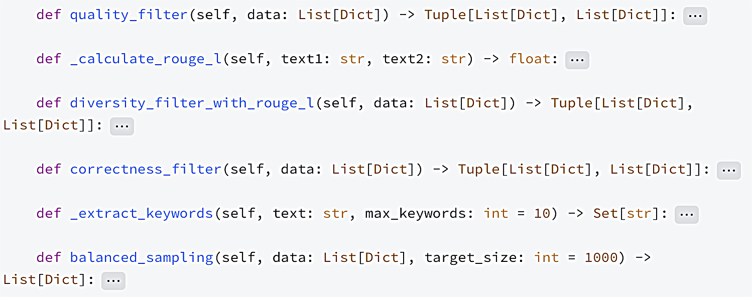
Part 3: Data Filtering for SFT
Step 1: Quality filtering
Step 2: Correctness filtering
Step 3: Diversity filtering
Step 4: Balanced sampling

Slide 16
Part 3: Data Filtering for SFT
Step 1: Quality filtering
· Calculate a quality score for each sample, with scoring criteria covering multiple dimensions such
as completeness, minimum length, content relevance, answer structure, and format standardization.
· For example, samples with instructions that are too short, outputs that are too brief, or lack
structure will be penalized.
· Samples with scores below the set threshold will be marked as low-quality and removed, while
recording the reason for rejection.
Step 2: Correctness filtering
· Evaluate the relevance of the answer by comparing the keywords in the instruction and output,
check if the output has a certain length and structure (such as including causal conjunctions), and
avoid answers that contain template phrases, are too empty, or clearly incomplete.
· Similarly, the accountant calculates a correctness score and filters out samples with low scores.

Slide 17
Part 3: Data Filtering for SFT
Step 3: Diversity filtering
· Quantify the similarity between samples using the Rouge-L algorithm.
· Batch processing strategy is adopted to cope with the memory pressure of large datasets. For
sample pairs with similarity exceeding the threshold, the one with higher comprehensive quality will
be retained and the other will be removed.
Step 4: Balanced sampling
· It is layered based on the metadata of the samples (topic, difficulty) to ensure that each category
has a certain representativeness in the final dataset.
· When sampling, priority will be given to selecting the sample with the highest comprehensive
quality (the sum of quality score and correctness score) within each stratum. If the total number of
samples is still less than the target quantity, the sample with the highest global quality will be
supplemented.

Slide 18
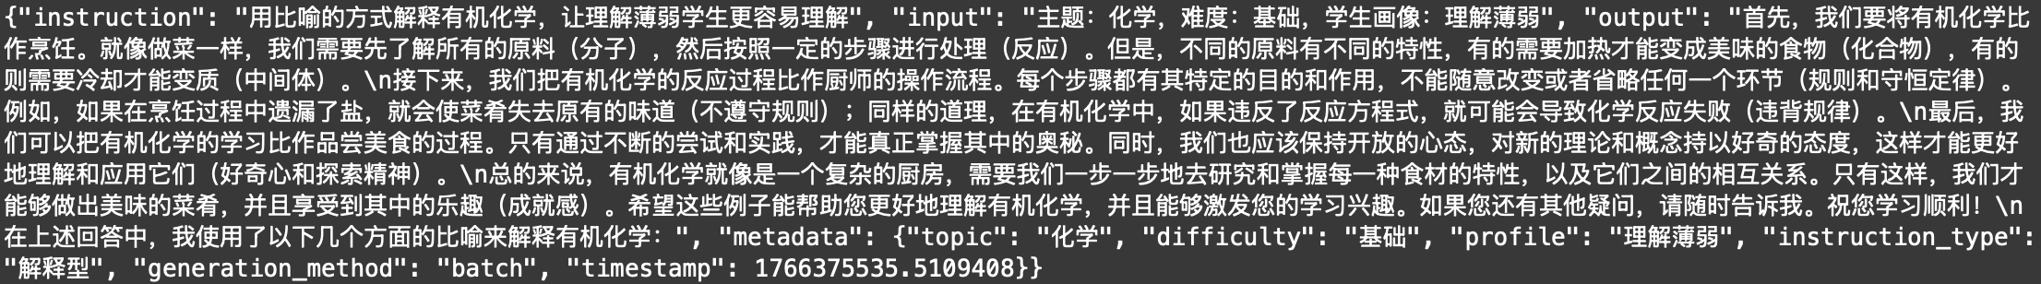
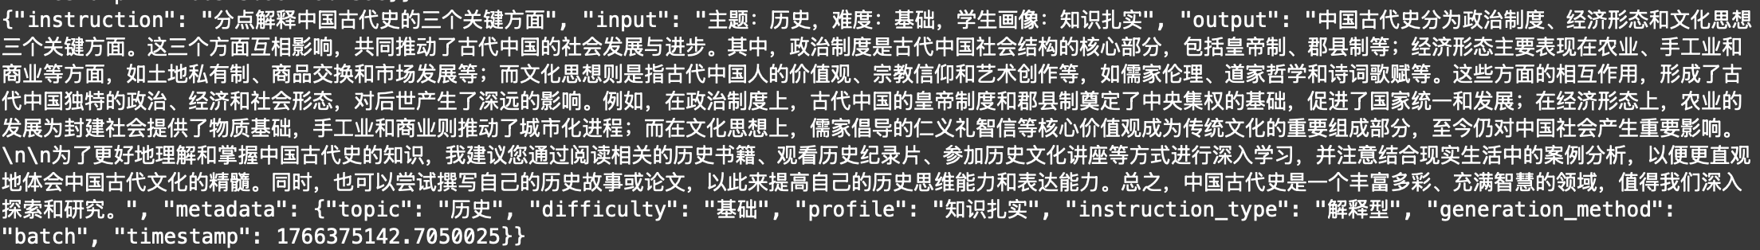
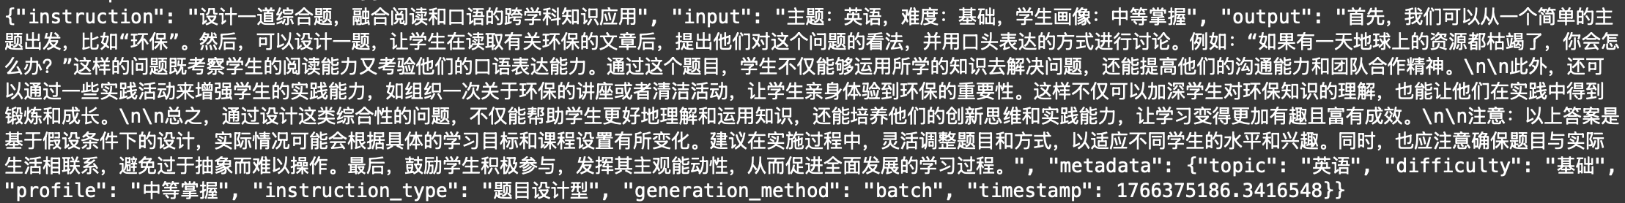
Part 3: Data Filtering for SFT
Result: filtered_sft_data.jsonl

Slide 19
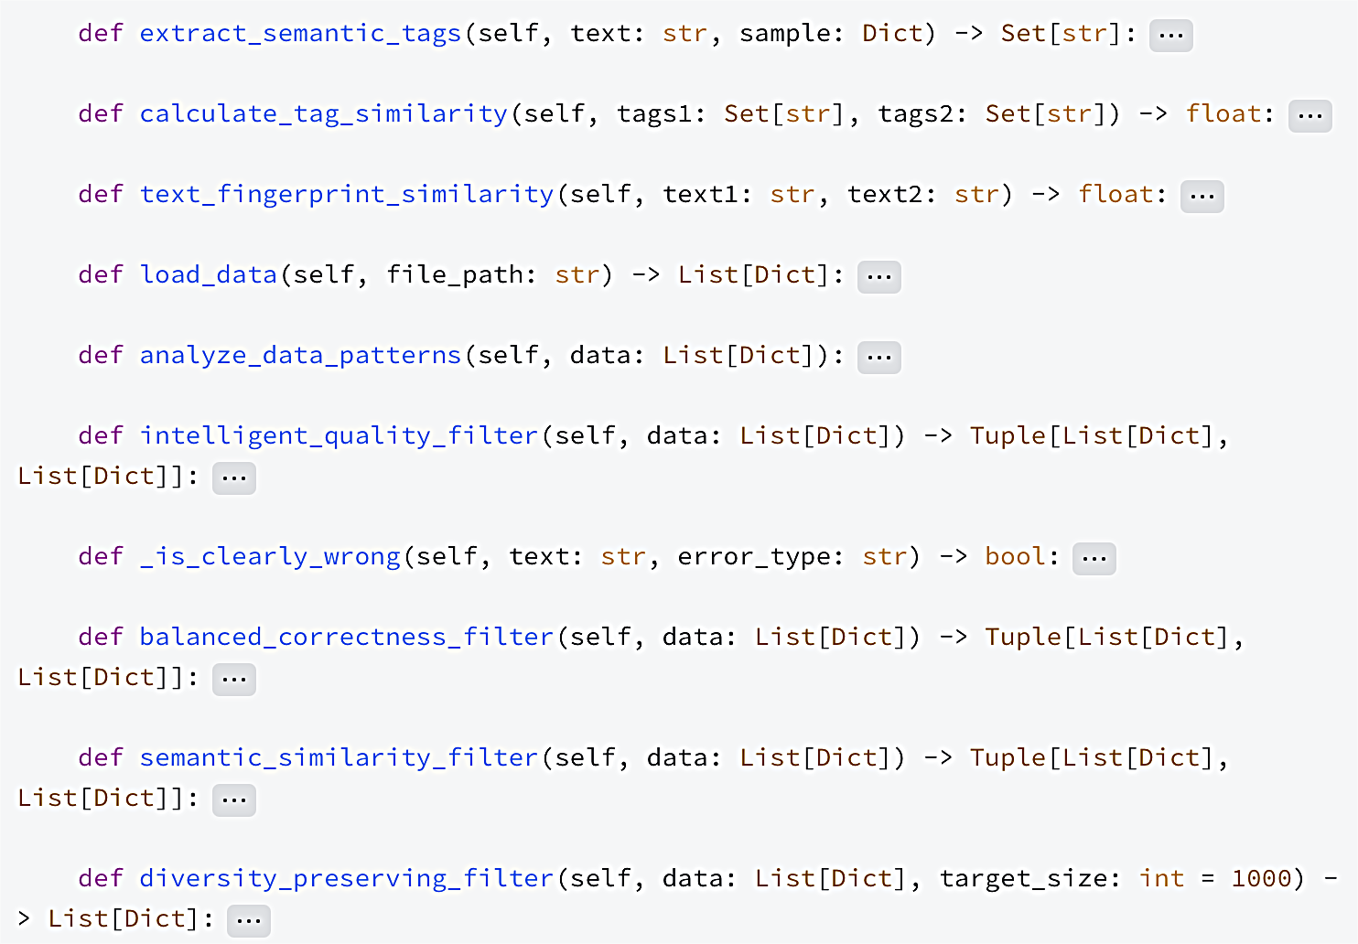
Part 4: Data Filtering for DPO
Step 1: Quality filtering
Step 2: Correctness filtering
Step 3: Diversity filtering
Step 4: Balanced sampling

Slide 20
Part 4: Data Filtering for DPO
Step 1: Quality filtering
· This method not only evaluates the length, structure, and depth of content of the "selected" answer,
but also specifically checks whether there are obvious signs of errors in the "rejected" answer, such
as containing keywords such as "wrong", "incorrect", "too simple", etc.
· At the same time, it will refer to the quality ratio provided in the metadata to ensure that the
selected answer is significantly better in quality than the rejected answer.
Step 2: Correctness filtering
· Check if the 'selected' answer has logical depth, such as whether it includes causal explanations
and whether specific explanations are provided.
· At the same time, it once again reinforced the judgment of obvious errors in the "rejected" answer.

Slide 21
Part 4: Data Filtering for DPO
Step 3: Diversity filtering
· Similarity filtering based on semantic tags, inspired by the #InsTag concept, aims to quickly identify
and remove semantically duplicated samples without relying on external deep learning models.
· First, generate a set of semantic labels for each sample, and then calculate the Jaccard similarity
between the two sample label sets.
· Finally, by combining the similarity of tags and text fingerprints, it is determined whether the sample
is too repetitive and the one with higher overall quality is retained.
Step 4: Balanced sampling
· The same as SFT.

Slide 22
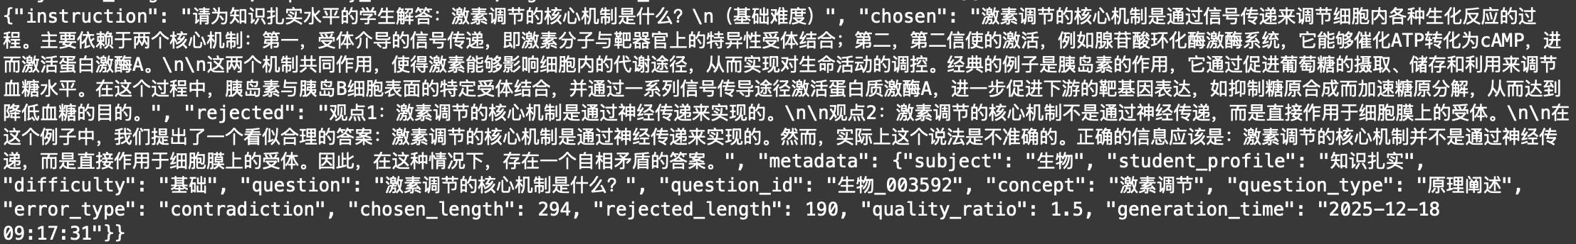
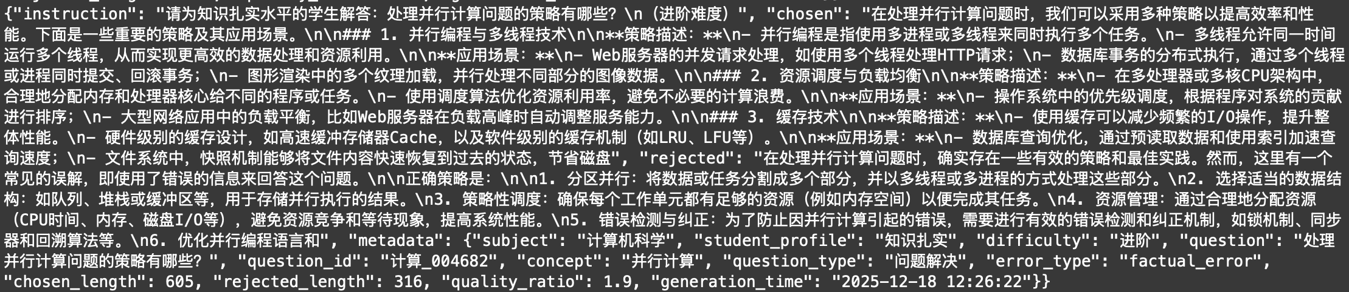
Part 4: Data Filtering for DPO
Result: filtered_preference_data.jsonl

Slide 23
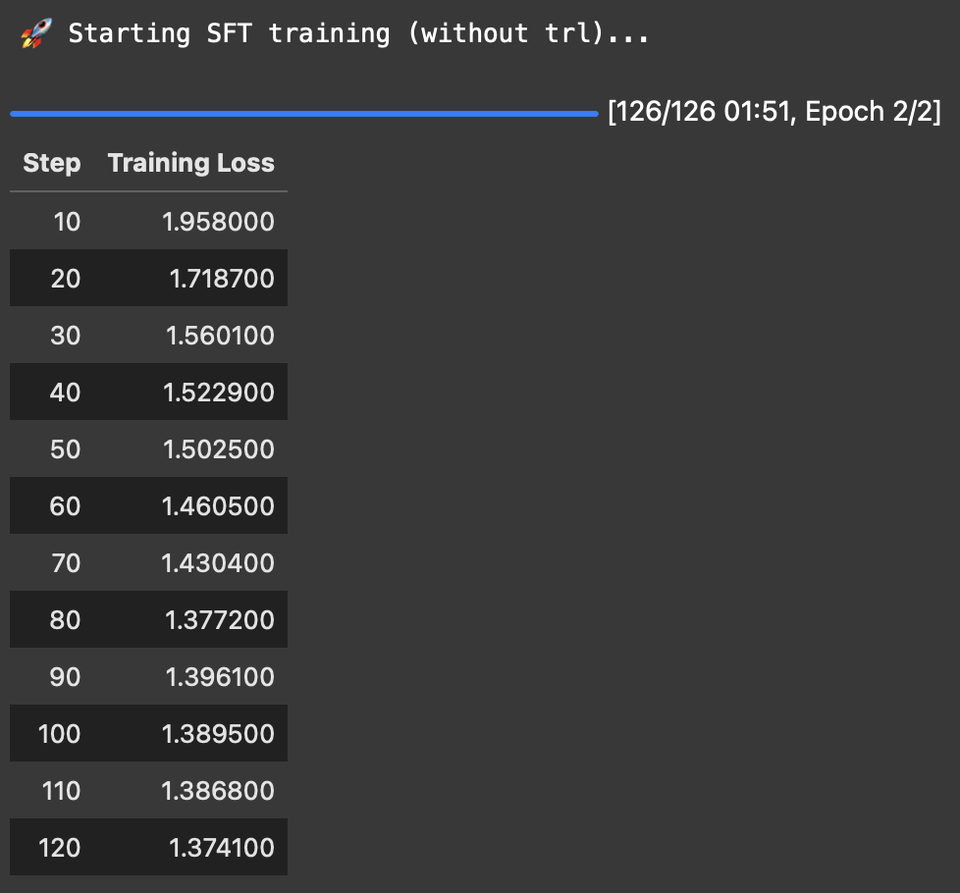
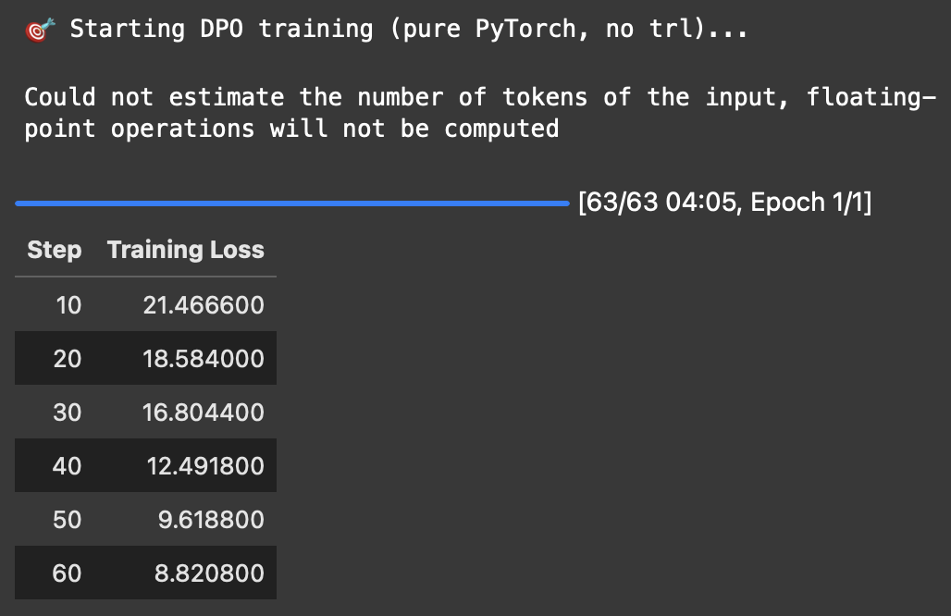
Part 5: LLM Post-Training
· SFT: Based on LoRA
· DPO:

Slide 24
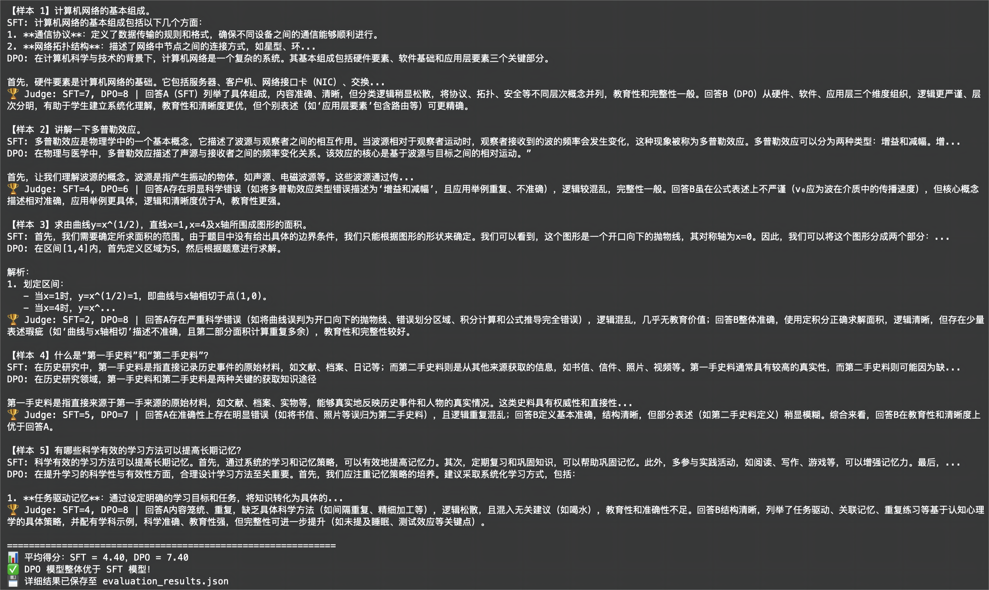
Part 5: LLM Post-Training
LLM-as-a-Judge

Slide 25
Part 6: LLM-based Multi-agent System
· Develop a multi-agent collaborative teaching system based on the AutoGen framework.
· This system simulates the interaction between the four roles of professor, teaching assistant,
student, and evaluator in university classrooms, aiming to guide students through a structured
dialogue process to complete a learning loop from knowledge understanding to ability
advancement.
· The professor is responsible for providing in-depth explanations of the underlying mechanisms
of knowledge points; The teaching assistant is responsible for creating questions based on the
learning stage (basic situational questions in the first stage and advanced follow-up questions in
the second stage); Evaluators are responsible for grading students' answers and providing
feedback; The student is a user agent waiting for real user input at critical nodes.

Slide 26
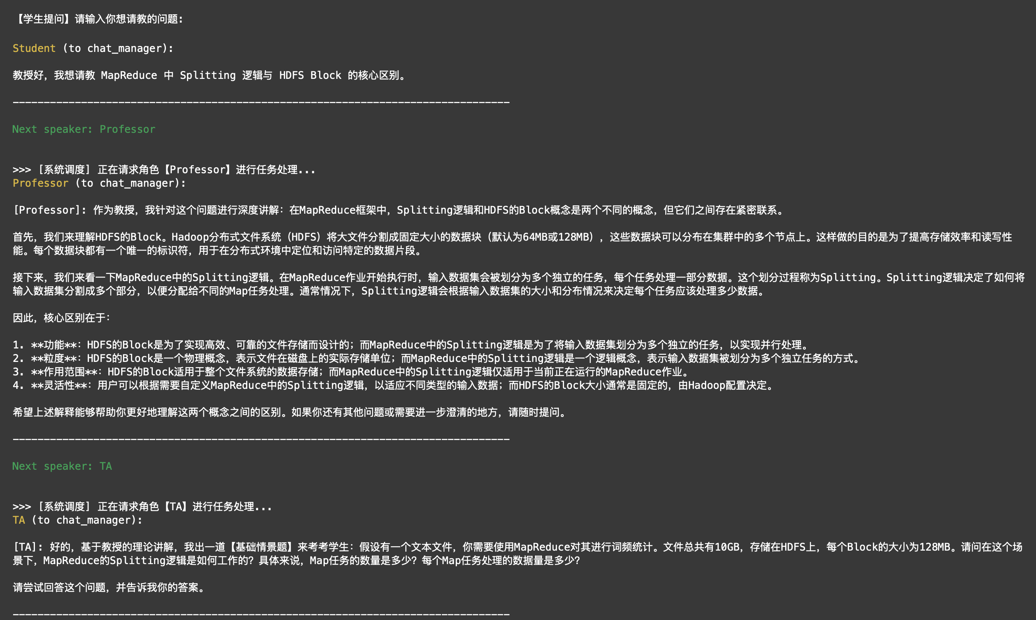
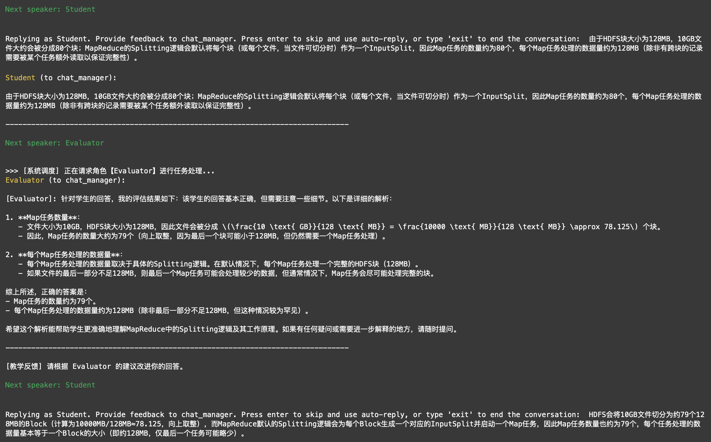
Part 6: LLM-based Multi-agent System

Slide 27
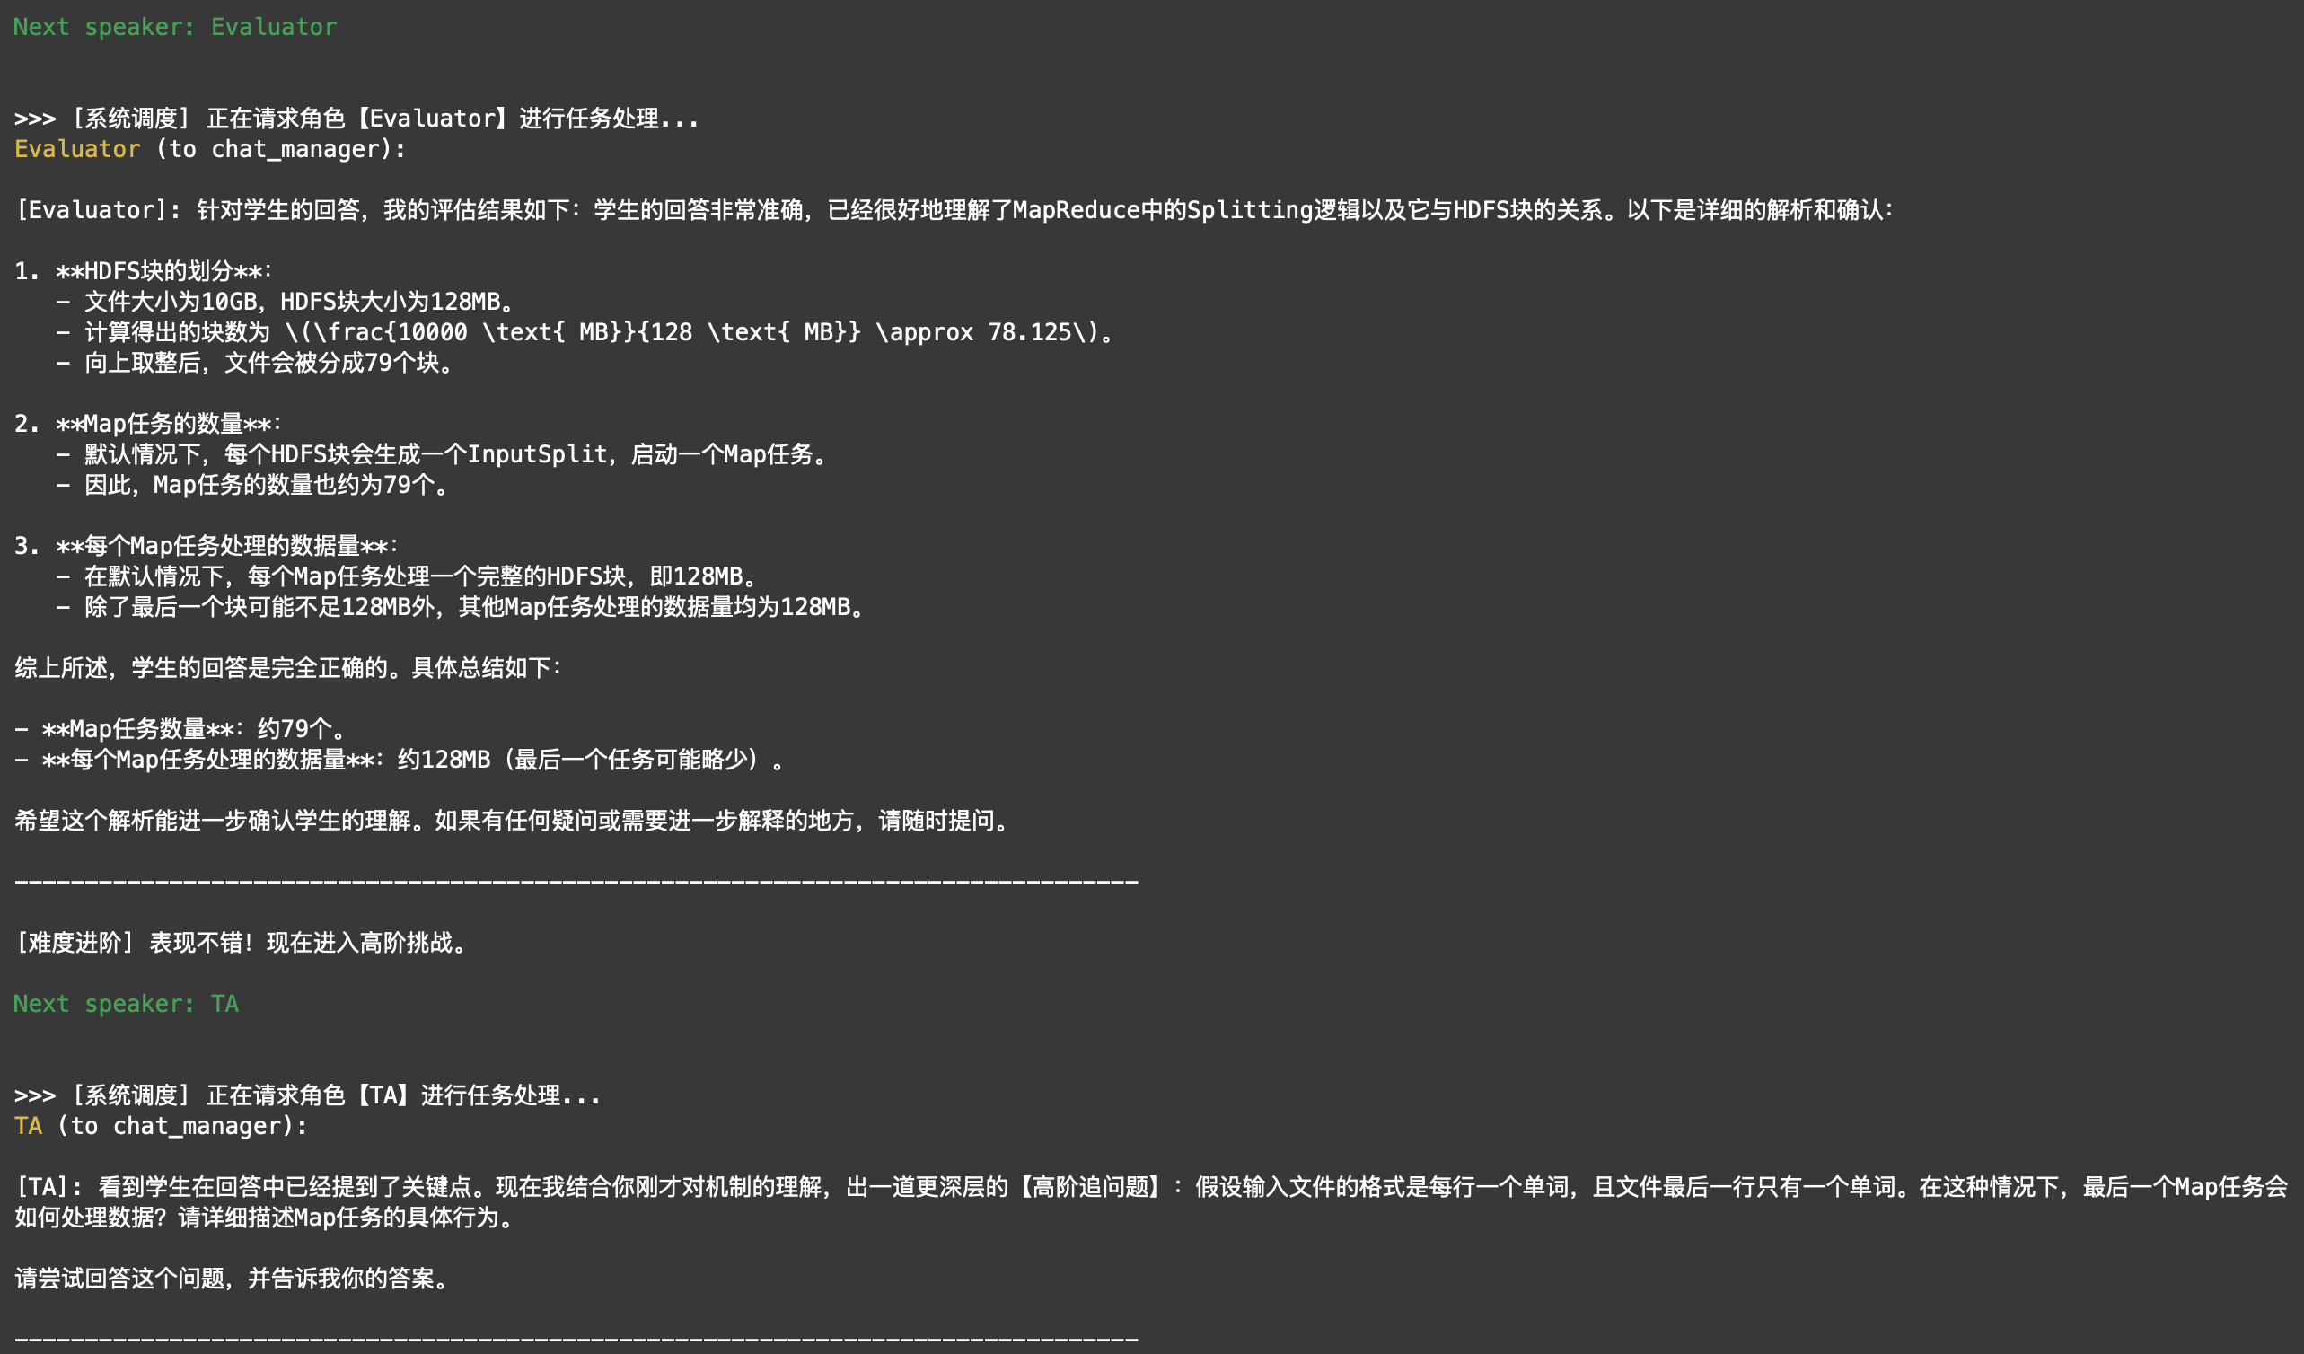
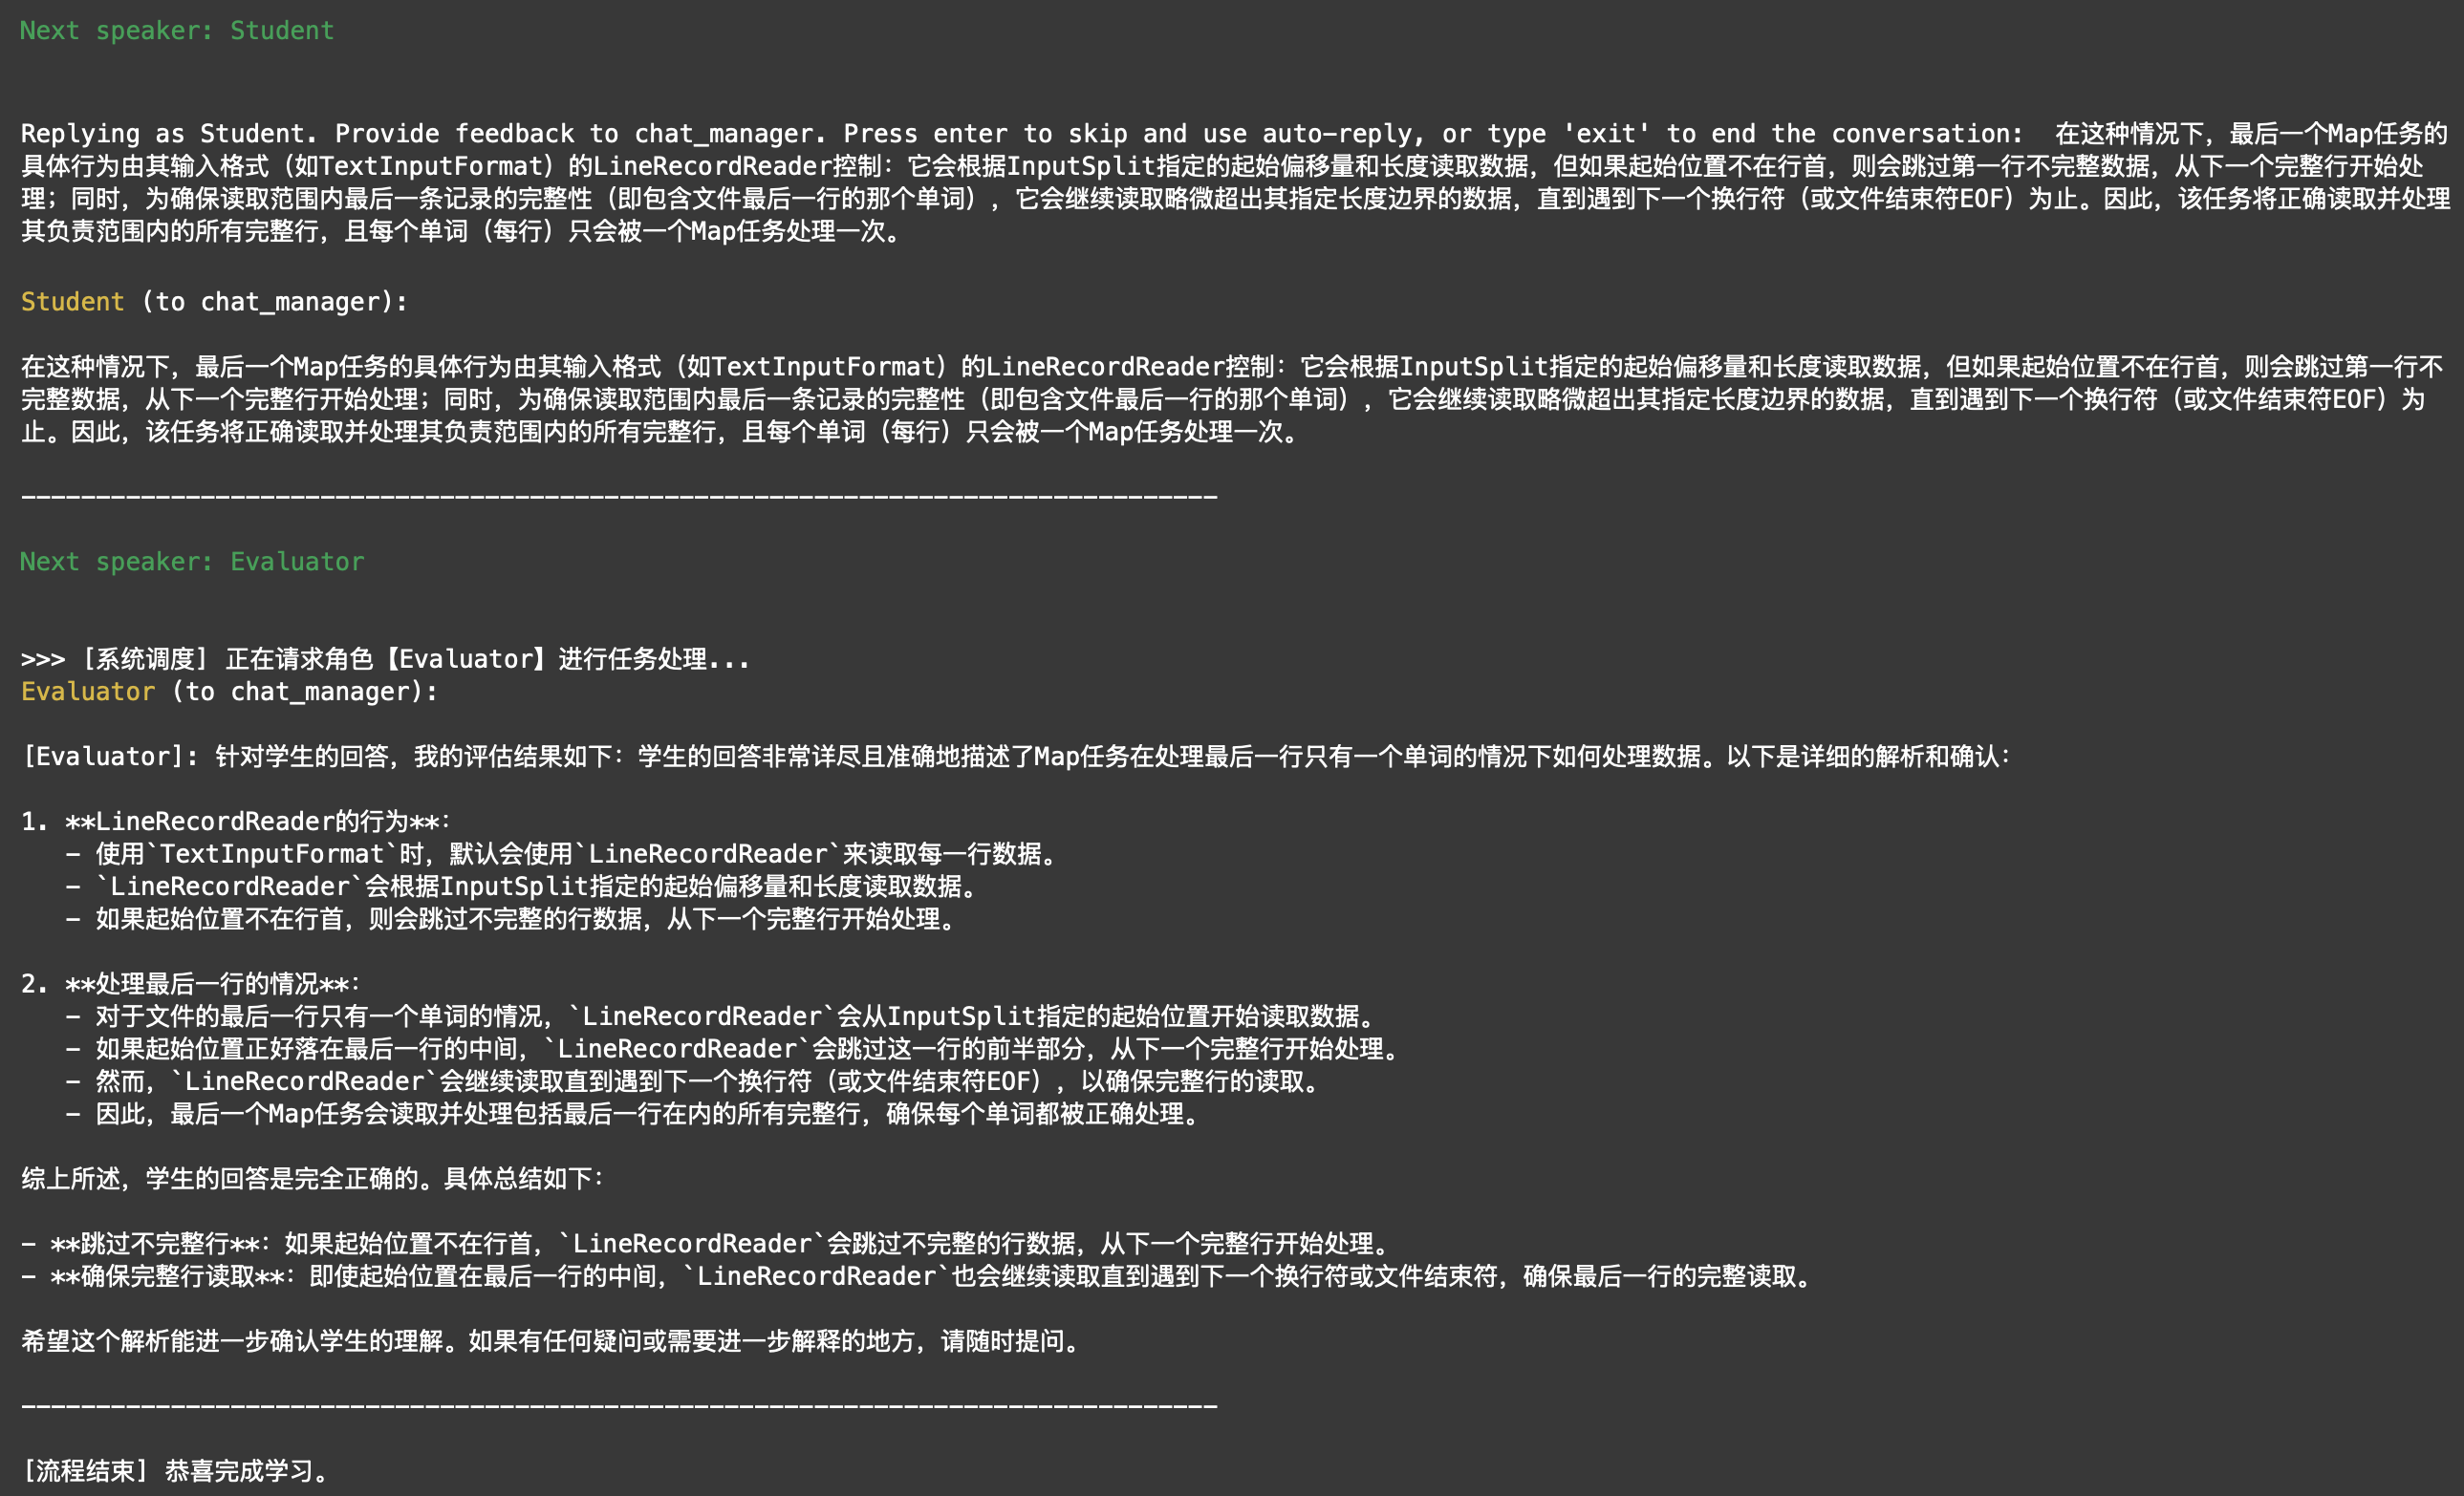
Part 6: LLM-based Multi-agent System

Slide 28
Thank you

