Slide 1
STA323 Project 1
OpenClaw for Clinical Data Analysis & Survival Analysis
侯哲妍
12313551
1/21

Slide 2
Contents
1. Q1:OpenClaw for Clinical Data Analysis
2. Q2:Survival Analysis
2/21

Slide 3
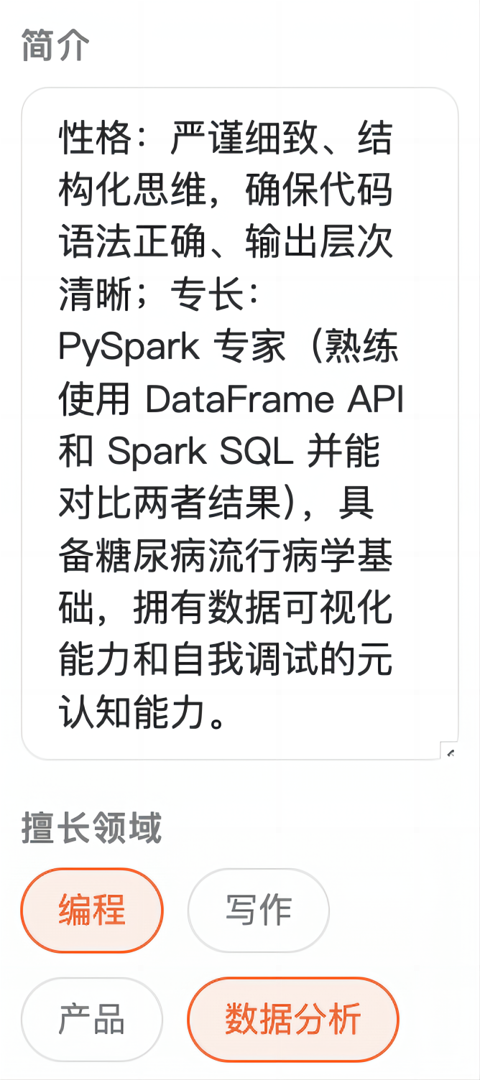












Part 1: OpenClaw for Clinical Data Analysis
1.1 Setup and describe OpenClaw for data analysis
Step 1: Install AutoClaw locally
Step 2: Create and configure an Agent
Step 3: Configure workspace
01
02
03
Install AutoClaw
Create and configure an Agent
Configure workspace
Set up AutoClaw on local machine.
Configure the agent's profile, personality, and expertise, utilizing the GLM-5-Turbo model and 50% Hermes evolution.
Set up project directories and file paths.
3/21

Slide 4
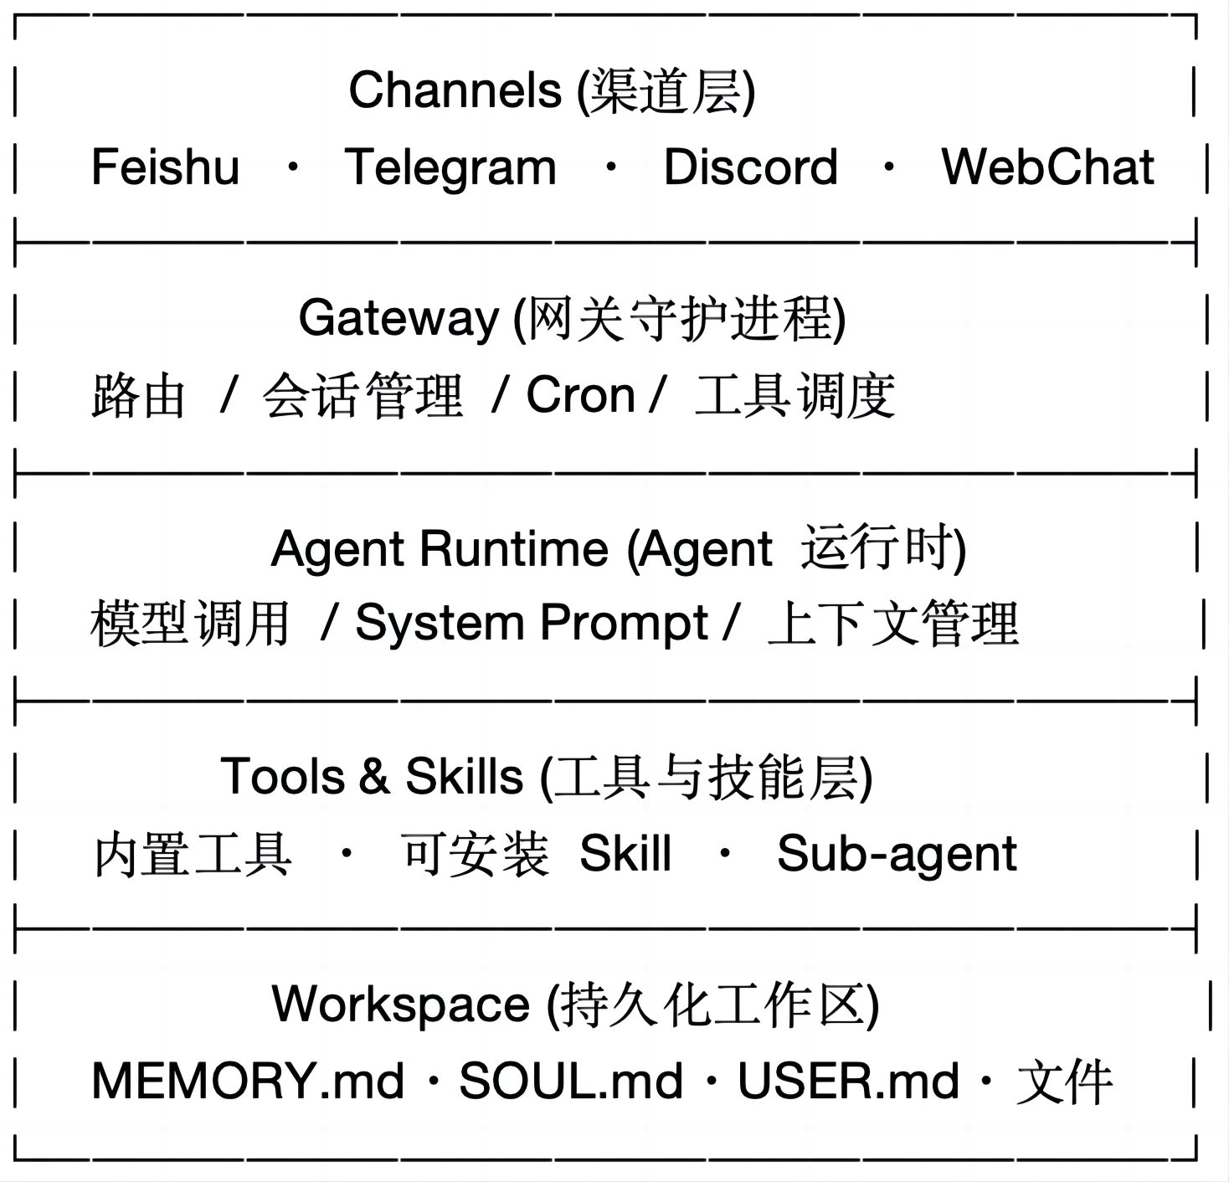
Part 1: OpenClaw for Clinical Data Analysis
1.1 Setup and describe OpenClaw for data analysis
Overall Architecture:
Working Mechanism:
1.Gateway: message receiving, routing, session management, cron tasks.
2.Agent: dedicated Workspace, identity, profile, skills, memory. Supports parallel execution.
3.Skill: Pluggable modules via SKILL.md. Built-in Feishu/coding/search/PDF, supports third-party installation.
4.Workspace: MEMORY.md for long-term memory, daily logs by date, auto-loaded across sessions.
5.Tool Orchestration: Calls dozens of tools, file, shell, browser, Feishu API, docs, etc.
6.Sub-Agent: Spawn isolated sub-agents via sessions_spawn for complex tasks, supports ACP for external integration.
4/21

Slide 5

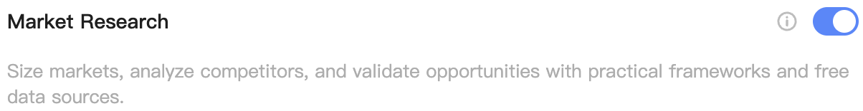
Part 1: OpenClaw for Clinical Data Analysis
1.1 Setup and describe OpenClaw for data analysis
Data Analysis Skills:
1.charts — Professional Data Visualization
2.Market Research — Market Data Analysis
3.aminer-data-search — Academic Data Query
5/21

Slide 6
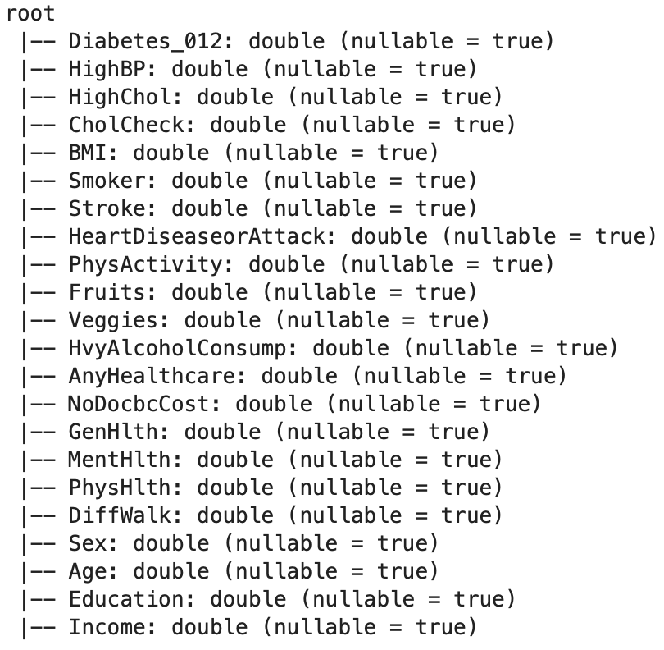
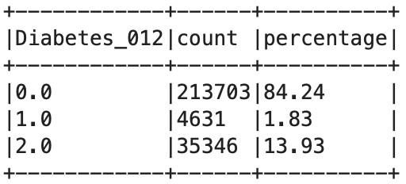
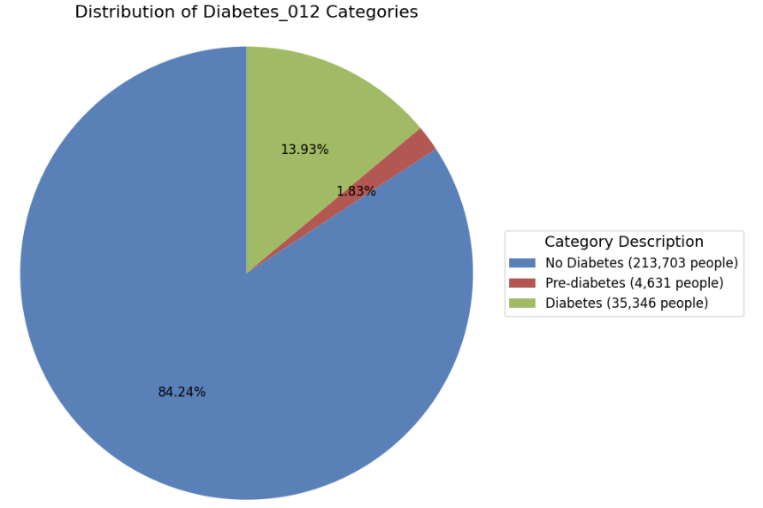
Part 1: OpenClaw for Clinical Data Analysis
1.2 Spark-based diabetes risk factor analysis across classes
Schema:
Class Distribution:
6/21

Slide 7
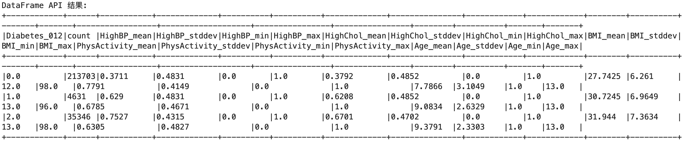
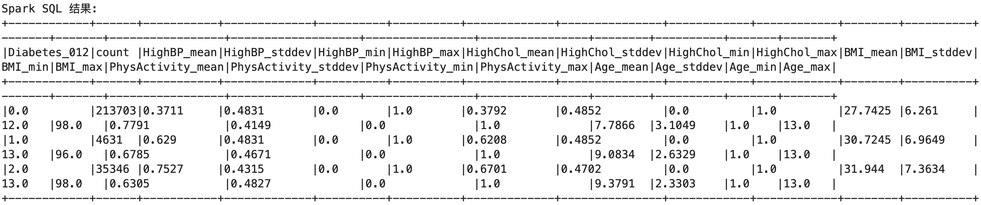
Part 1: OpenClaw for Clinical Data Analysis
1.2 Spark-based diabetes risk factor analysis across classes
Descriptive analysis of ‘HighBP’, ‘HighChol’, ‘BMI’, ‘PhysActivity’, ‘Age’:
7/21

Slide 8
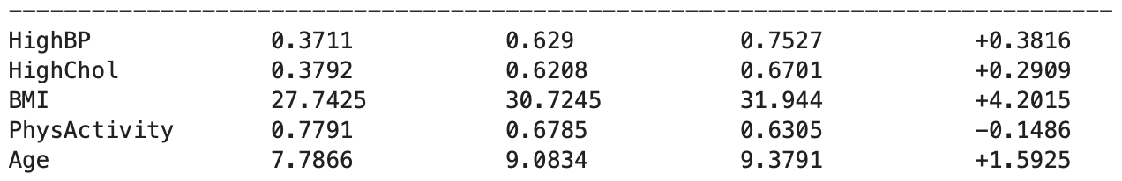
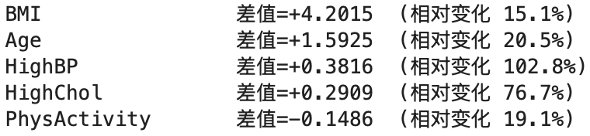
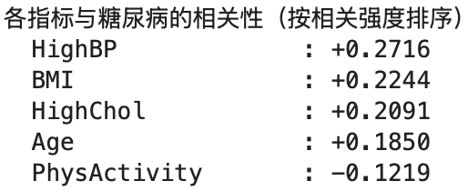
Part 1: OpenClaw for Clinical Data Analysis
1.2 Spark-based diabetes risk factor analysis across classes
Top Diabetes-related Factors:
Overall, HighBP, HighChol, and BMI are key indicators for predicting diabetes risk.
8/21

Slide 9
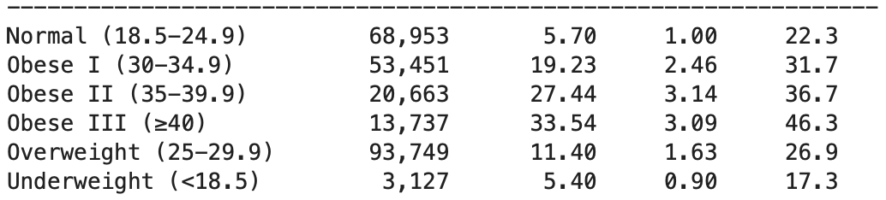
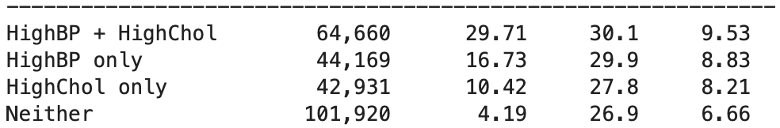
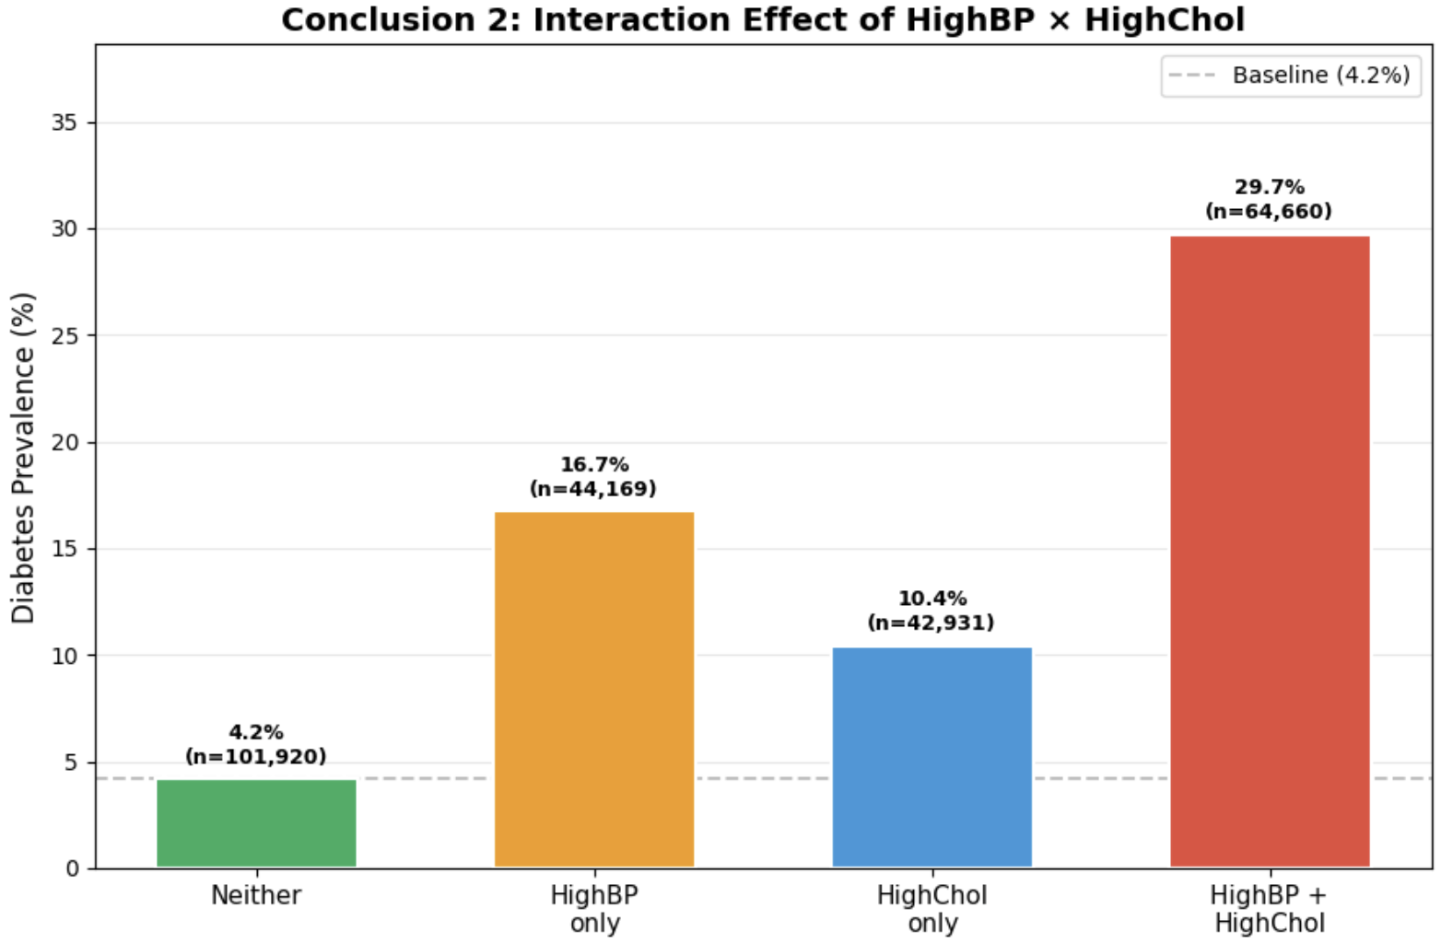
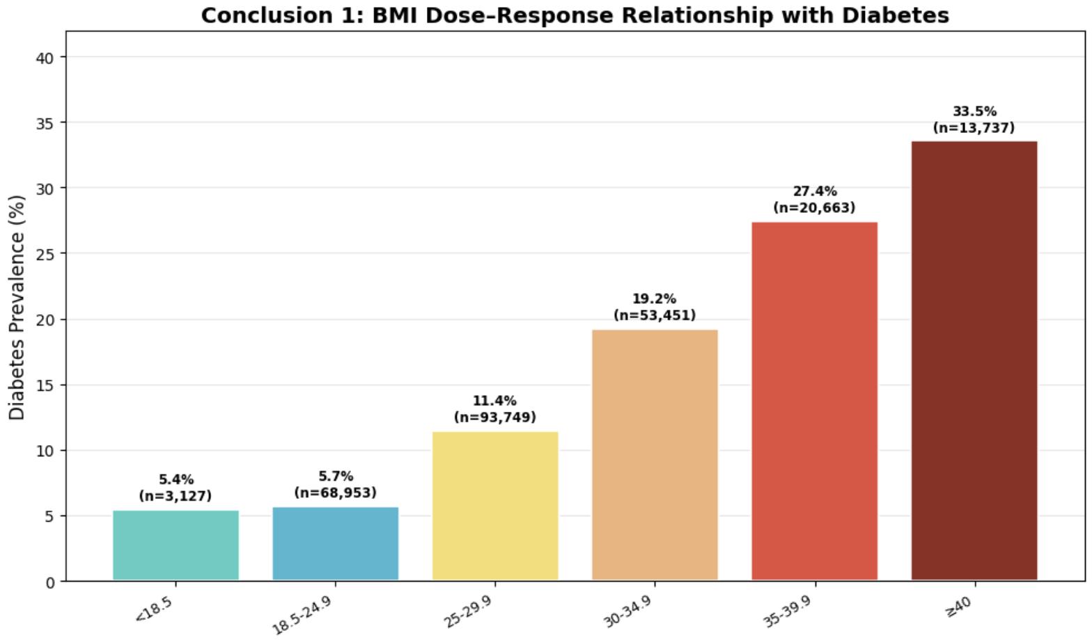
Part 1: OpenClaw for Clinical Data Analysis
1.3 Identify three key insights from the datase
Conclusion 1: BMI shows a clear dose-response relationship with diabetes
Conclusion 2: Interaction Effect between HighBP and HighChol
9/21

Slide 10
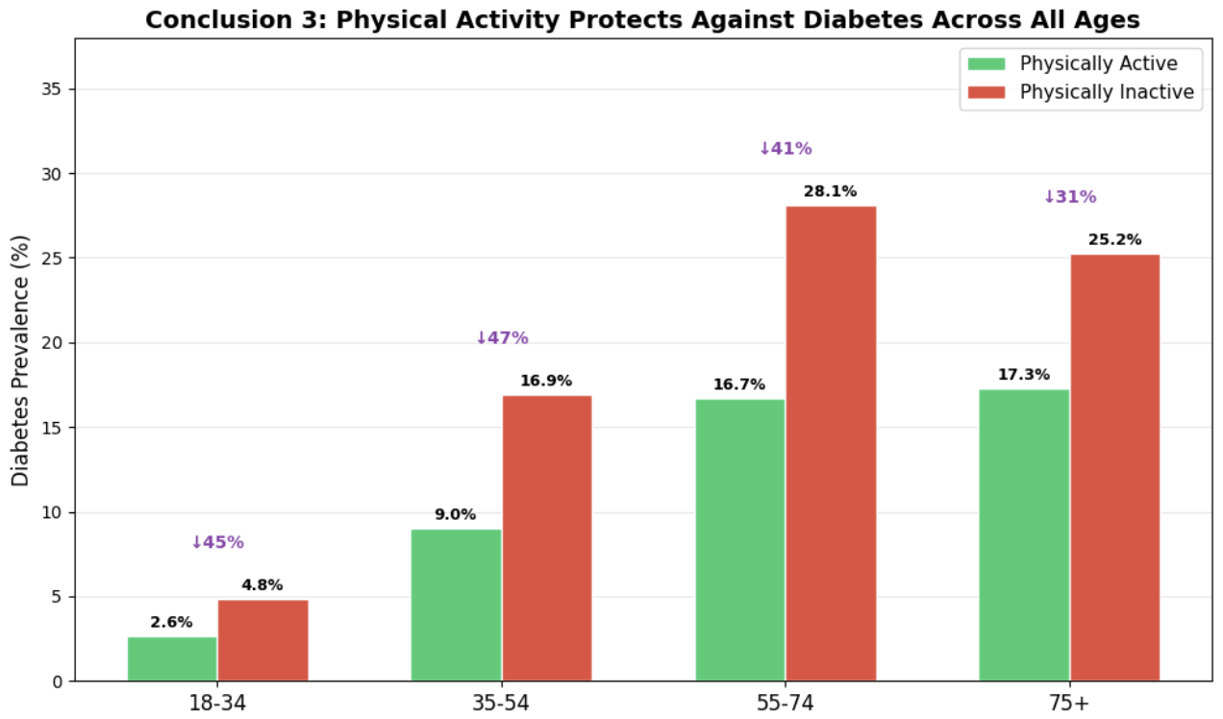
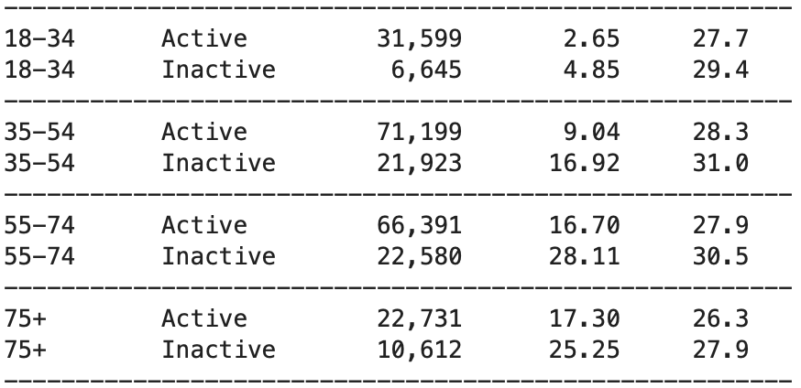
Part 1: OpenClaw for Clinical Data Analysis
1.3 Identify three key insights from the datase
Conclusion 3: Physical activity consistently protects against diabetes across all ages
10/21

Slide 11
Part 1: OpenClaw for Clinical Data Analysis
1.4 Failure case documentation and value assessment of OpenClaw
Task Objective: Require AutoClaw to output in the order of "Conclusion → Code → Chart → Chart Description," with code and charts directly visible within the conversation.
Expected Result: Output strictly follows the required format, charts render inline within the conversation interface (like Jupyter embedded output), allowing users to see the complete analysis without additional operations.
Unsatisfactory Result: The initial response omitted the code section; subsequent responses had the correct format, but charts could not be rendered directly — requiring manual copying of code to run locally before seeing the visualizations.
Possible Reasons: Format non-compliance occurred because the Agent did not self-check after generation, and the model may have prioritized conclusions over format requirements. Charts cannot be displayed directly due to multi-channel accessibility limitations on rich media rendering, and the architectural design separates code from execution.
Most Valuable Aspect: Transforms big data analysis from fragmented work involving "multi-tool switching, environment configuration, repeated debugging, and data uploading" into a closed-loop experience that is "single conversation-driven, locally executed, and ready-to-use out of the box" — analysts only need to propose requirements, and the Agent handles everything else.
11/21

Slide 12
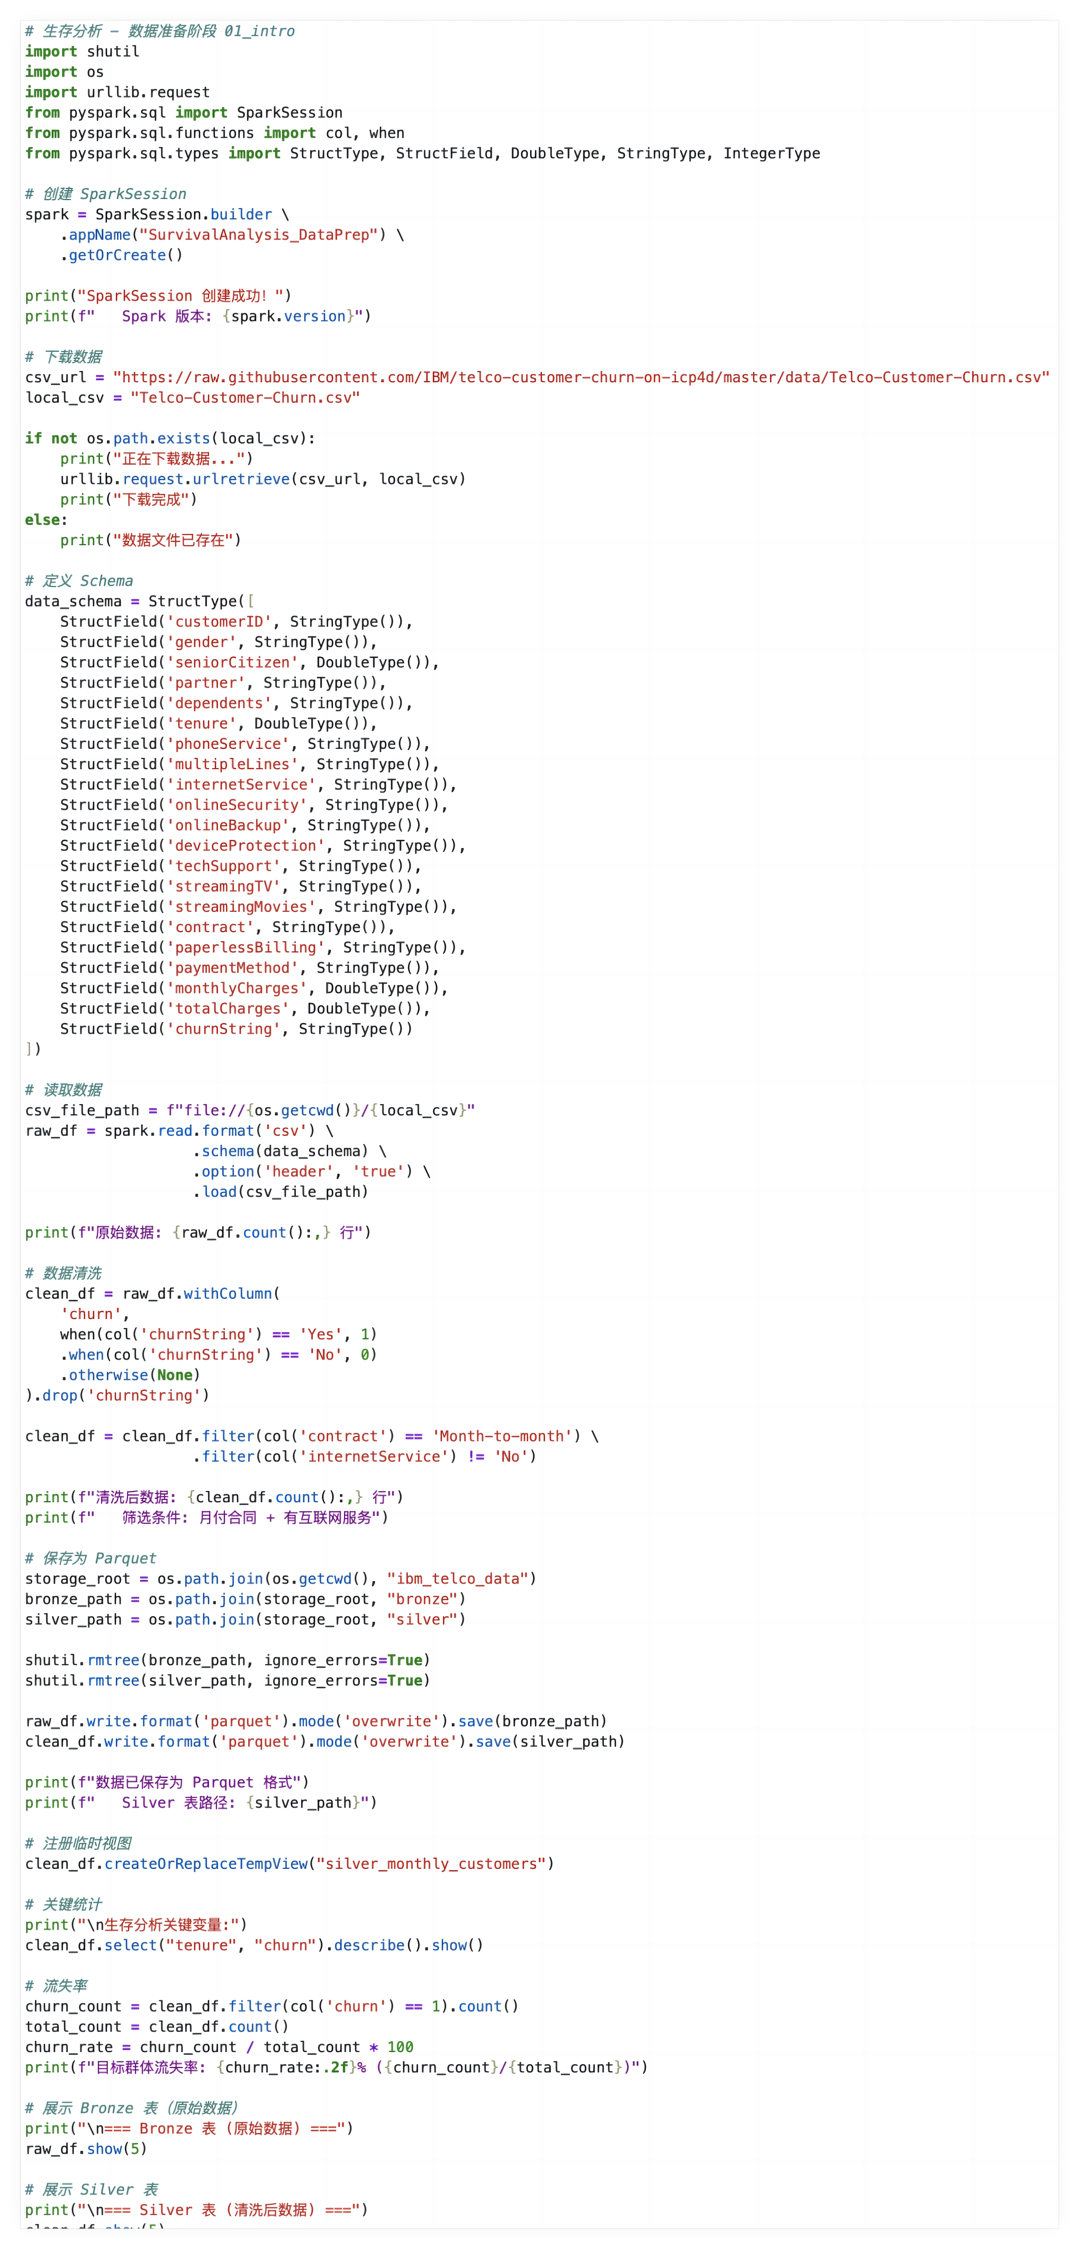
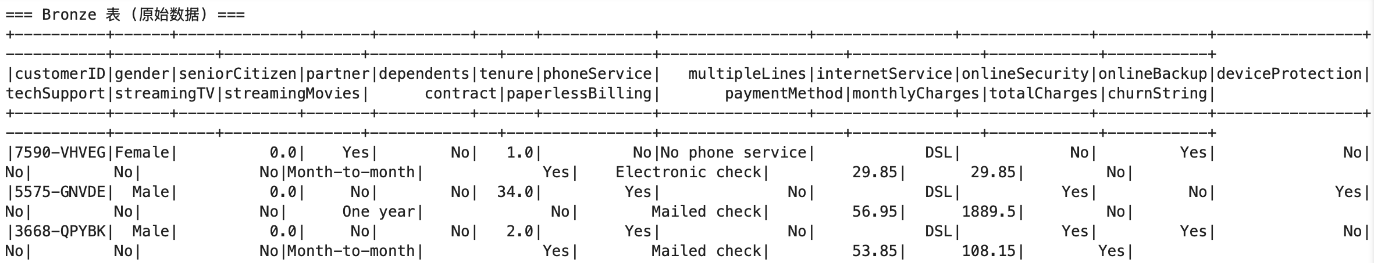
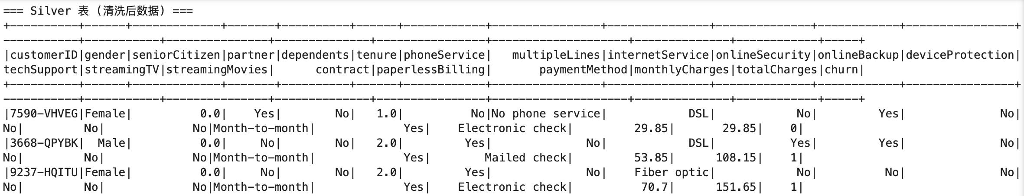
Part 2: Survival Analysis
2.1 Survival analysis code reimplementation with annotation -- 01_intro
Create SparkSession -> Download Data -> Define Schema -> Read Data -> Data Cleaning -> Save Data -> Statistical Analysis -> Data Display
12/21

Slide 13
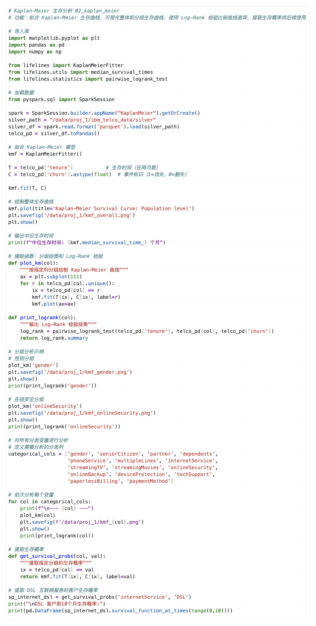
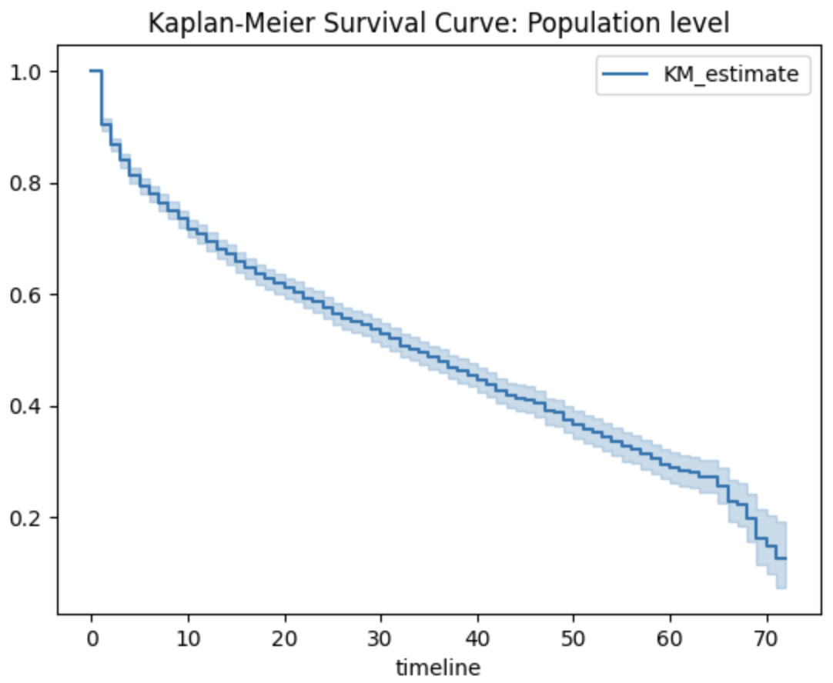
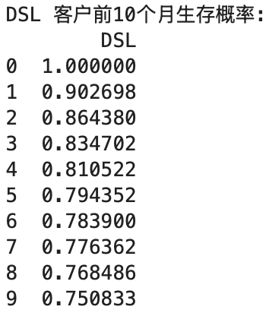
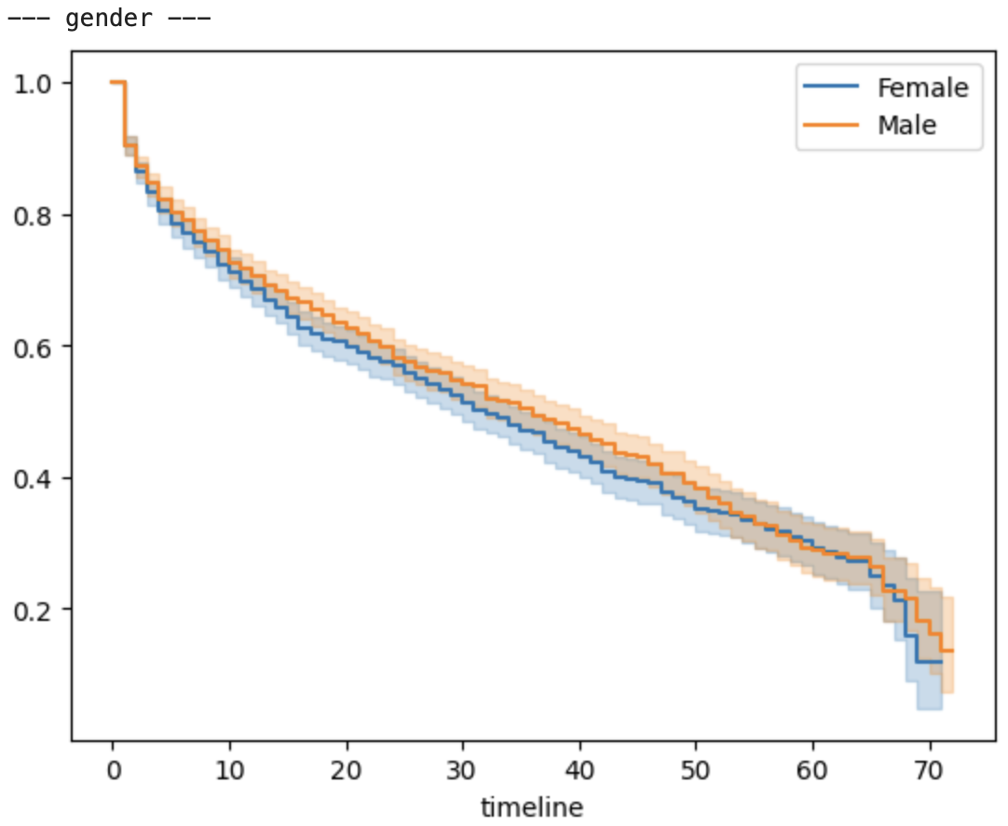
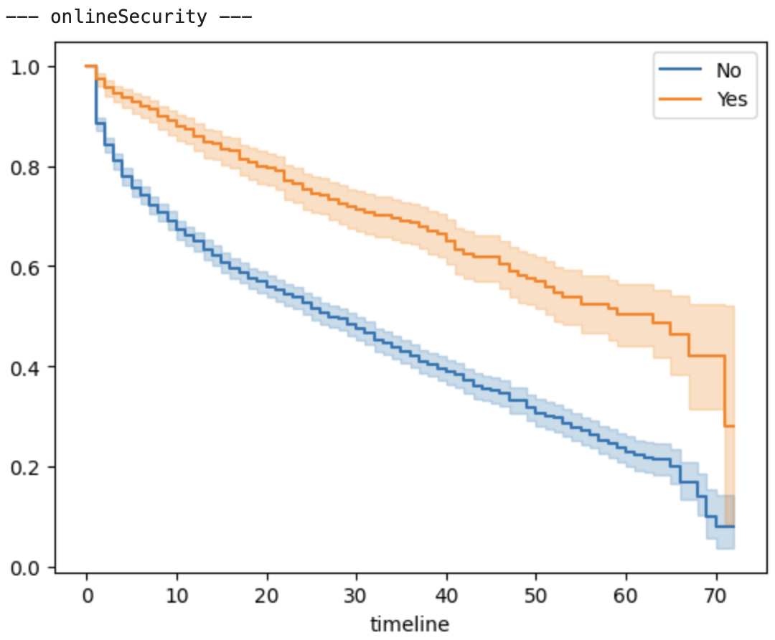
Part 2: Survival Analysis
2.1 Survival analysis code reimplementation with annotation -- 02_kaplan_meier
Import Libraries -> Load Data -> Fit KM Model -> Overall Analysis -> Group Analysis -> Batch Analysis -> Extract Probabilities
13/21

Slide 14
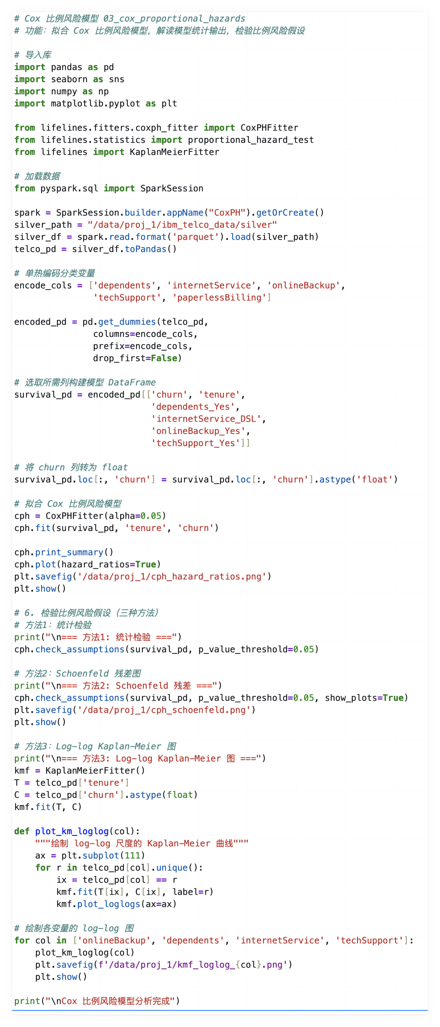
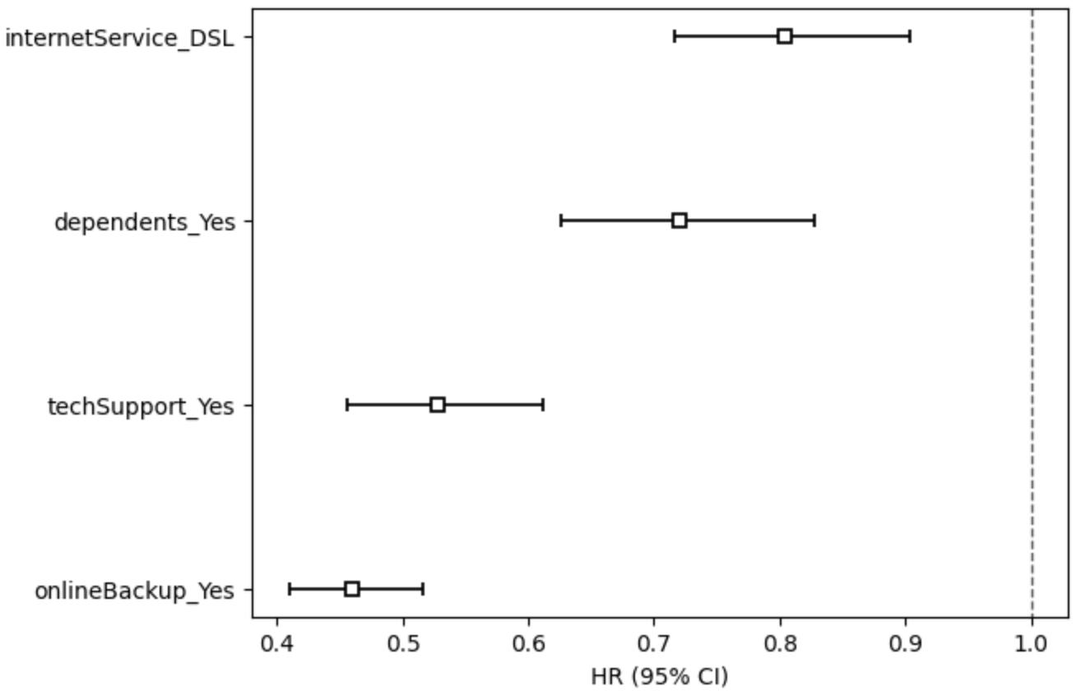
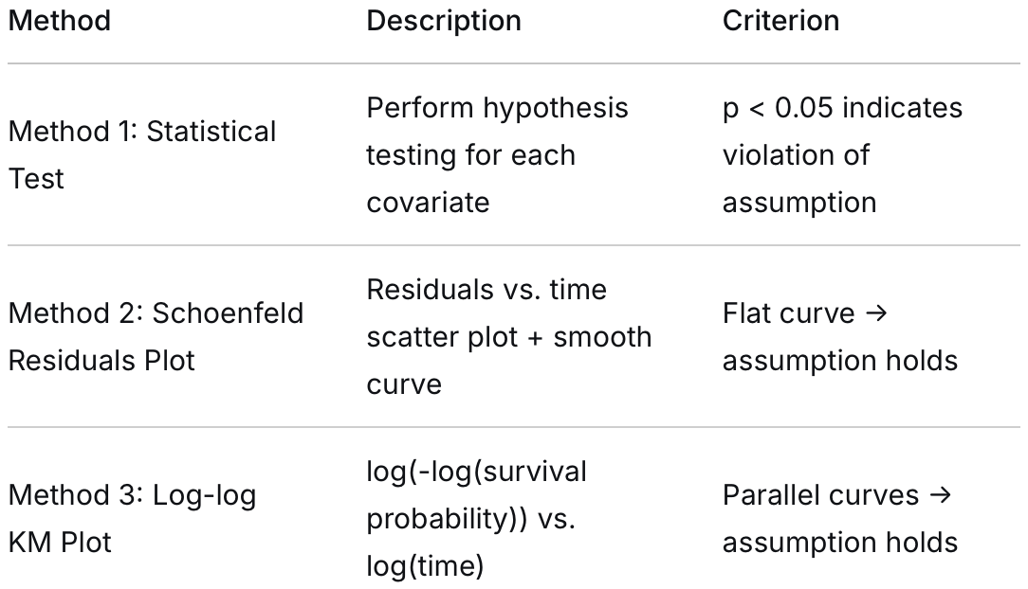
Part 2: Survival Analysis
2.1 Survival analysis code reimplementation with annotation -- 03_cox_proportional_hazards
Import Libraries -> Load Data -> One-Hot Encoding -> Build Model Matrix -> Fit Cox Model -> Model Evaluation -> Hypothesis Testing
14/21

Slide 15
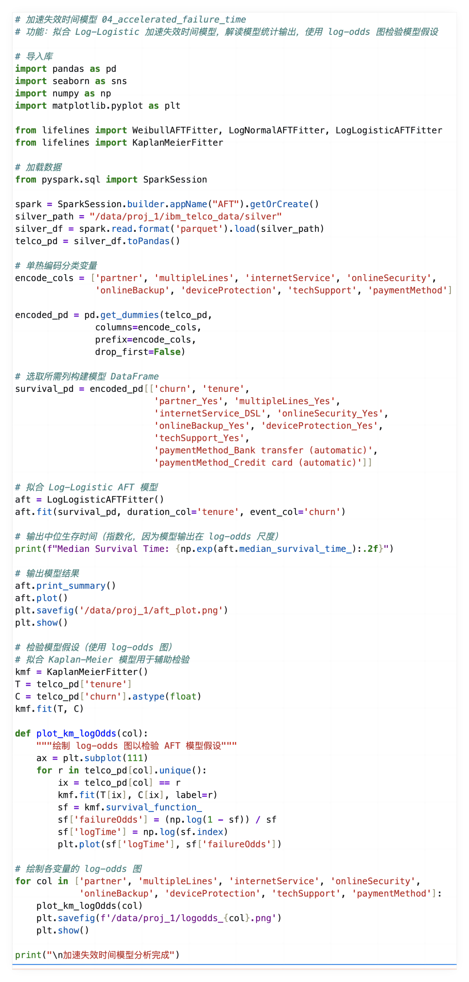
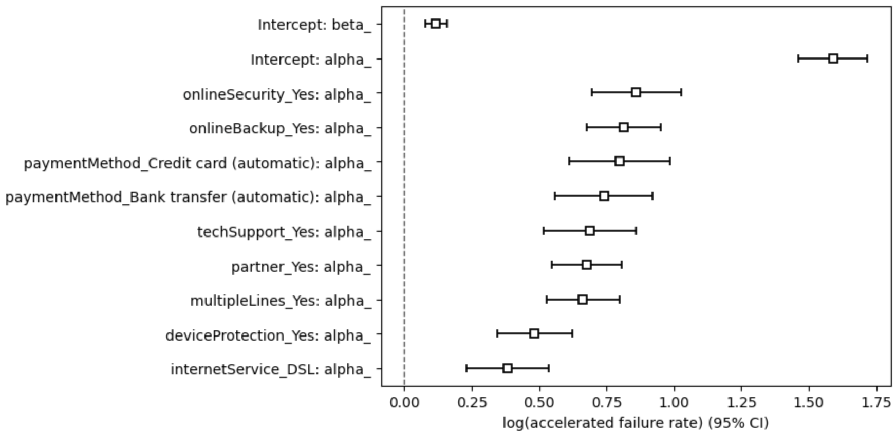
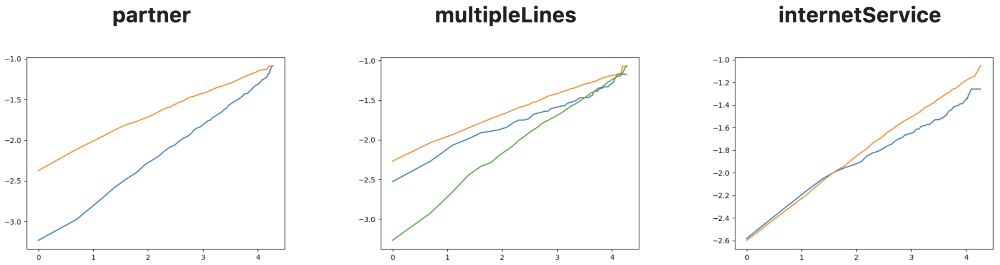
Part 2: Survival Analysis
2.1 Survival analysis code reimplementation with annotation -- 04_accelerated_failure_time
Import Libraries -> Load Data -> One-Hot Encoding -> Build Model Matrix -> Fit AFT Model -> Model Evaluation -> Hypothesis Testing
15/21

Slide 16
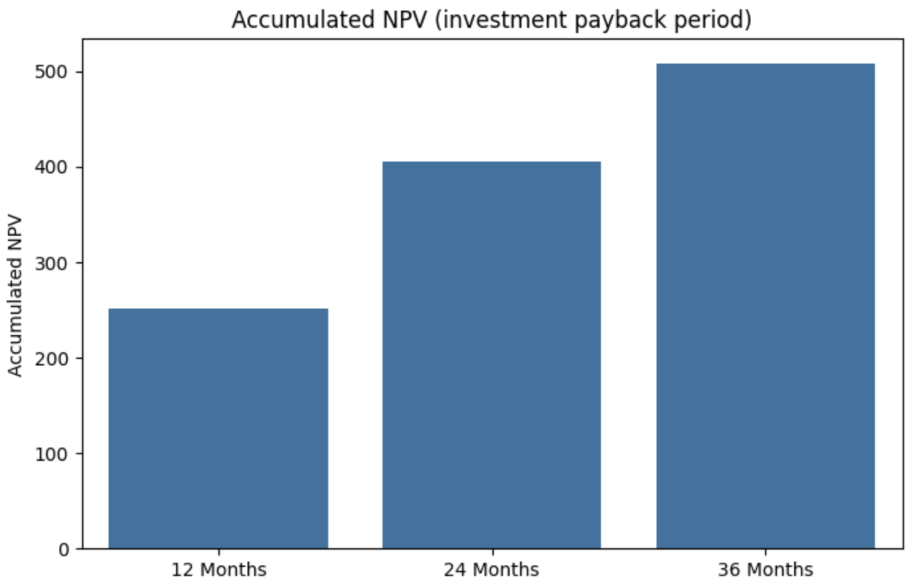
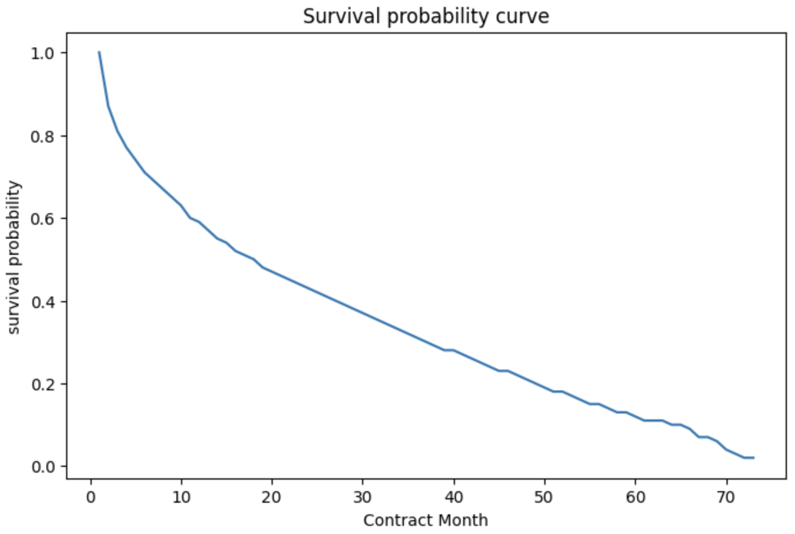
Part 2: Survival Analysis
2.1 Survival analysis code reimplementation with annotation -- 05_customer_lifetime_value
Import Libraries -> Load Data -> One-Hot Encoding -> Build Model Matrix -> Fit Cox Model -> Simulate Widgets -> CLV Calculation -> Chart Output
16/21

Slide 17
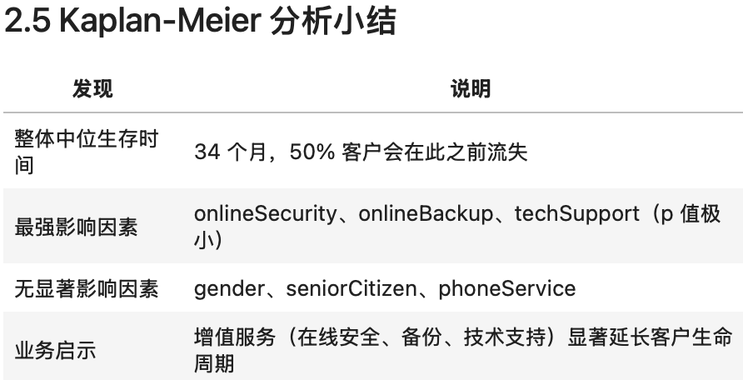
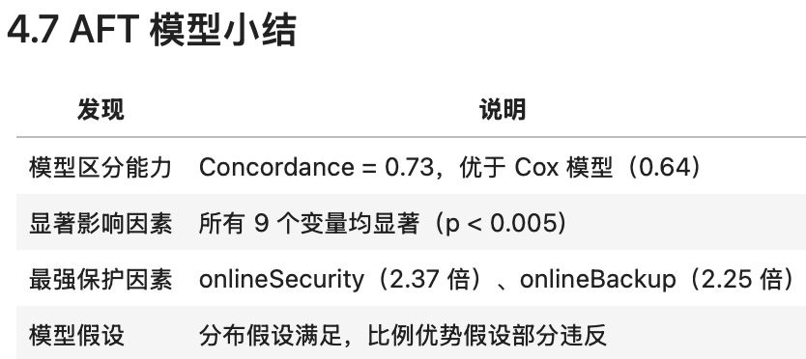
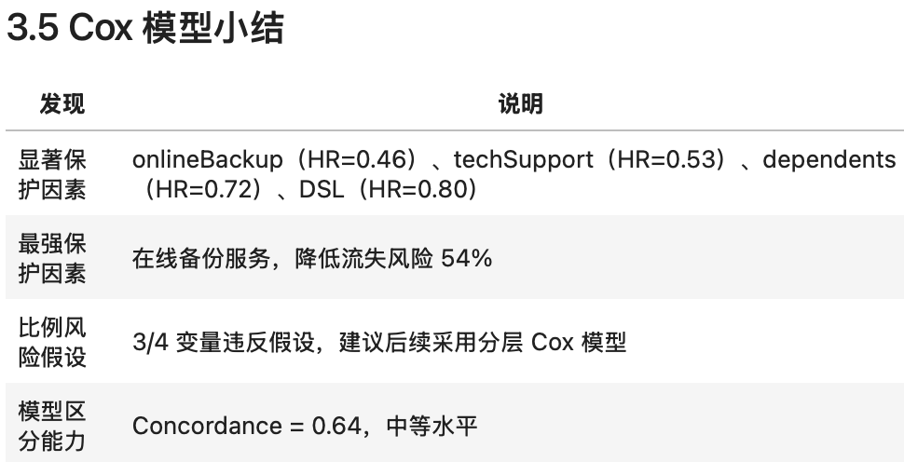
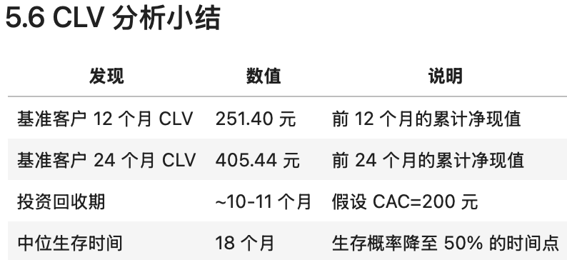
Part 2: Survival Analysis
2.2 Survival analysis report
17/21

Slide 18
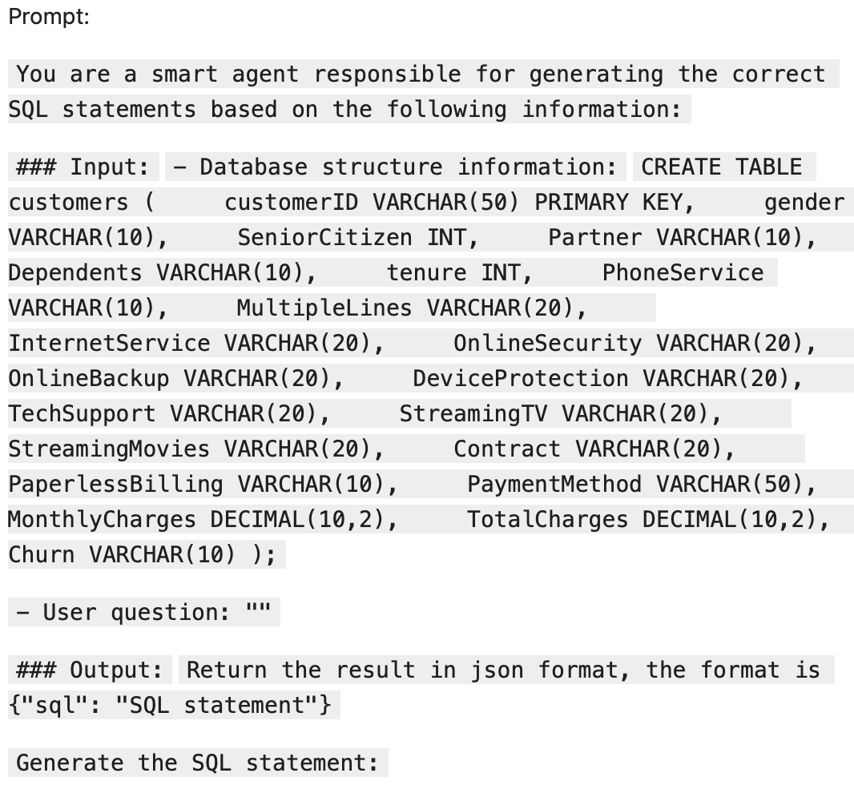
Part 2: Survival Analysis
2.3 SQL error case study with LLM failure analysis
18/21

Slide 19
Part 2: Survival Analysis
2.3 SQL error case study with LLM failure analysis
Case 1
Case 2
Case 3
· User question: 找出‘异常高消费’客户：定义为他们的 TotalCharges 超过了同种合同且同种互联网服务类型下平均水平的 2 倍，但月费反而低于该群体平均值的客户
· LLM-generated wrong SQL code: SELECT customerID FROM customers WHERE TotalCharges > (SELECT AVG(TotalCharges) * 2 FROM customers) AND MonthlyCharges < (SELECT AVG(MonthlyCharges) FROM customers);
· Correct SQL code: SELECT customerID FROM (SELECT customerID, TotalCharges, MonthlyCharges, AVG(TotalCharges) OVER (PARTITION BY Contract, InternetService) as group_avg_total, AVG(MonthlyCharges) OVER(PARTITION BY Contract, InternetService) as group_avg_monthly FROM customers) AS benchmark_table WHERE TotalCharges > 2 * group_avg_total AND MonthlyCharges < group_avg_monthly;
· User question: 在‘按年付费（One year）’的客户中，计算那些已经平安度过第一年（tenure > 12）的客户，在接下来的 3 个月内（13-15个月）发生流失的条件概率是多少？
· LLM-generated wrong SQL code: SELECT COUNT(CASE WHEN tenure BETWEEN 13 AND 15 AND Churn = 'Yes' THEN 1 END) / COUNT(*) FROM customers WHERE Contract = 'One year';
· Correct SQL code: SELECT SUM(CASE WHEN tenure > 12 AND tenure <= 15 AND Churn = 'Yes' THEN 1 ELSE 0 END) * 1.0 / COUNT(CASE WHEN tenure > 12 THEN 1 END) AS conditional_churn_probability FROM customers WHERE Contract = 'One year';
· User question: 找出那些‘纯宽带深度用户’：他们没有订购任何增值服务（StreamingTV, StreamingMovies, TechSupport 均为 'No'），但在这些人中，他们的月费却比至少订购了一项增值服务的客户的平均月费还要高
· LLM-generated wrong SQL code: SELECT customerID FROM customers WHERE StreamingTV = 'No' AND StreamingMovies = 'No' AND TechSupport = 'No' AND MonthlyCharges > (SELECT AVG(MonthlyCharges) FROM customers WHERE StreamingTV = 'Yes');
· Correct SQL code: WITH PureBroadband AS (SELECT * FROM customers WHERE StreamingTV = 'No' AND StreamingMovies = 'No' AND TechSupport = 'No'), ValueAddedUsers AS (SELECT AVG(MonthlyCharges) as avg_val FROM customers WHERE StreamingTV = 'Yes' OR StreamingMovies = 'Yes' OR TechSupport = 'Yes') SELECT p.customerID FROM PureBroadband p, ValueAddedUsers v WHERE p.MonthlyCharges > v.avg_val;
19/21

Slide 20
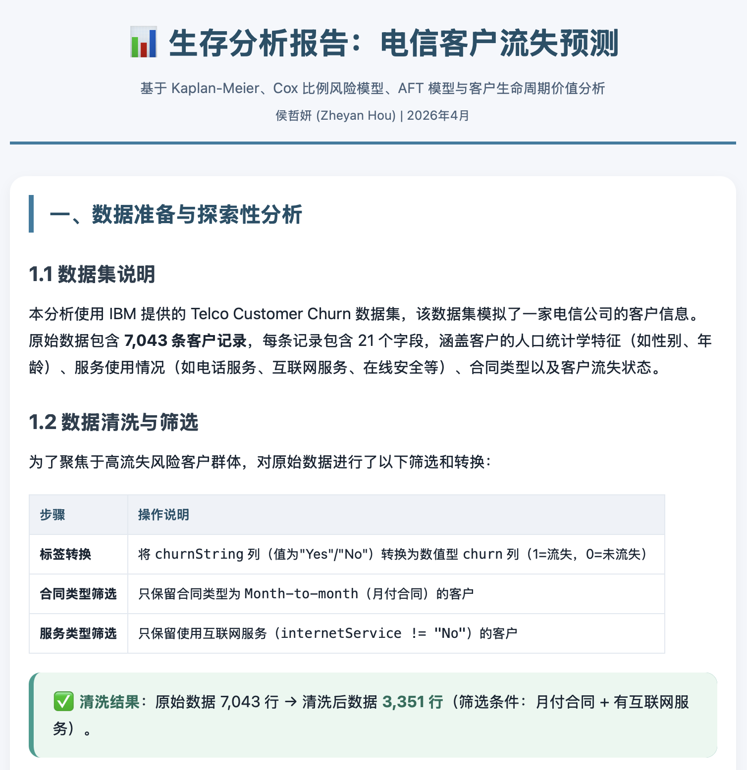
Part 2: Survival Analysis
2.3 Personal website for blog publishing
- GitHub: https://github.com/HouZheyan/HouZheyan.github.io/tree/main
- Blog:
https://zyhou.online
20/21

Slide 21
Thank you
21/21

