Slide 1
STA323 Project 2
Data Agent System & Startup Business Plan
侯哲妍
12313551
1/21

Slide 2
Contents
1. Q1: Data Agent System
2. Q2: Startup Business Plan
2/21

Slide 3
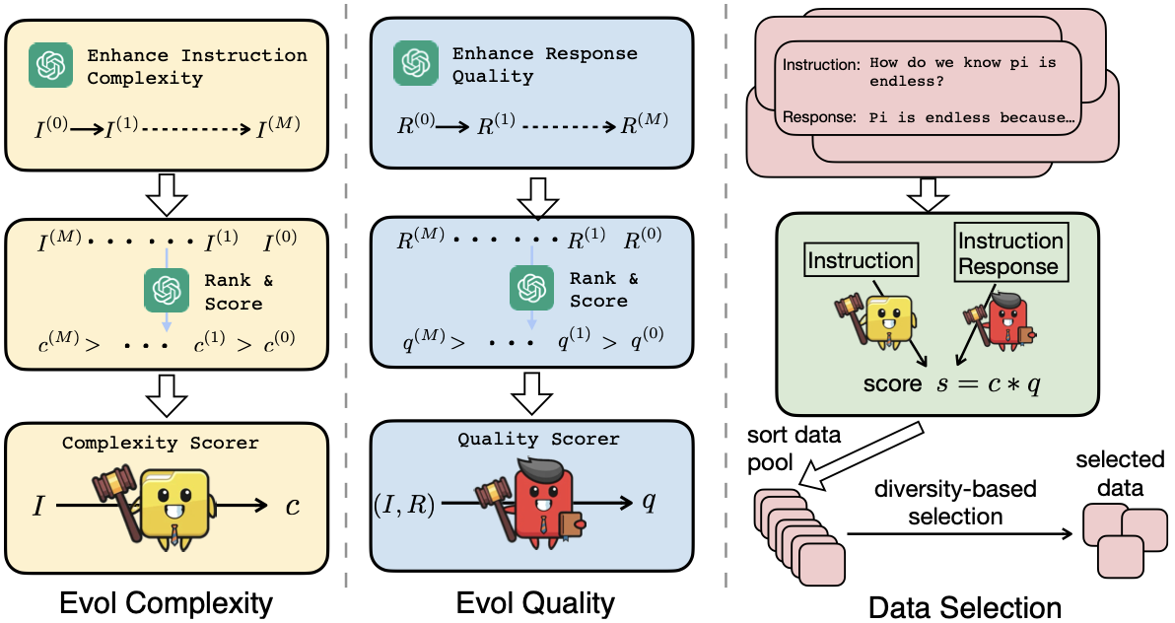
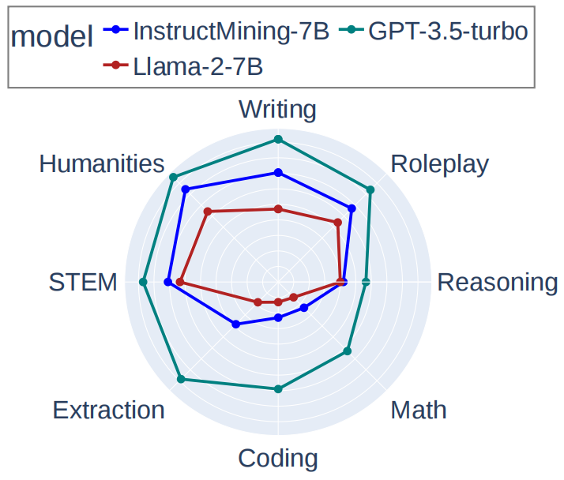
Part 1: Data Agent System
1.1 Effective Data Selection Methods
1. Reward-Based Selection
Paper 1 – What Makes Good Data for Alignment? (Liu et al., 2023)
· Reward model scores effectively filter high-quality
math/science data
· Reward-based signals outperform heuristic
selection methods
Paper 2 – Instruction Mining (Cao et al., 2023)
· IFD uses perplexity gap (instruction vs. answer) as
reward signal
· Top 5% IFD data beats full-dataset training on
GSM8K & ScienceQA
https://arxiv.org/abs/2312.15685 https://arxiv.org/abs/2307.06290
3/21

Slide 4
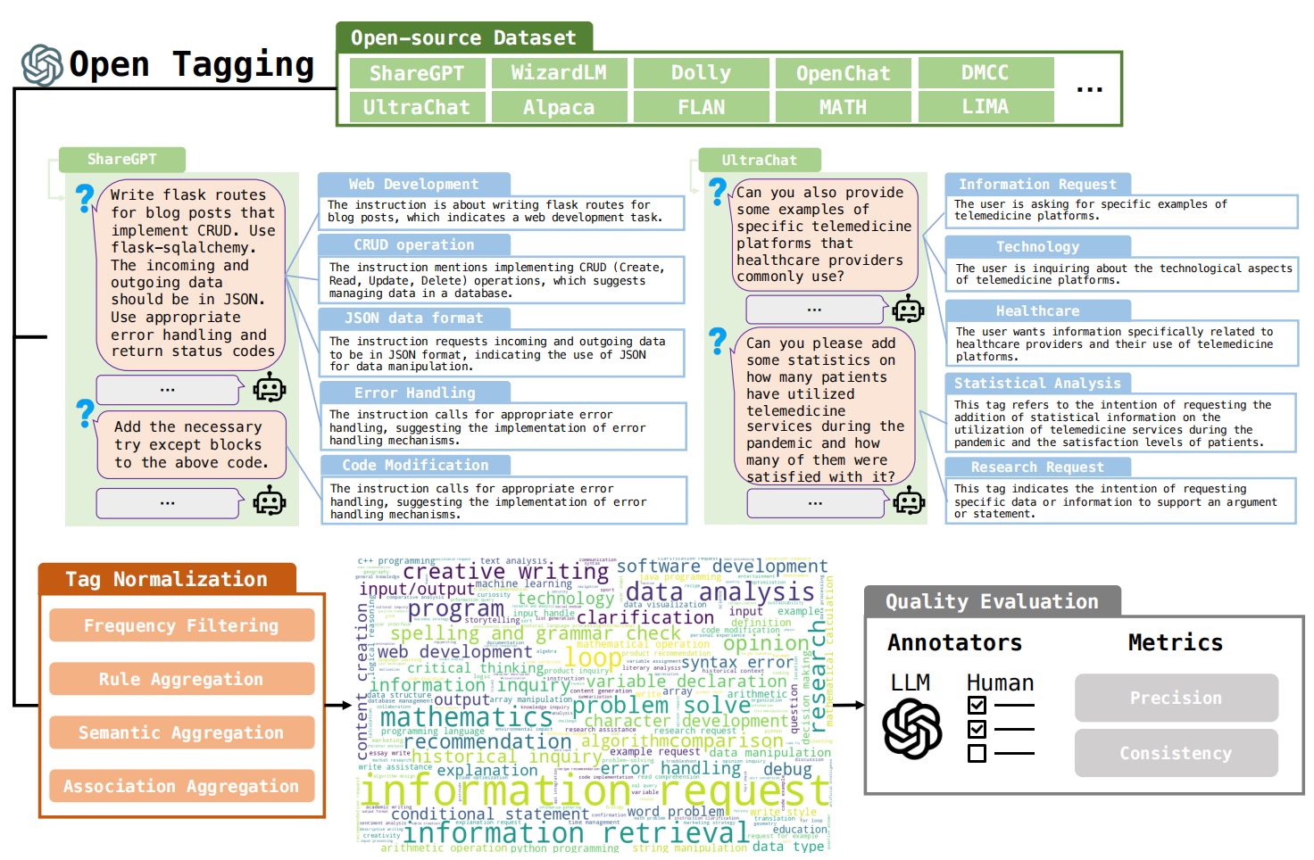
Part 1: Data Agent System
1.1 Effective Data Selection Methods
2. Trajectory Deduplication / Diversity
Paper 1 – #InsTag (Lu et al., 2023)
· Semantic tagging identifies redundant
instruction trajectories
· Deduplication is critical for multi-step
math reasoning
Paper 2 – Super-NaturalInstructions (Wang et al., 2022)
· Diverse task sets beat repeated single-
task data
· Covering diverse reasoning paths
enhances math generalization
https://arxiv.org/abs/2308.07074 https://arxiv.org/abs/2204.07705
4/21

Slide 5
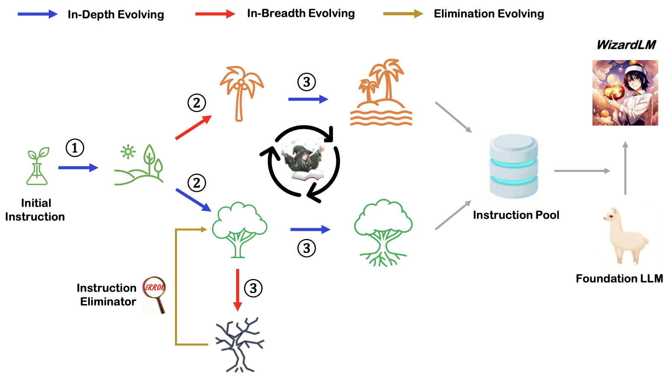
Part 1: Data Agent System
1.1 Effective Data Selection Methods
3. Complexity-Based Filtering
Paper 1 – WizardLM (Xu et al., 2023)
· Evol-Instruct method progressively increases
instruction complexity
· Higher-complexity data improves performance on
multi-step math reasoning
Paper 2 – Active Instruction Tuning (Kung et al.,
2023)
· Medium-complexity data has highest learning value
· Avoids low/high extremes; targets model-sensitive
tasks
https://arxiv.org/abs/2304.12244 https://arxiv.org/abs/2311.00288
5/21

Slide 6
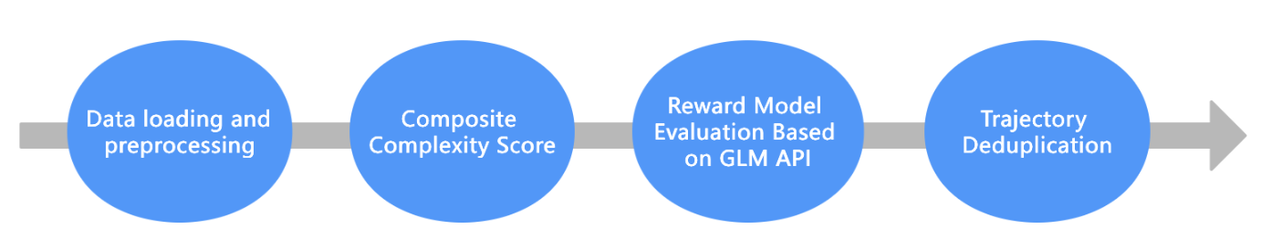
Part 1: Data Agent System
1.2 Data Selection from DataMind-12K for Training
1. Data loading and preprocessing:
· Load the datamind_12k. json file
· Adapt to multiple difficulty level annotations
(Simple/easy → 1.0, Medium/Rate → 2.0, Hard/Complex → 3.0)
· Extract the core features of each trajectory: user problem, difficulty, file name, number of
messages, number of code blocks, etc
6/21

Slide 7
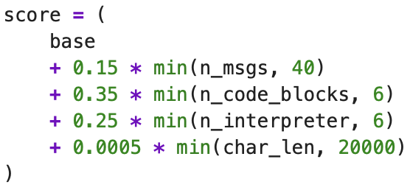
Part 1: Data Agent System
1.2 Data Selection from DataMind-12K for Training
2. Composite Complexity Score:
· Calculate the basic score for each trajectory
· The code block has the highest weight (0.35), emphasizing programming ability
· The second highest number of messages is 0.15, reflecting the depth of the conversation
7/21

Slide 8
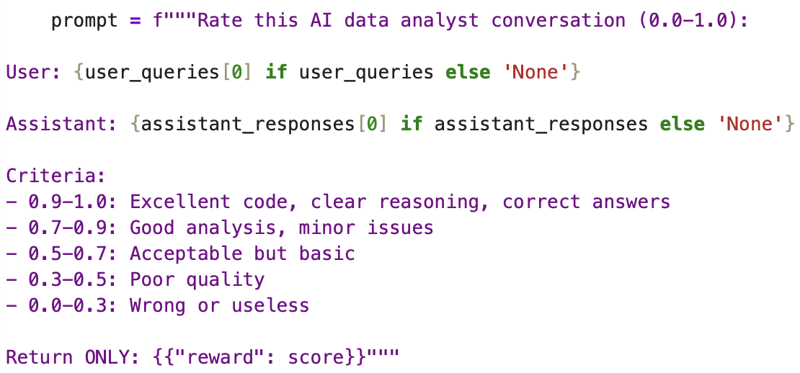
Part 1: Data Agent System
1.2 Data Selection from DataMind-12K for Training
3. Reward Model Evaluation Based on GLM API:
· Use GLM-4-Flash as the reward model
· Evaluate the quality of each conversation (relevance, correctness, clarity) and output a reward
score of 0.0-1.0
· Implement intelligent caching mechanism: reward_cachejson caches all API results to avoid
duplicate calls
8/21

Slide 9
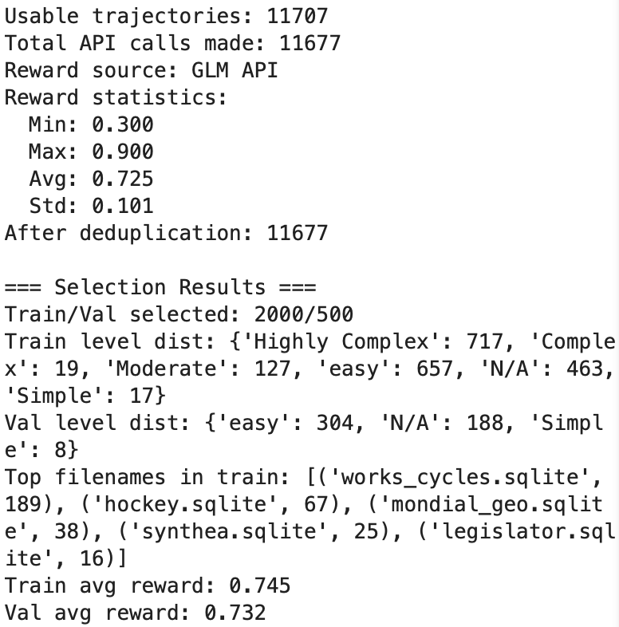
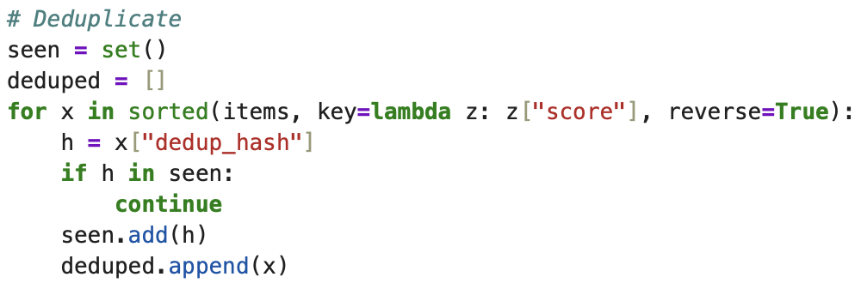
Part 1: Data Agent System
1.2 Data Selection from DataMind-12K for Training
4. Trajectory Deduplication:
· Generate de duplication key: {filename} | | {normalized
user issue}
· Use SHA1 hash to ensure uniqueness
· Sort in descending order by comprehensive score
(score+1.2 x reward) and retain high scoring samples
9/21

Slide 10
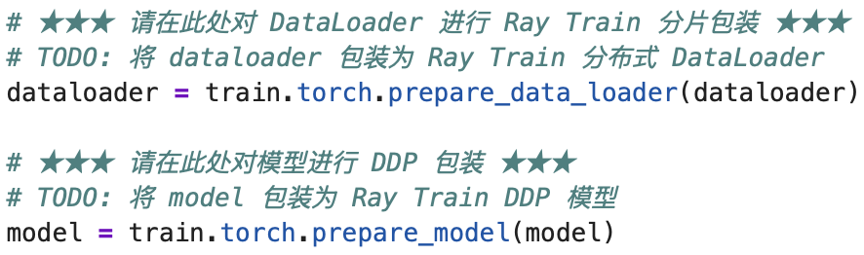
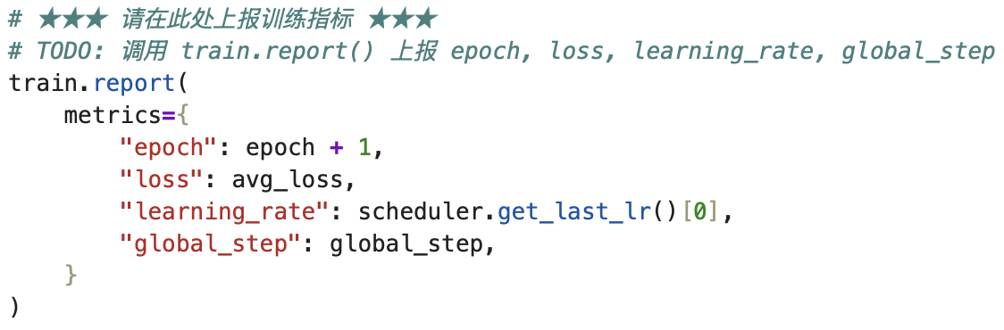
Part 1: Data Agent System
1.3 Fine-tune Qwen3.5-0.8B on DataMind-12K Using Ray-train
1. Data preprocessing function
· Convert the conversation trajectory data of DataMind-12K into tokenized format that can be used for SFT
· Only calculate loss for replies from the assistant role, system and user messages do not participate in loss calculation
2. Training function
· Use Ray Train for full fine-tuning
· Train Qwen3.5-0.8B model on DataMind-12K dataset
· Support distributed training (DDP) and multi worker parallelism
10/21

Slide 11
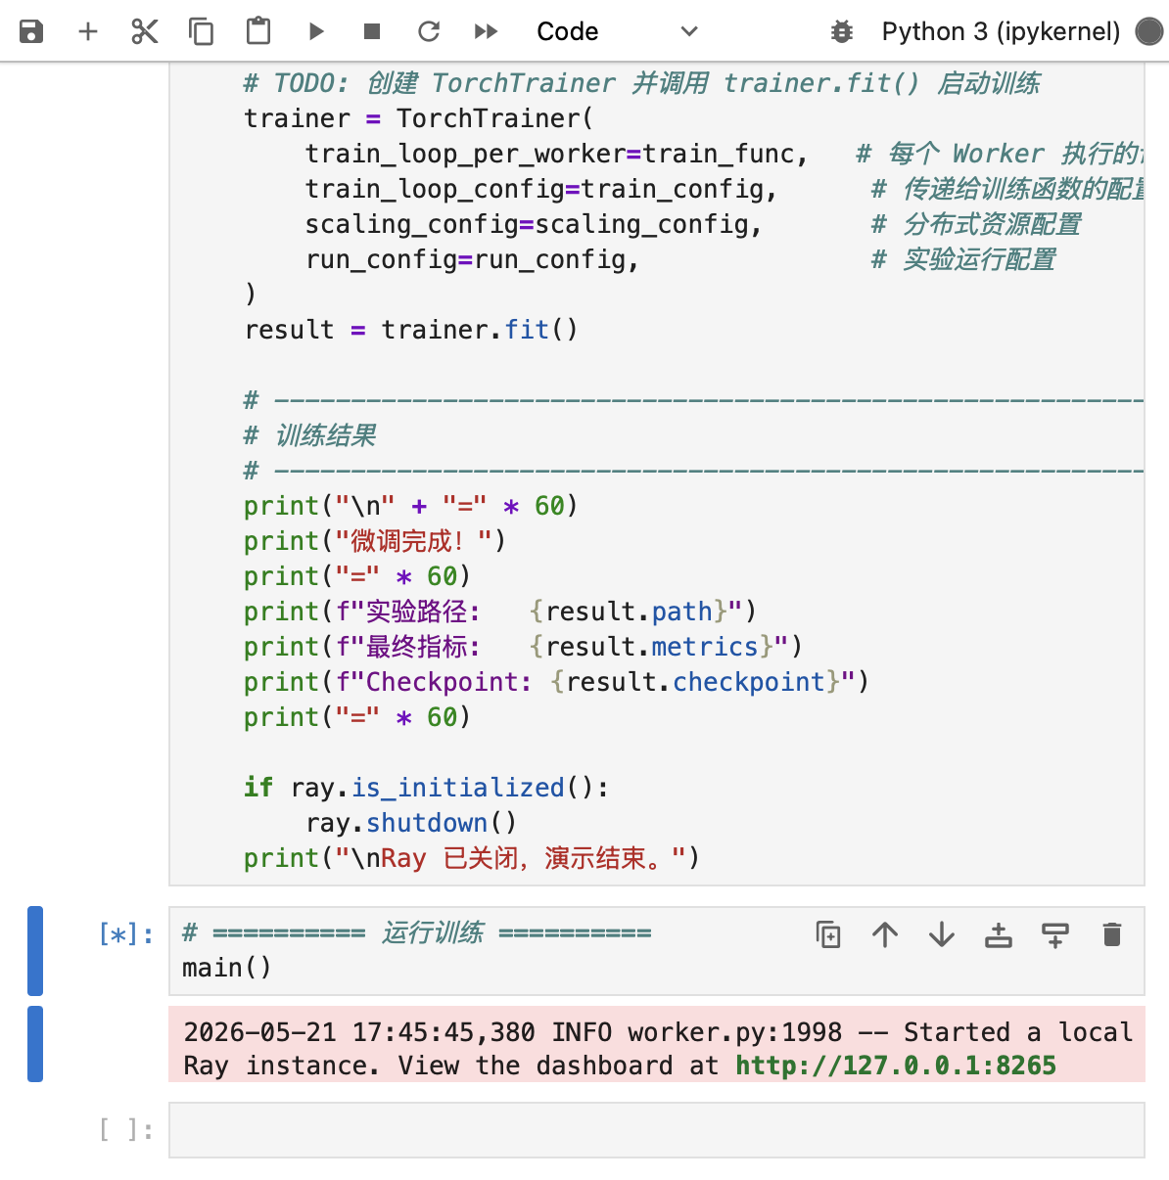
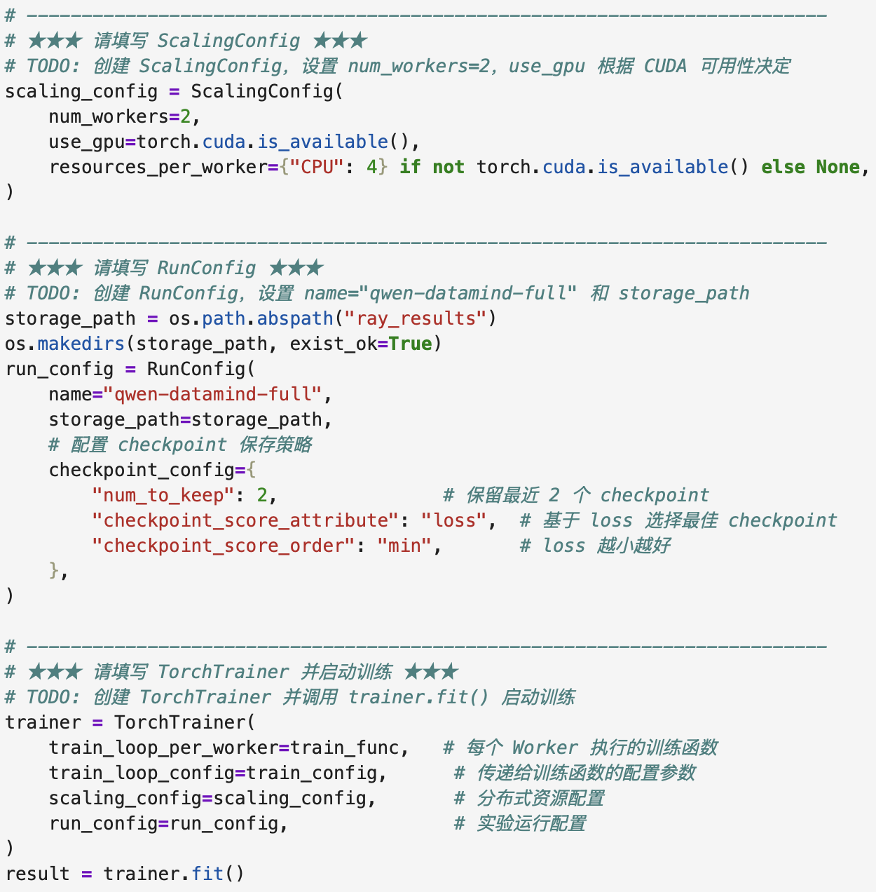
Part 1: Data Agent System
1.3 Fine-tune Qwen3.5-0.8B on DataMind-12K Using Ray-train
3. Start Ray Train distributed training
· Configure and start Ray distributed training
· Perform full fine-tuning of Qwen model using TorchTrainer
· Manage the training lifecycle (initialization → training → cleanup)
11/21

Slide 12
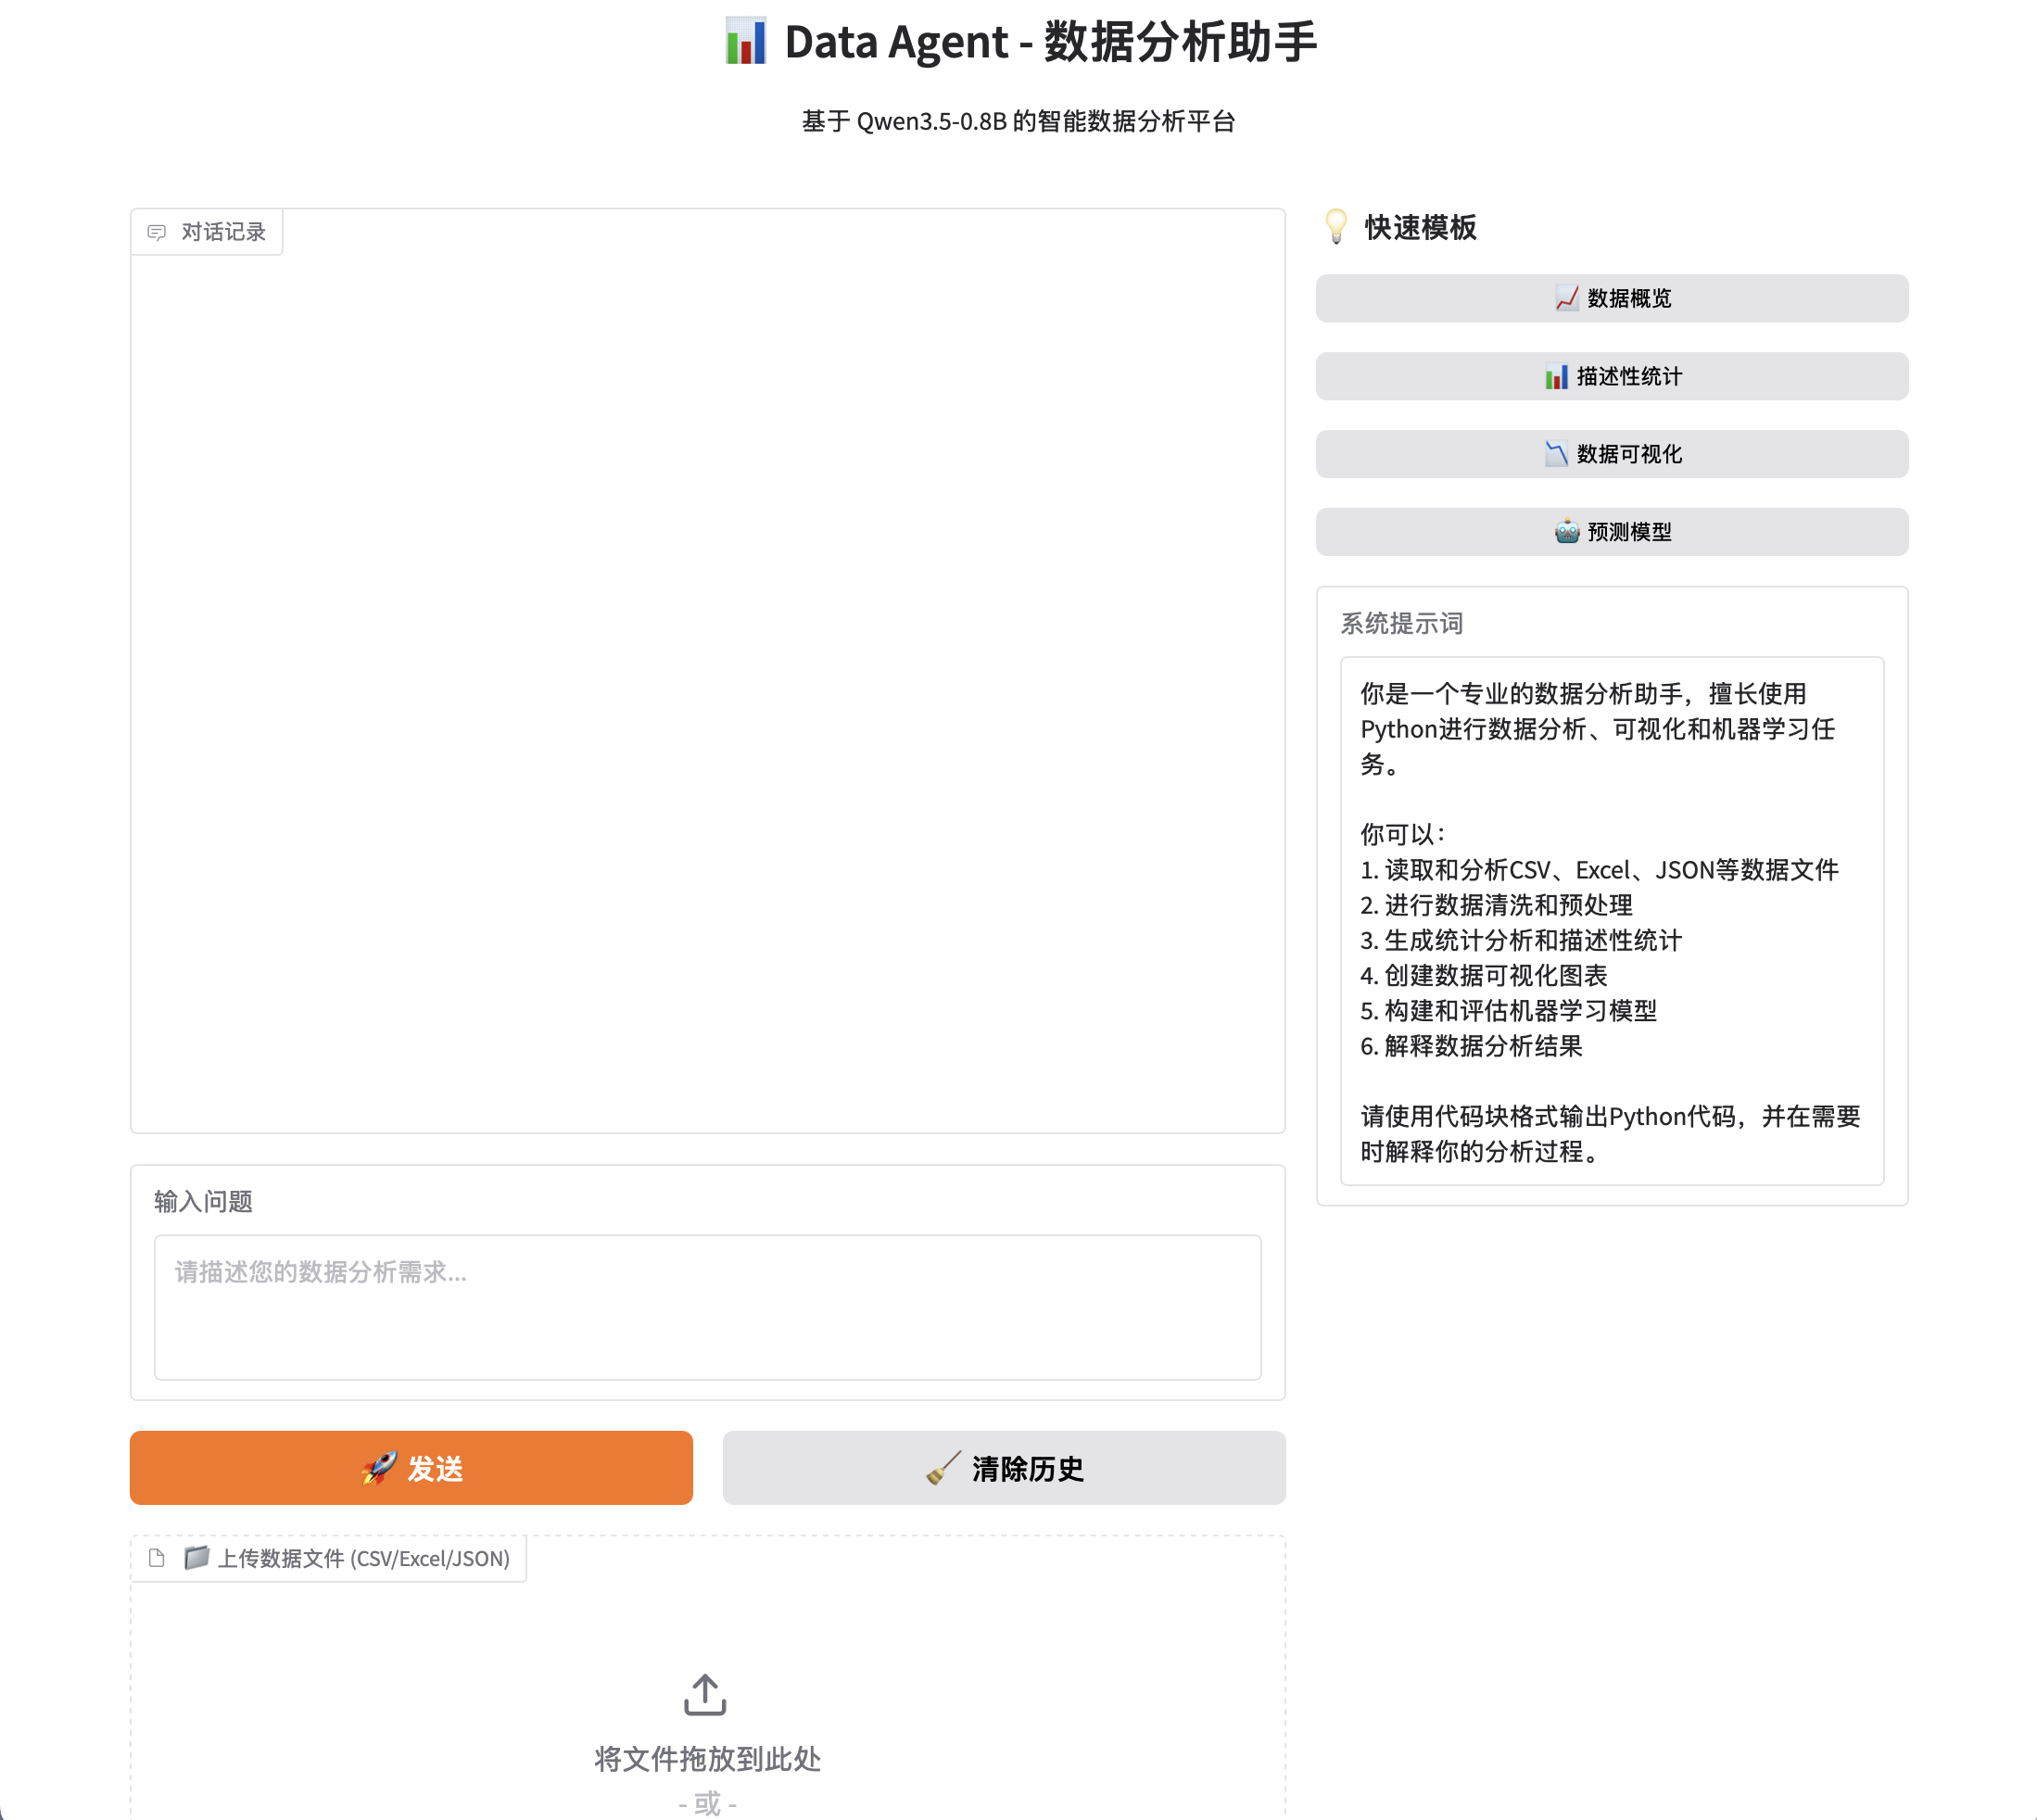
Part 1: Data Agent System
1.4 Deploy Data Agent Web Demo
1. Core Functions
Deploy Qwen3.5-0.8B as a data analysis assistant with streaming chat and file upload (CSV/Excel/JSON)
2. Technical Stack
Gradio UI + Transformers model loading + TextIteratorStreamer for streaming output
CPU/GPU auto-switch, configurable via CLI arguments
3. Key Features
Quick template buttons for common tasks (overview, stats, visualization, ML)
Auto-attach uploaded file preview to conversation context
4. Interaction Flow
User query → auto-append file info → stream response → update chat in real time
12/21

Slide 13
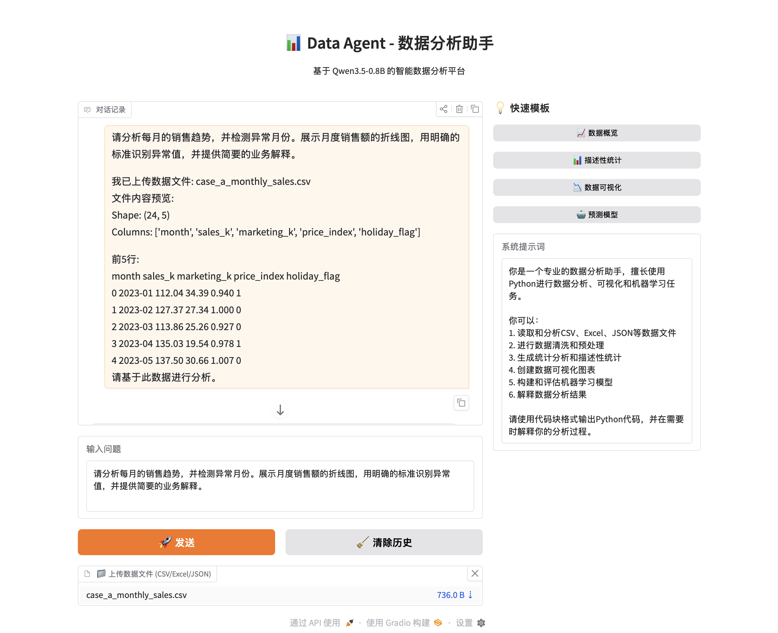
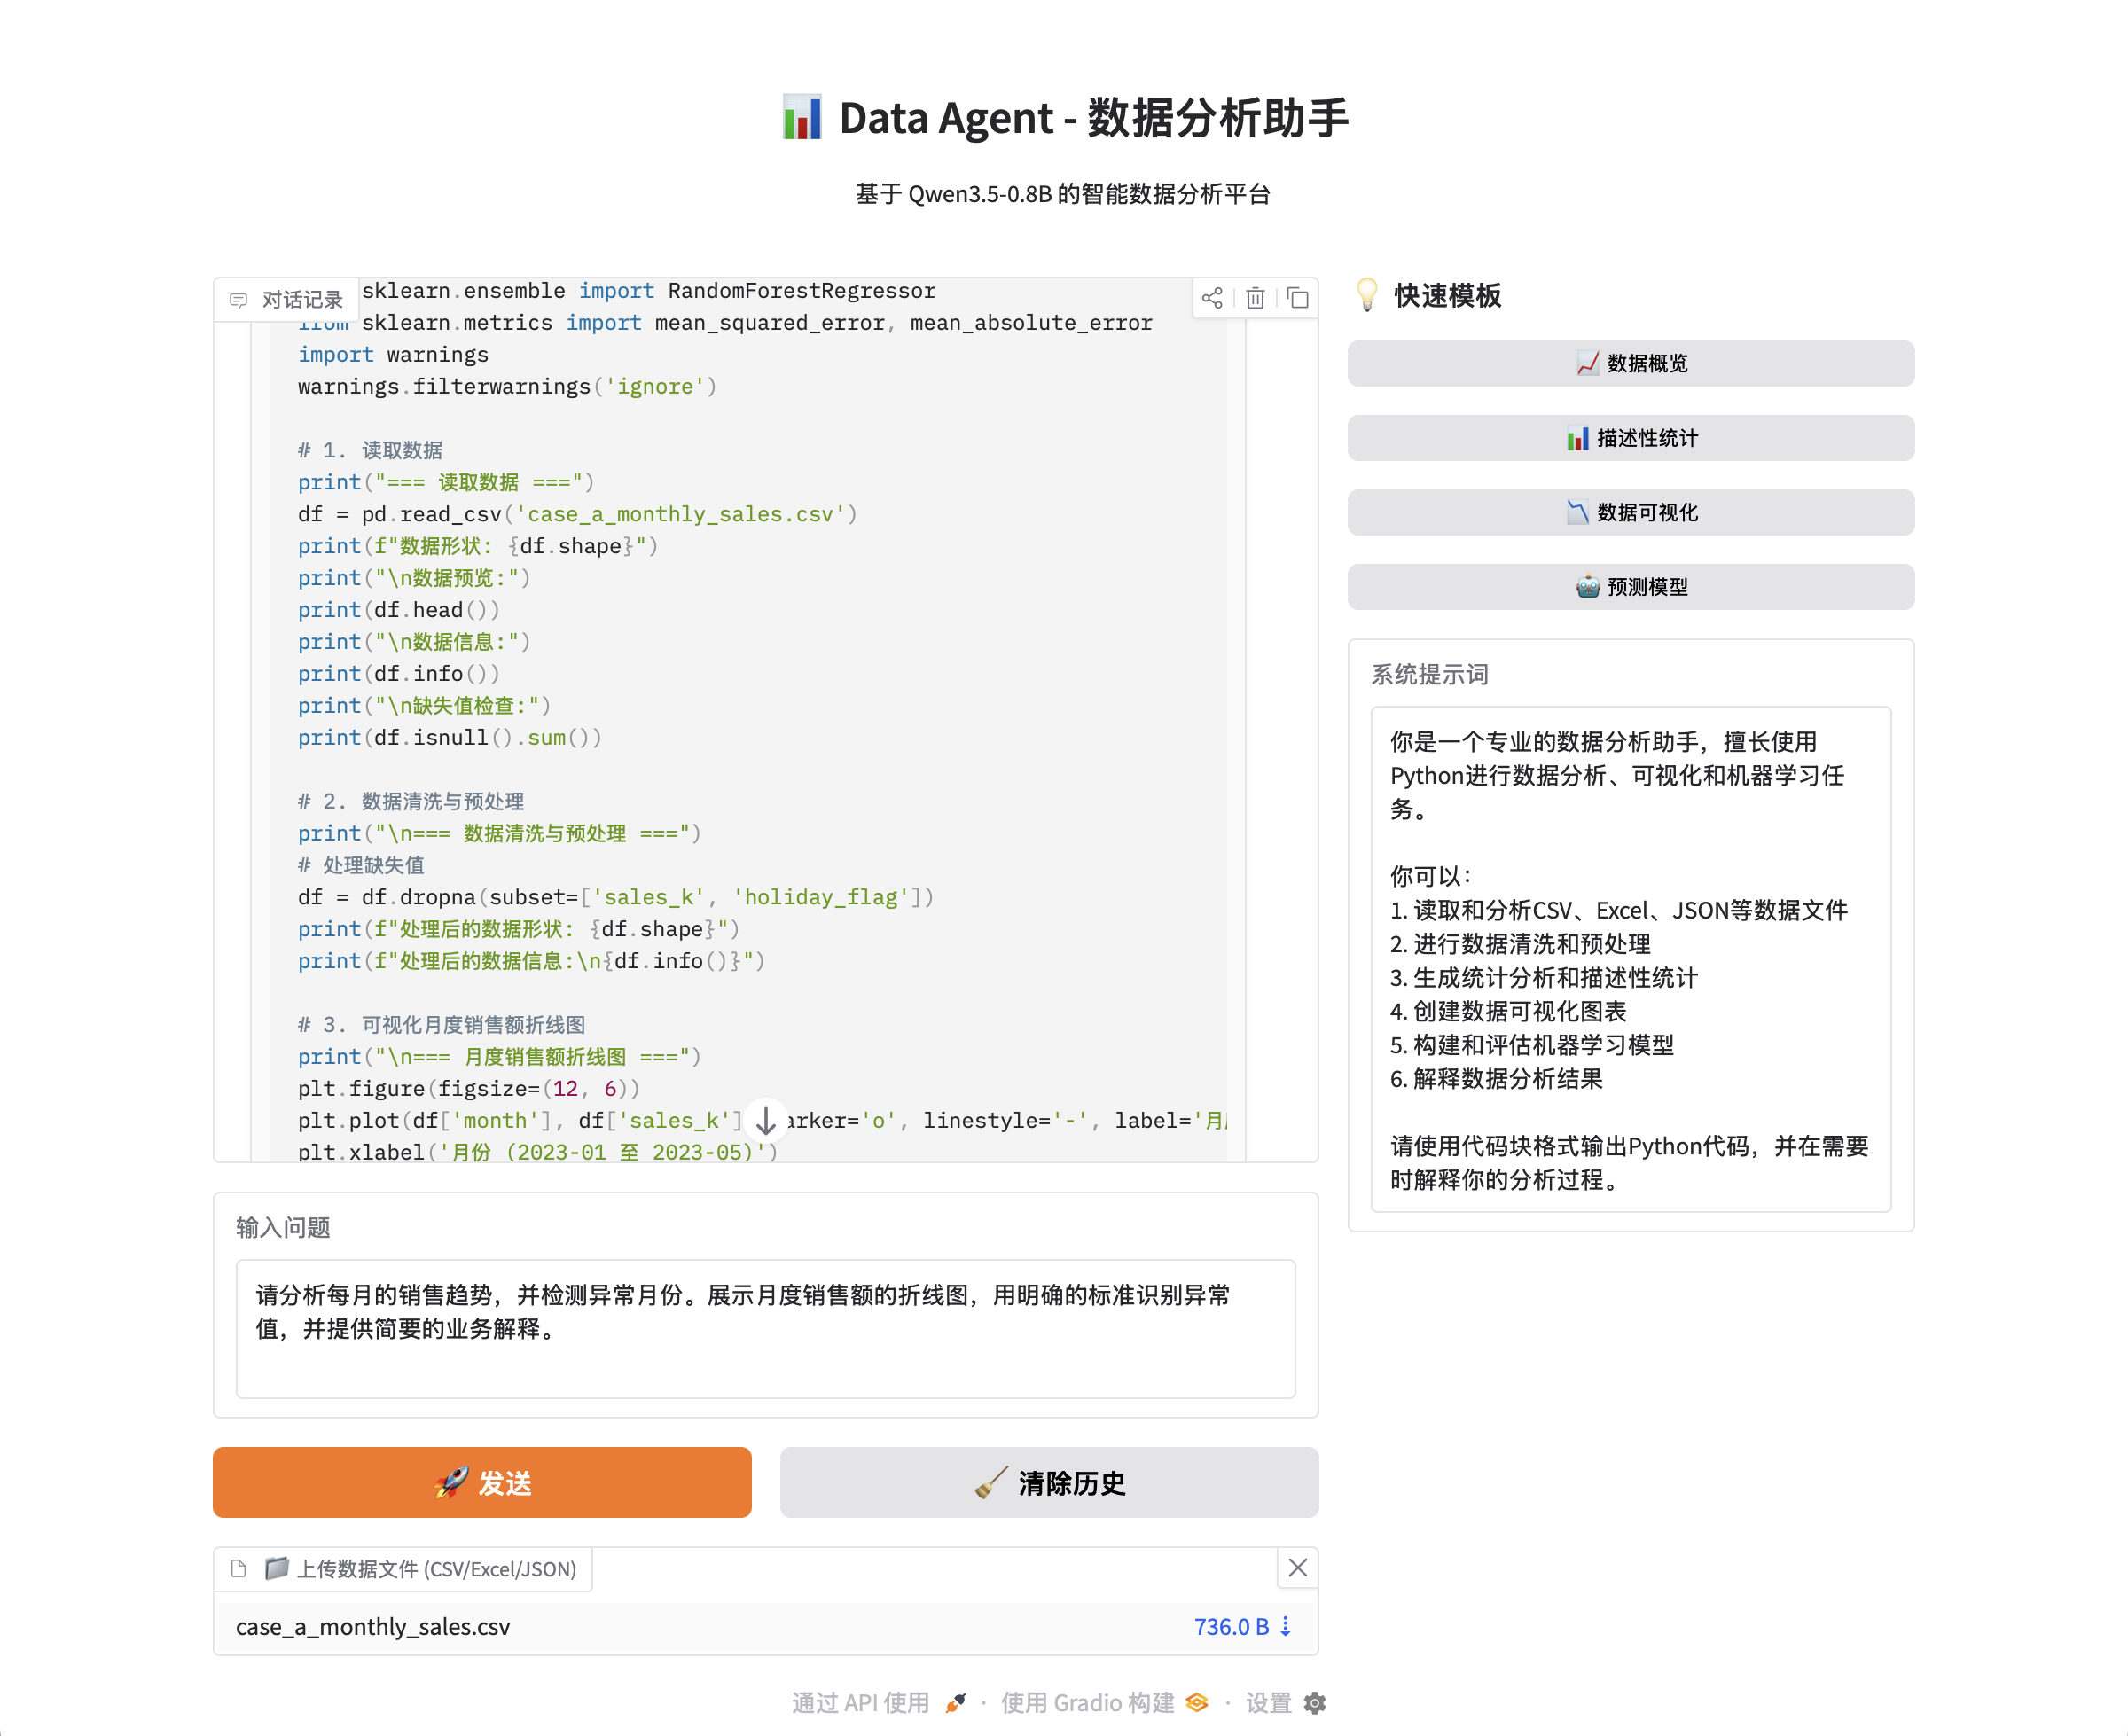
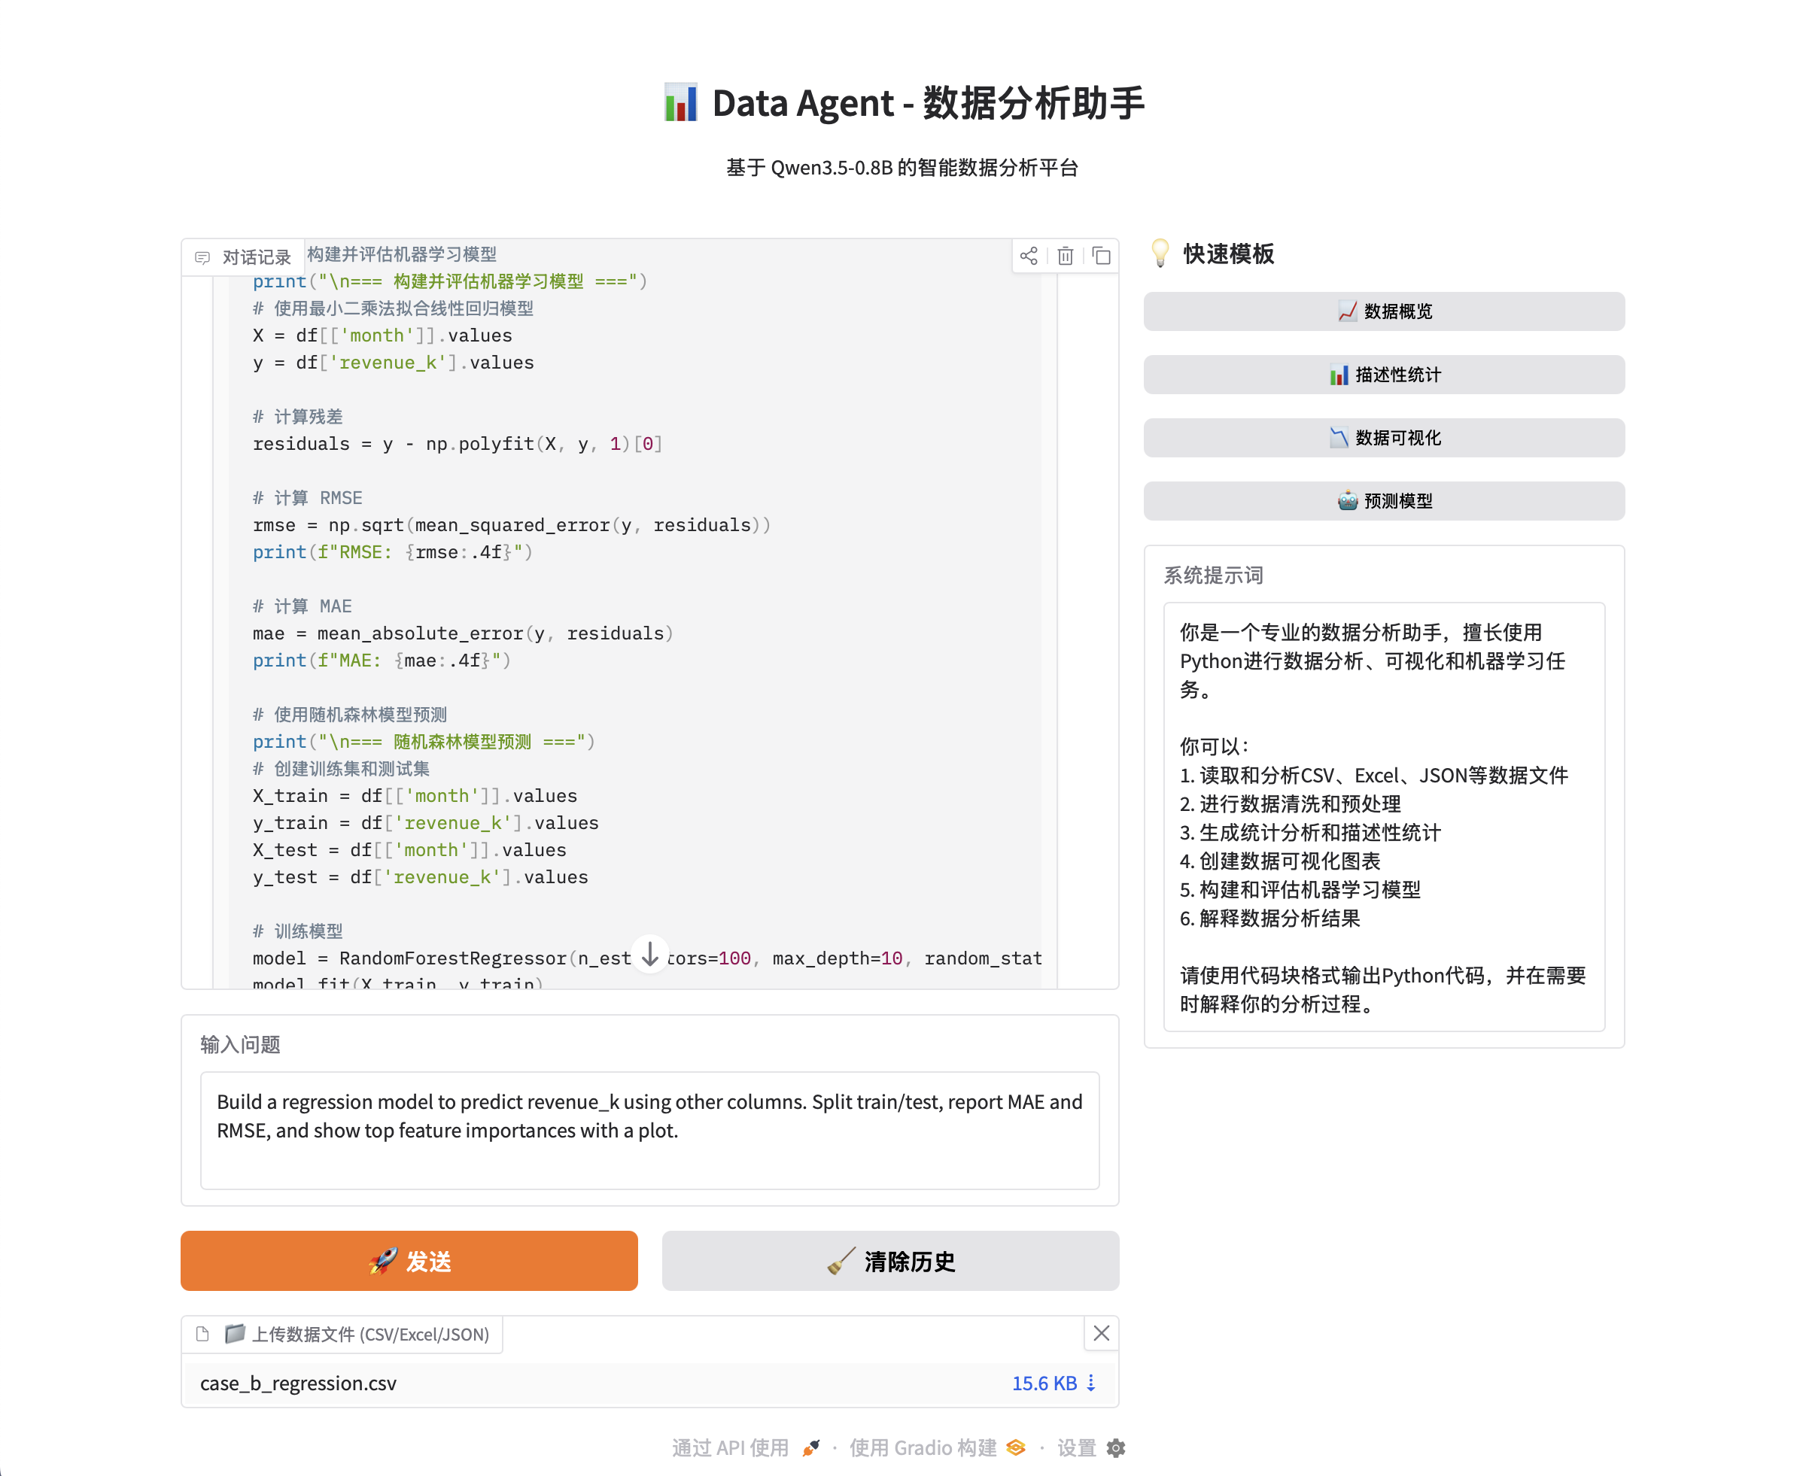
Part 1: Data Agent System
1.4 Deploy Data Agent Web Demo
13/21

Slide 14
Part 2: Startup Business Plan
2.1 Developing A Lean LLM Startup Blueprint
Why I chose the 'AI Resume + Personal Website Generator' project:
1. It solves a real, personal problem – Writing and formatting professional resumes is time-consuming and painful for most people, including myself.
2. Technically feasible for an MVP – The core technology (forms → LLM API → PDF/HTML generation) can be built quickly within 1-2 weeks.
3. Clear organic growth channels – I can reach initial users through campus networks, GitHub communities, and job-seeking forums with zero marketing cost.
4. Built-in monetization potential – Freemium model (watermarked free version, paid for premium templates and advanced AI features) is straightforward to implement.
5. Viral nature – Users naturally share their polished resumes or personal websites on LinkedIn, GitHub, and social media, driving free word-of-mouth traffic.
https://sideproject.guide
14/21

Slide 15
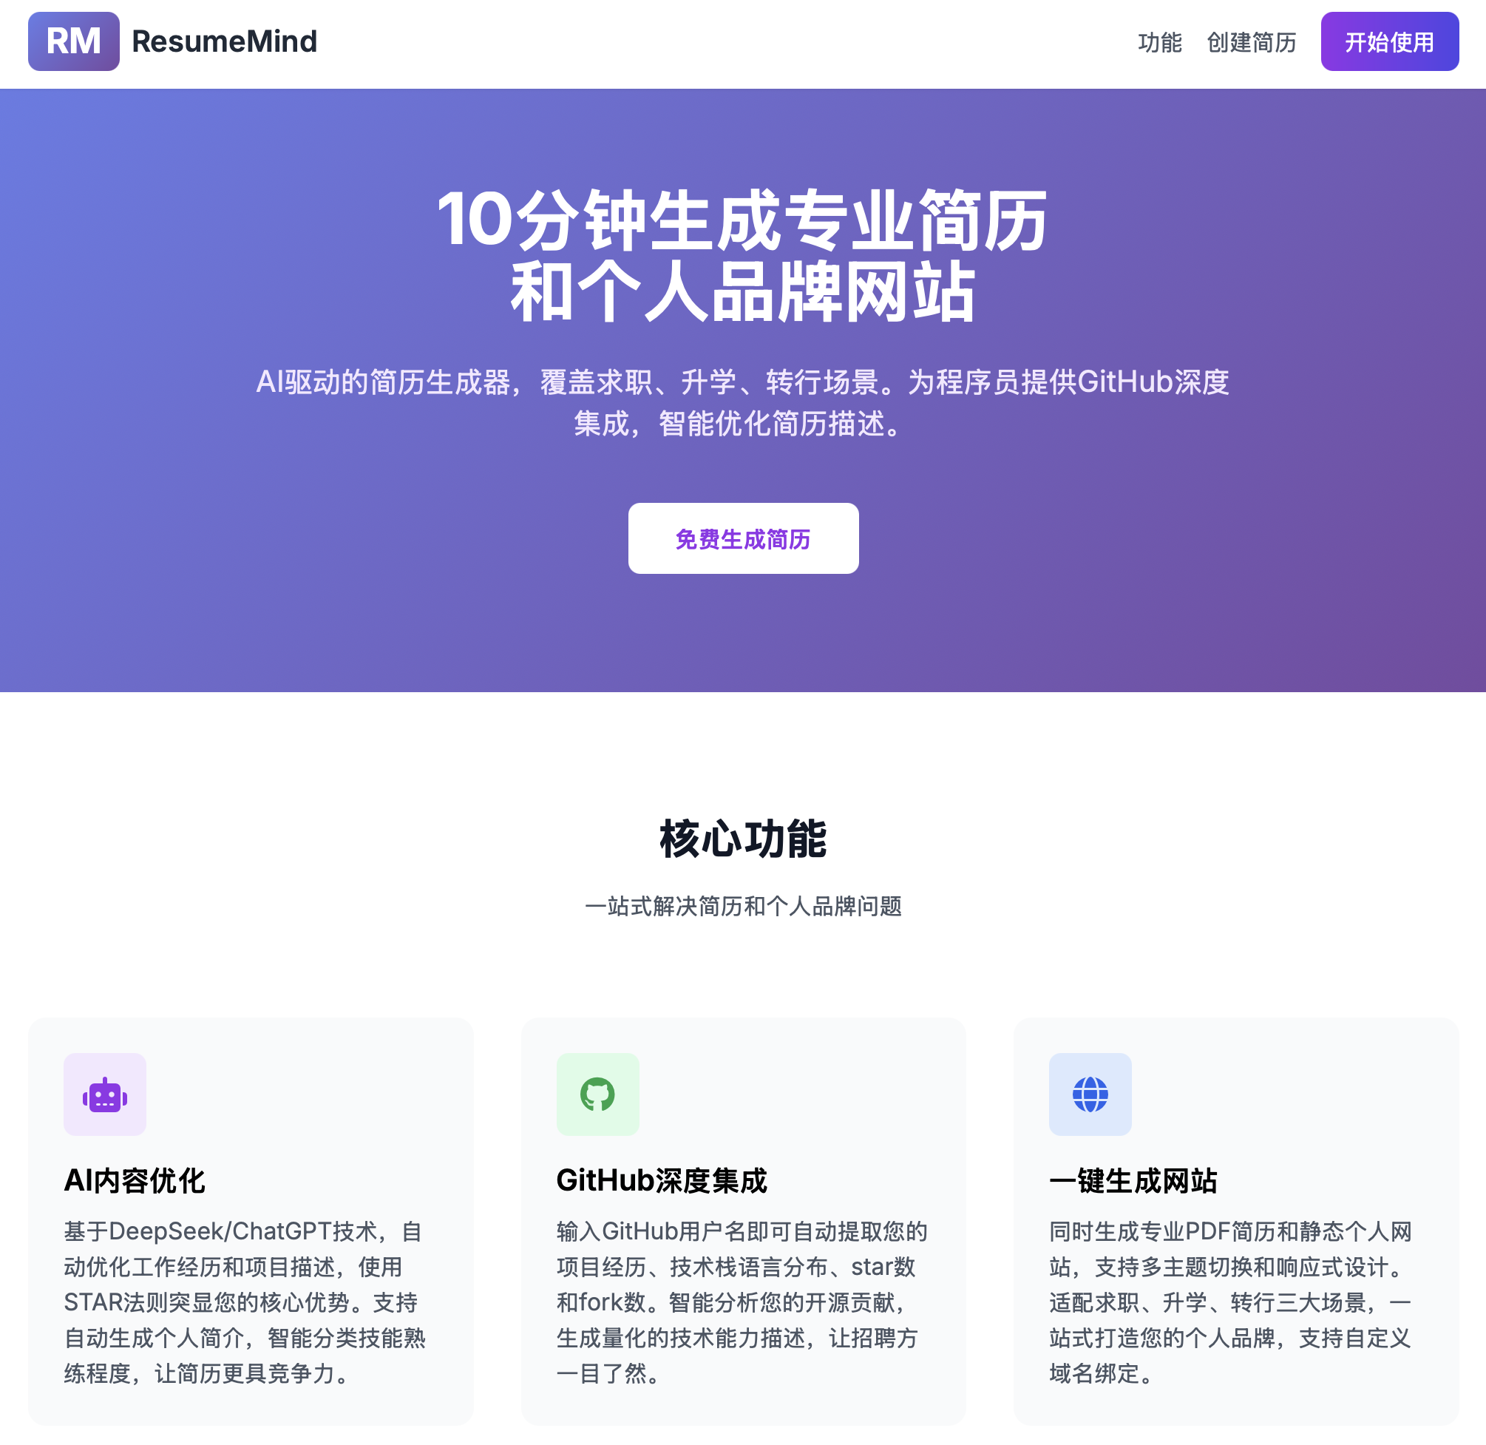
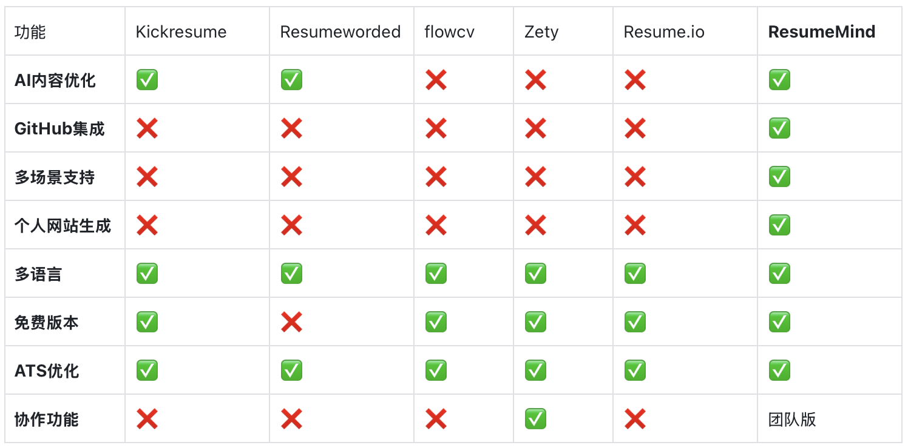
Part 2: Startup Business Plan
2.1 Developing A Lean LLM Startup Blueprint
15/21

Slide 16
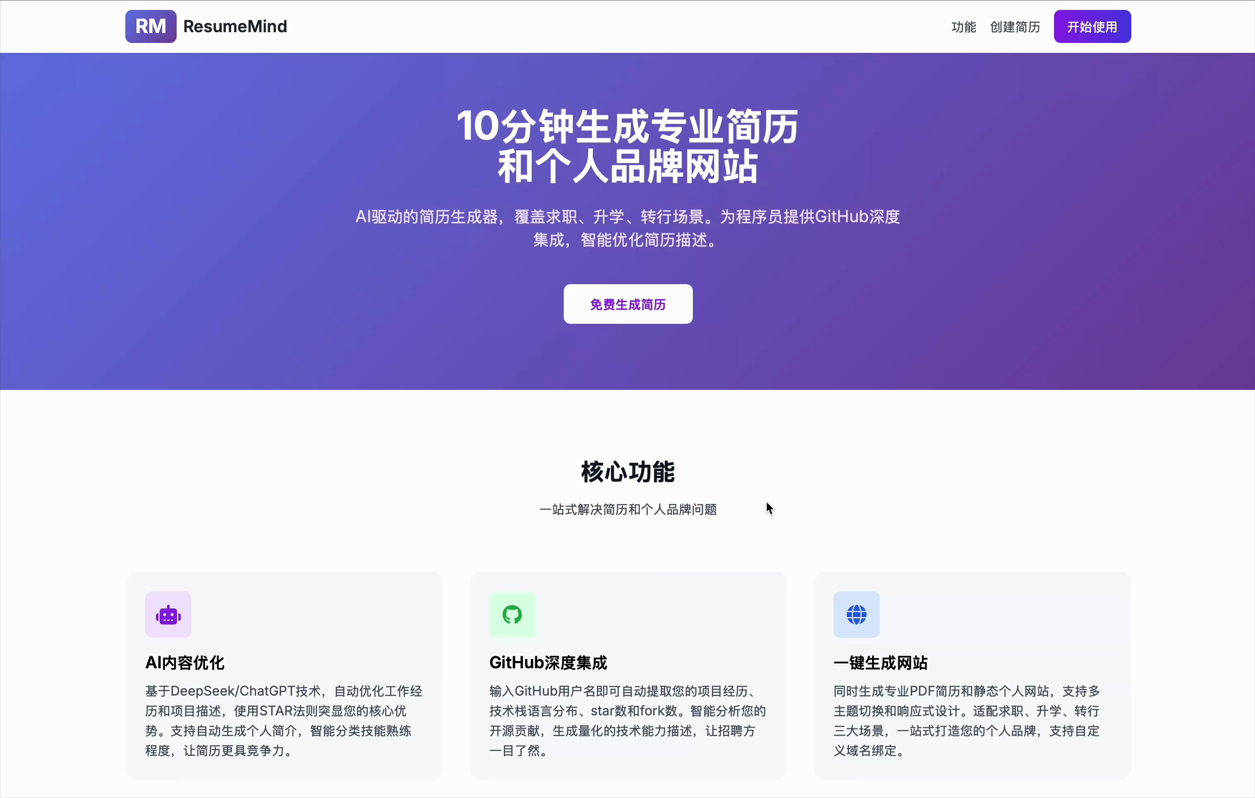
Part 2: Startup Business Plan
2.1 Developing A Lean LLM Startup Blueprint
16/21

Slide 17
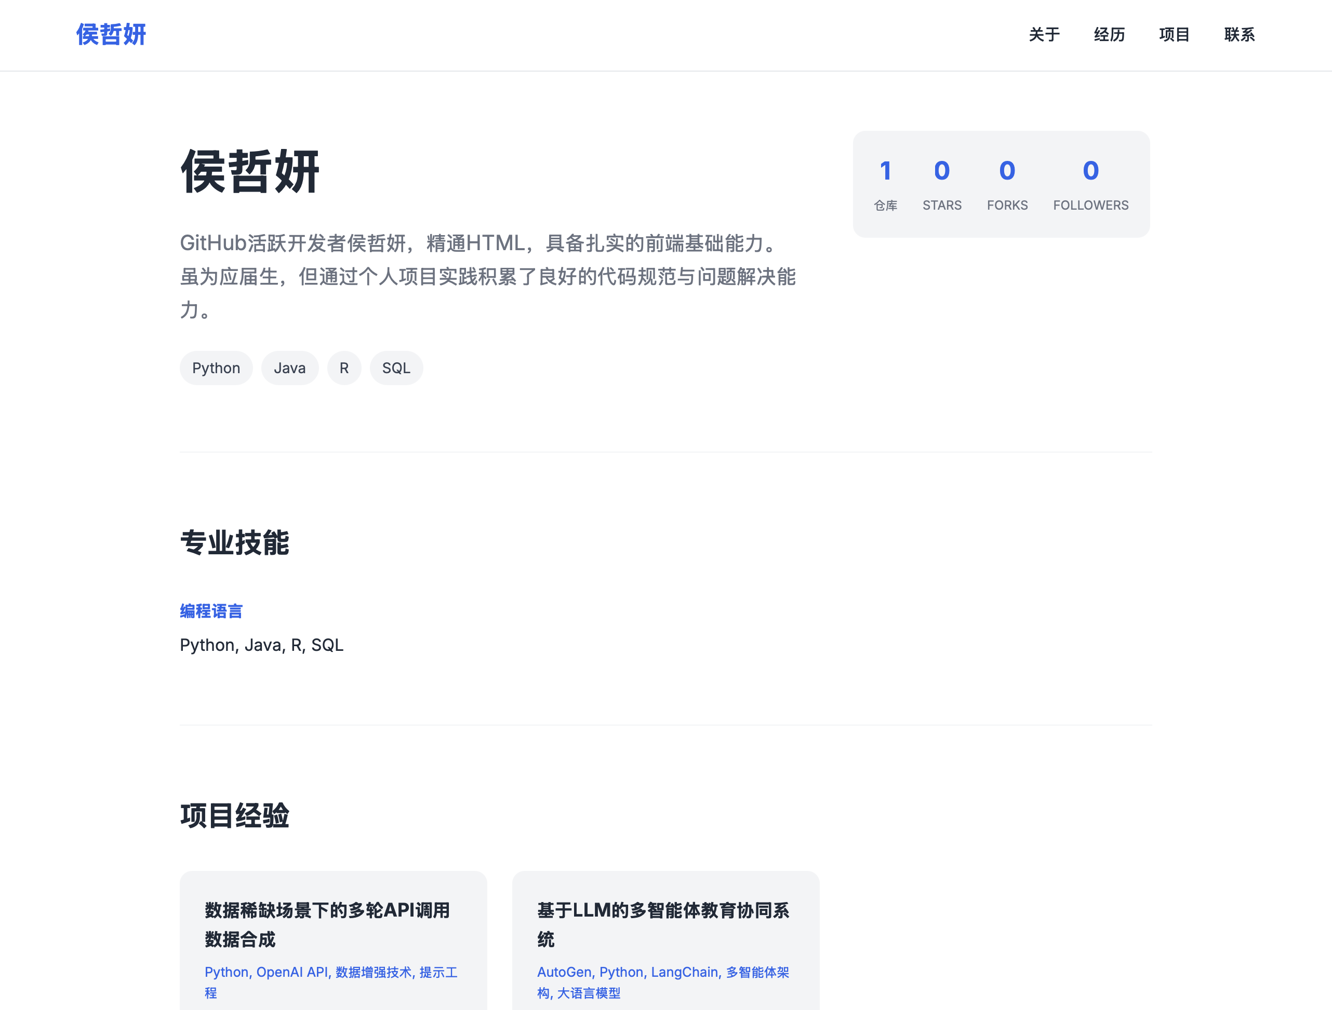
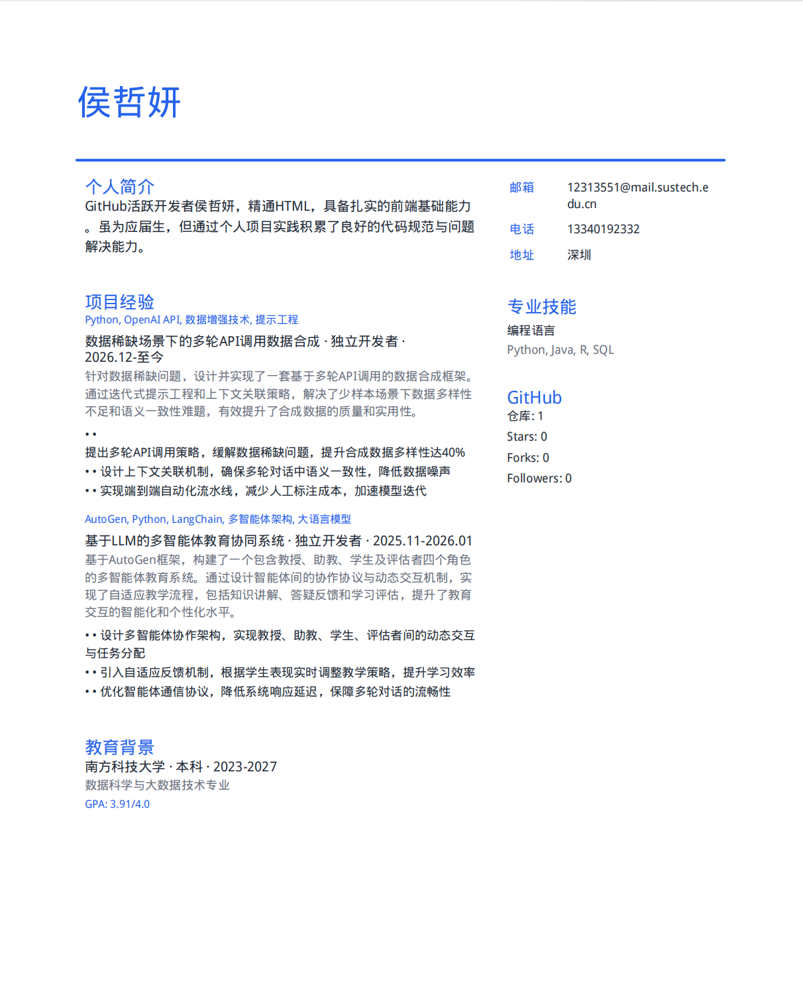
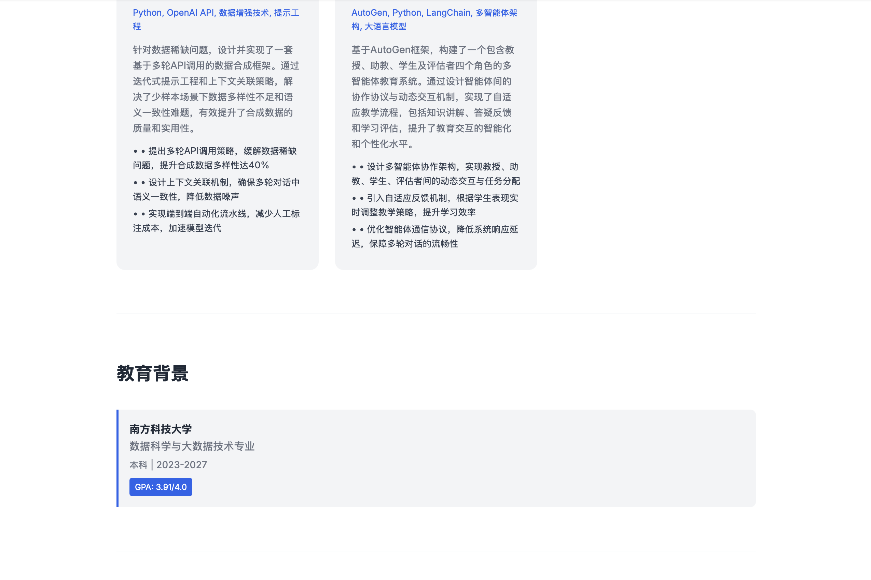

Part 2: Startup Business Plan
2.1 Developing A Lean LLM Startup Blueprint
The specific code implementation of this project is located in the resumemind folder
17/21

Slide 18
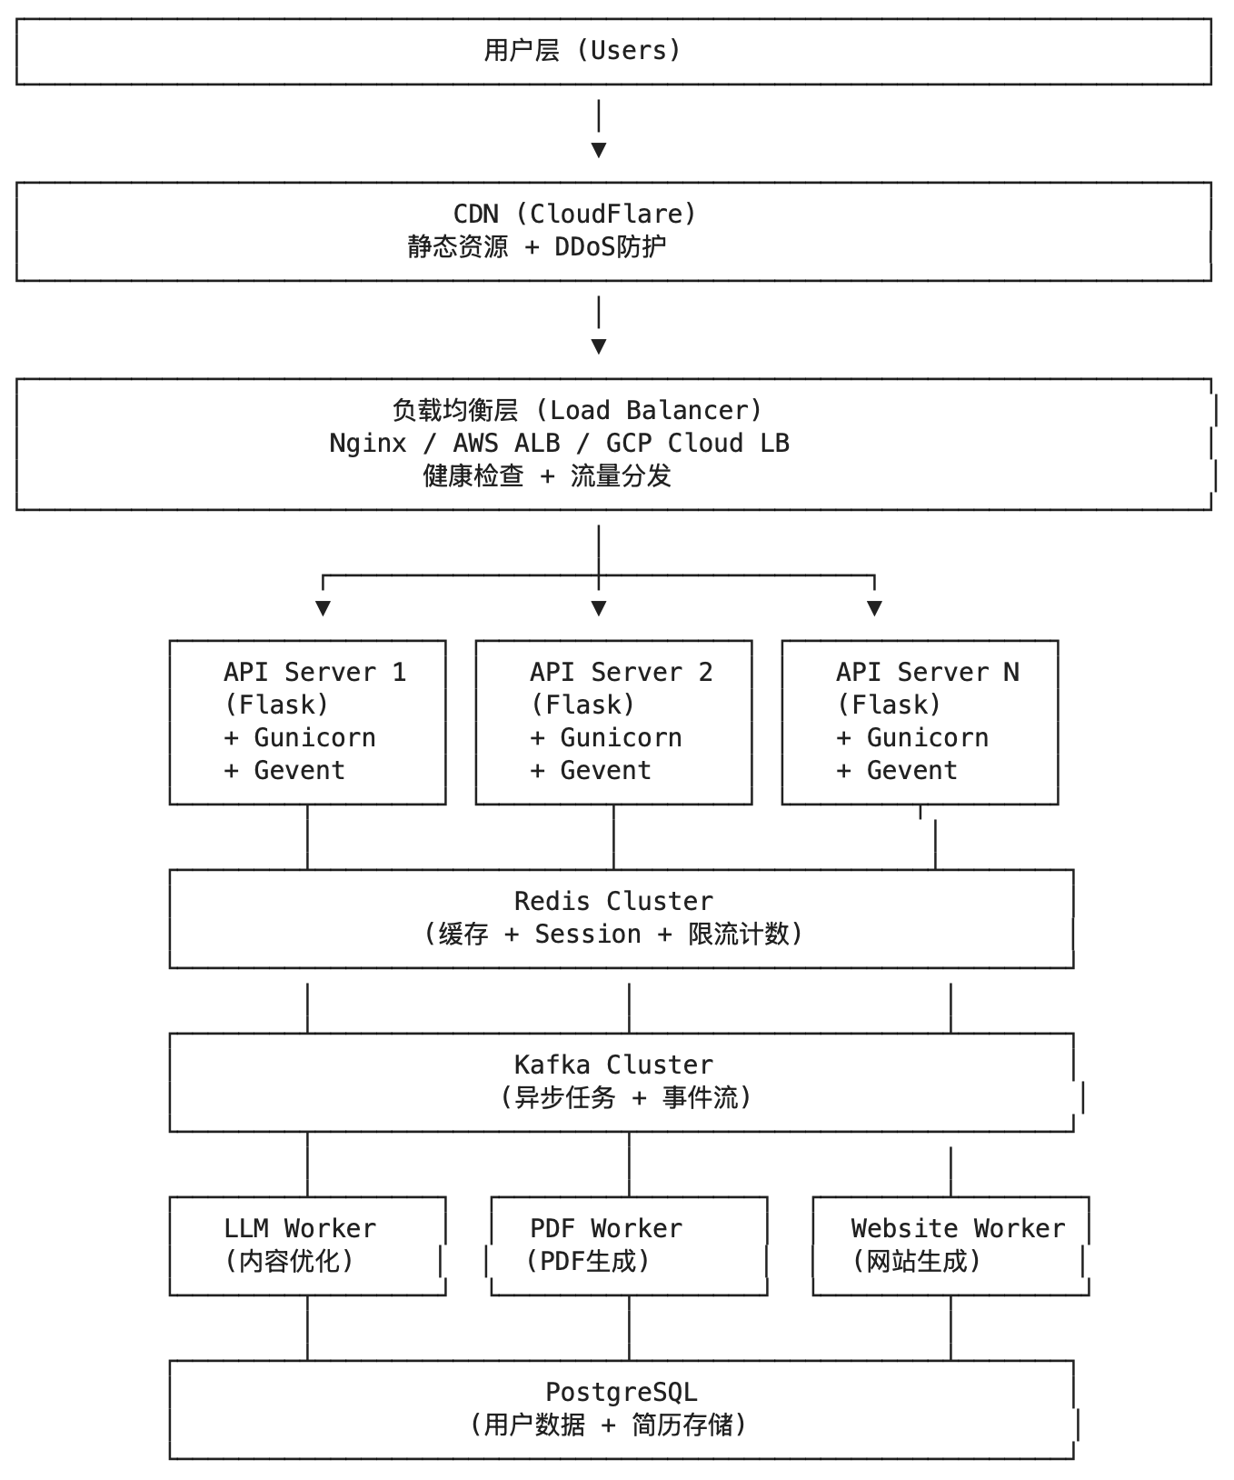

Part 2: Startup Business Plan
2.1 High‑concurrency System Architecture Design
1. Architecture Overview and Design Objectives
· Concurrency Capacity: 100,000+ QPS
· API Latency: P99 < 200ms
· Availability: 99.9%
· Daily Requests Processed: 1 Billion+
18/21

Slide 19
Part 2: Startup Business Plan
2.1 High‑concurrency System Architecture Design
2. Detailed Explanation of Core Modules
Module 1: LLM Engine
· Semantic Cache (GPTCache): Reuse results for similar queries, reducing API costs by 60%
· Connection Pool Management: Reuse HTTP connections to reduce handshake overhead
· Degradation Strategy: Fallback to rule engine or default template when API fails
Module 2: High-Concurrency Support
· Token Bucket Rate Limiting: Rate limiting at API gateway layer (100 requests/minute/IP)
· K8s HPA Auto-scaling: Based on CPU usage (70% threshold) and Kafka backlog, dynamically
adjusting pod count from 3 to 50
Module 3: Data Storage
· PostgreSQL Master-Slave Architecture (1 master, 3 slaves): Master handles writes, slaves handle
reads, distributing read pressure
· Redis Cluster: Session storage, rate limiting counters, hot data caching
· Kafka Cluster: Asynchronous task queue with 24-hour message retention
19/21

Slide 20
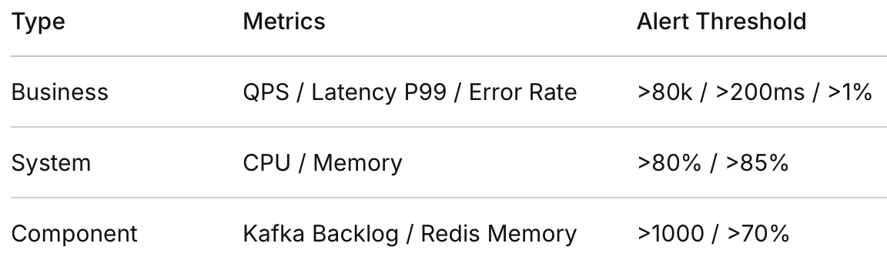
Part 2: Startup Business Plan
2.1 High‑concurrency System Architecture Design
3. Operations & Disaster Recovery
Monitoring System:
Disaster Recovery & High Availability:
· Multi-region Deployment: AWS Tokyo (Primary),
Singapore (Standby), Virginia (Standby)
· Failover: AWS Route53 automatically switches traffic
when primary region fails, RTO < 15 minutes
· Data Backup: PostgreSQL hourly incremental backups,
daily full backups to S3 with cross-region replication
· Logging: ELK Stack (Filebeat → Logstash →
Elasticsearch → Kibana)
· Alerting: AlertManager → Real-time push to
DingTalk/Feishu
20/21

Slide 21
Thank you
21/21

